Slide 1

A strategy for improving the uptake and adoption of NICE guidance
Dr. Louise Edwards
Programme Director, Implementation and Insight
March 2025

Slide 2




About NICE
NICE helps practitioners and commissioners get the best care to people, fast, while ensuring value for the taxpayer.
We do this by:
Producing useful and usable guidance for health and care practitioners.
Focusing on what matters most by prioritising topics that are most important to the health and care system or address an unmet need.
Providing rigorous, independent assessment of complex evidence for new health technologies.
Encouraging the uptake of best practice to improve outcomes for everyone.

Slide 3
Background

Slide 4



Improving uptake and adoption of NICE guidance is key to delivering greater demonstrable impact
While preserving our core principles of transparency, rigour and independence,
we're focussed on developing guidance that is...
More timely and easy to use
More relevant
Greater demonstrable impact
…by providing timely and usable advice.
…by focusing on what matters most.
...by learning from data and implementation.

Slide 5
Understanding the uptake of guidance is important in NICE’s learning and continuous improvement.
1. Budget efficiency – How much?
2. Organisational Productivity
– How?
3. Effectiveness – Why?
Public money
Inputs
Outputs
Desired outcomes
Is our guidance being adopted get care to people fast, ensuring value to the taxpayer?
Doing the right things
Doing things right
Value for money
Source: Productivity Institute 2024 – public sector delivery chain

Slide 6
NICE’s role in supporting uptake of our guidance has adapted to the needs of the health and care system since it’s inception
2005 Implementation remit agreed and strategy developed
2017 Implementation strategy updated
Implementation strategy updated to support the objective to both drive and enable the effective delivery of services provided by the health and care system
2021 Refreshed strategic aims for implementation
Board agreed 4 strategic aims for implementation:
Implementation function established to improve uptake of guidance.
1. Embedding implementation upstream
2. Strengthening external collaboration and partnerships
3. Developing implementation campaigns for system priorities
4. Increasing the use of data for uptake & impact
1999 NICE established
Remit to produce guidance for the NHS
Implementation is the responsibility of the wider health system
1. Raising awareness of the need to change
2. Motivating and inspiring change
3. Providing practical support
4. Evaluating and monitoring the impact
Strategy included:
2012 and 2013 NICE incorporated National Prescribing Centre and Health Technology Adoption Programme
Implementation function grew to provide specific support for medicines and for the adoption of NICE recommended health technologies

Slide 7
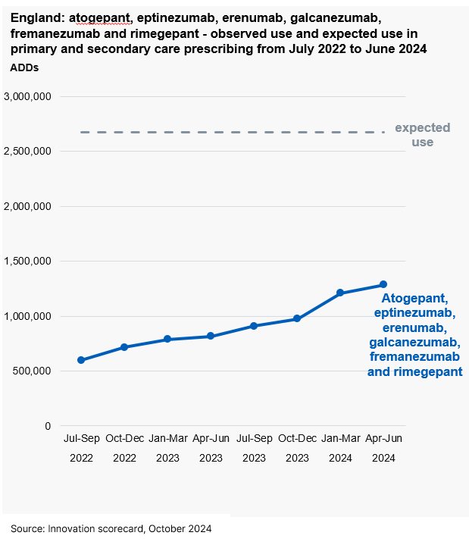
Why is it important to revisit the question of NICE’s role in uptake and adoption now? – 1/2
NICE has a well-established and respected place in the health and care evidence ecosystem, evaluating health technologies for NHS use and publishing guidance that considers clinical effectiveness and value for taxpayers.
But we know from guidance uptake data there is a gap between NICE’s synthesis of knowledge and evidence and its adoption by NHS decision-makers. For example, the Cardiovascular Disease Prevention Audit (CVDPREVENT) has found that only around 46% of people with GP recorded CVD in England have their cholesterol managed to NICE recommended levels, with variation between ICBs ranging from 37 to 56%. Data published in the Innovation Scorecard shows that prescribing of a group of medicines for preventative treatment of migraine remains below 50% of the estimated use.

Slide 8
Why is it important to revisit the question of NICE’s role in uptake and adoption now? 2/2
The question of NICE’s role supporting uptake and adoption of our guidance is particularly pertinent now, given the challenges and improvement opportunities in the health and care system.
Digital health technologies are constantly evolving, and the amount of health and care data has grown exponentially, providing the opportunity to anticipate and meet people’s health needs more effectively.
But the healthcare system is facing significant workforce, capacity, demand and financial pressures. The recent Darzi rapid investigation described the NHS as being in a critical state, with increasing waiting times for services and an overall deterioration of population health¹.
In this challenging context, effective mechanisms to support large-scale learning and improvement have never been more needed by the health and care system.

Slide 9
NICE’s role in the health and care system

Slide 10
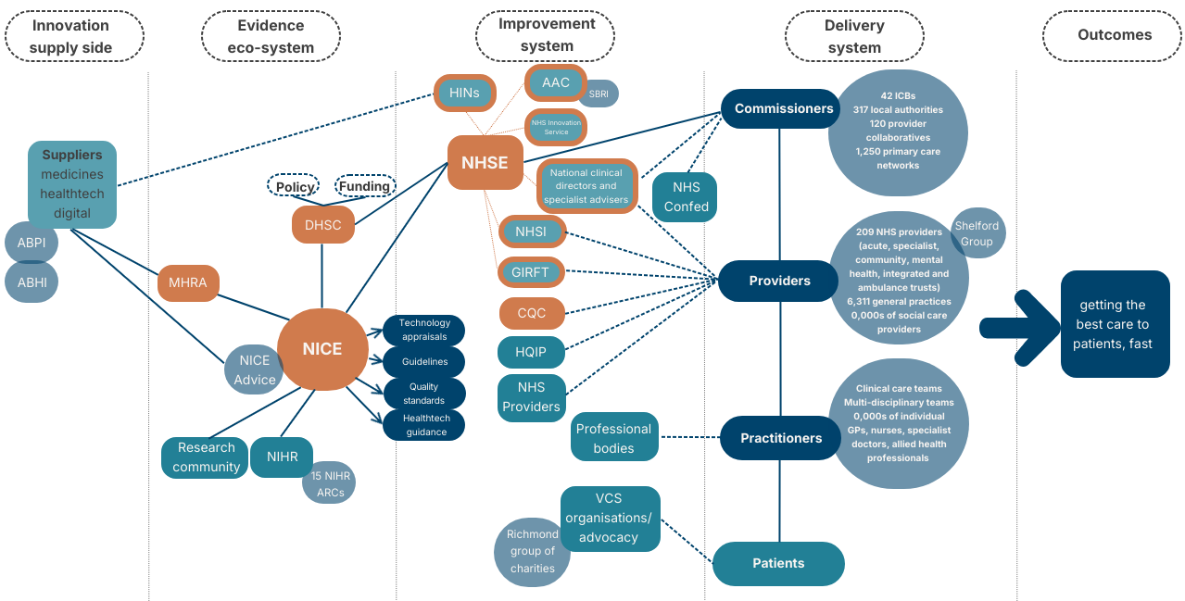

Slide 11
The characteristics of this system relating to uptake and adoption of NICE guidance
NICE is firmly established in the evidence synthesis system, respected for the rigor and independence of its evidence synthesis and recommendations.
The improvement system is an essential bridge between evidence-based recommendations and their adoption by decision makers in the delivery system. This system of organisations is currently fragmented with some duplication of effort and a lack of role clarity.
The delivery system can be helpfully understood as made up of multi-level decision makers – macro (commissioners), meso level (organization level – providers), and micro level (clinical care team and practitioners).
We know from user research that NICE’s products are currently strongest at micro level (practitioner and clinical team), so can have significant impact on individual decisions about patient care. But as systemic challenges in health and care increase (quality, safety, access, finance and workforce), then the ability of individual practitioners/clinical care teams to adopt guidance is impacted by the higher levels in the system (their organization, commissioners etc.) Mutually reinforcing activities and prioritisation across commissioner, provider and practitioner levels in order for sustainable adoption and uptake on NICE guidance to happen.

Slide 12
Barriers to uptake and adoption in the current health and care system | Leverage points to uptake and adoption in the current health and care system
1. Prioritisation in pressurised system Health and care system is under pressure Focus on operational challenges leads to many NICE recommendations not being prioritized Financial challenges mean difficult prioritisation decisions | The NHS Long Term Plan will provide clarity on long term priorities for the health and care system NICE evidence-based methods balancing quality and value for taxpayer are the basis of prioritisation.
2. System direction There are competing priorities in the health and care system due to complex organizational arrangements There is a lack of integration of NICE recommendations in health and care performance frameworks/standards | NICE has the skills and credibility to provide the evidence based standards and direction for the health and care system. NICE could play a pivotal role in driving large-scale, evidence-based innovation and improvement needed by the health and care system.
3. Improvement system There is a lack of clarity on priorities, roles and accountabilities between NICE and organisations in the improvement system | The Sinker review NICE will develop a shared value proposition and target operating model with key organisations in the improvement system
4. Commissioner and provider support Practitioners lack commissioner and provider support for adoption of NICE guidance in a system under pressure Commissioners and providers offer insufficient funding to support to adoption of recommendations due to operational pressures | NICE skills and capabilities are highly relevant to providers and commissioners. Through structured tactical engagement with provider and commissioners there is an opportunity for NICE to support longer term planning and resource allocation in the system.
5. Knowledge and awareness Practitioners lack knowledge of how to apply NICE guidance in their setting Users struggle to keep up with the volume of new NICE guidance Data on uptake and adoption of NICE guidance is not easily accessible to our users | NICE organization-wide approach to supporting adoption and uptake will help practitioners, providers and commissioners to apply guidance in their setting. NICE Useable strategy will make our products more useable for our primary audiences NICE has data on uptake of our guidance which can be shared with our primary audiences to reduce variation in uptake.

Slide 13
The underpinning principles of our strategy
We will ensure our approach to supporting implementation is part of a learning health system, and wider government missions, using data and intelligence to understand uptake, barriers and enablers to drive continuous improvement in our core purpose and with system partners and decision makers.
Although NICE’s remit does not include the direct responsibility for improving the uptake of guidance, we will use the levers at our disposal to effectively support decision makers in implementing our guidance within the system.
We will develop outcomes-based partnerships with other organisations in the improvement system to align our efforts to improve uptake, and to achieve more collective impact.
We will recognise that health and care decisions are made at different levels in our system – commissioner/system level, organisation level, and practitioner level – and that our guidance will have the most impact if it is framed differently for each of these decision-making levels.
We will have uptake in mind encouraging consideration of uptake barriers and enablers, in all of our guidance producing functions.

Slide 14
Our three core areas of focus
1
2
2
3
A cross-organisation approach to supporting adoption and uptake
Effective stakeholder engagement
Use uptake insights and system intelligence to drive change

Slide 15
Our three areas of focus
 | Core Areas of Focus |  |  | How will these core areas help us achieve our aim
 | A cross –organisation approach to supporting adoption and uptake |  |  | We will establish a single programme with aligned outputs which brings together all teams in NICE whose work aims to improve the uptake of NICE guidance for commissioners, providers and practitioners in priority areas. We will develop partnerships with organisations in the improvement system to support the uptake and adoption of guidance in priority areas. Our uptake and adoption support will be framed differently for all decision-making levels – commissioning, providers and practitioners.
 | Effective stakeholder engagement |  |  | We will introduce a more consistent and actively managed approach to engagement with tactical stakeholders (practitioners, commissioners and providers). We will also refresh and prioritise NICE’s strategic stakeholder engagement framework, with active management of stakeholder insight to inform NICE decision making. We will focus our efforts on the highest impact stakeholders with the most influence in the system and interest in our work.
 | Use uptake insights and system intelligence to drive change |  |  | We will use uptake insights for medicines, guidelines and health technology to drive continuous improvement in the support that we offer to health care decision makers. We will ensure we use data and intelligence to inform NICE decision making and that uptake and adoption of NICE guidance is considered in the development of the healthcare data and performance landscape. Insights about uptake and adoption of NICE guidance will be part of a learning health system and be aligned with government missions.
1
2
3

Slide 16
How we will deliver these core areas of focus
Focus area | Key activities | Measured by
A cross-organisation programme to support adoption and uptake | Embed implementation science across all implementation functions, including evaluation framework for interventions to improve uptake and adoption, Provide targeted support for time-poor users (summaries, visual, stories, ‘so what’ pieces) Deliver implementation support for VPAG funded topics and other high priority areas Develop results-based partnerships with key organisations in improvement system | 10% improvement in national uptake of priority guidance measures by March 2028 Annual increase in % of health and care stakeholders who believe NICE works with partners to increase the uptake of guidance Improvement in uptake associated with improvement system partnerships (from baseline) Number of VPAG funded implementation support packages delivered
Effective stakeholder engagement | Refresh stakeholder engagement framework including strategic and tactical engagement approaches, ensuring we engage effectively with decision makers at all levels of the health and care delivery system Engage stakeholders earlier in developing innovative approaches for high impact/high risk technologies and guidelines | Internal compliance rate with the refreshed stakeholder engagement framework. Number of engagements per quarter % of overall engagements with networks Process for providing adoption support to EVAs developed and embedded
Use uptake insights and system intelligence to drive change | Ensure NICE uptake and adoption measures are included in NHS performance framework Work with partners to increase access to uptake data and insights and to integrate data. Provide actionable insights to NICE prioritisation, horizon scanning and guidance producing centres. | Number of NICE decisions influenced by uptake and system intelligence Internal NICE customer satisfaction measures in relation to intelligence received % of NICE recommendations included in quality and performance frameworks in the NHS.

Slide 17
Our aim is to improve uptake and adoption of NICE guidance in priority areas by 10% by 2028

Slide 18
What are we seeking to learn and demonstrate with a 10% improvement measure for uptake and adoption?
With collective focus across NICE directorates and through engagement of the health and care system, considerable improvement in uptake and adoption of NICE guidance is possible.
It isn't possible to measure the uptake and adoption of all NICE guidance – careful selection of priorities is required that is representative of the full NICE guidance portfolio (medicines, health technology, guidelines and quality standards)
Given the pressures in health and care, system levers and barriers will be considered as we refine the measure and select priorities (i.e. prioritisation, system direction, improvement system, commissioner/provider support, primary user knowledge and awareness)
We are proposing to take a continuous quality improvement and learning approach – continuously improving (and adapting) across NICE how we understand, measure and improve uptake and adoption of our guidance, working in partnership with the health and care system.

Slide 19
Designing a measure for improvement in uptake and adoption of NICE guidance
System priorities
Diabetes
Mental health care
Cancer: early diagnosis
Obesity
Maternity Care
Respiratory Care
CVD: risk assessment & secondary prevention
Hyper-tension
Value and productivity
NICE guidance: medicines, HealthTech and clinical guidelines (quality standards)
Factors & criteria
Alignment with Prioritisation Board/surveillance
Alignment with system partners
Opportunity for improvement
Health and Care planning and performance priorities
Data availability
Improvement
% improvement in uptake in a process from baseline
% improvement above natural projection
% improvement in an intermediate outcome
Health inequalities: % improvement for a pop. experiencing inequality
Health inequalities: relative improvement in gap
Select improvement appropriate to the topic/recommendation and
report on individual measures, and
build a composite measure
Nominally aiming for a goal of a 10% improvement over 3 years

Slide 20
Designing a measure of improvement in uptake and adoption: CVD (illustrative)
System priorities
Diabetes
Mental health care
Cancer: early diagnosis
Obesity
Maternity Care
Respiratory Care
CVD: risk assessment & secondary prevention
Hypertension
Value and investing in high impact
NICE guidance on CVD risk assessment and secondary prevention includes:
TA805 Icosapent ethyl with statin therapy for reducing the risk of cardiovascular events in people with raised triglycerides
TA733 Inclisiran for treating primary hypercholesterolaemia or mixed dyslipidaemia
TA694 Bempedoic acid with ezetimibe for treating primary hypercholesterolaemia or mixed dyslipidaemia
NG238 Cardiovascular disease: risk assessment and reduction, including lipid modification
QS100 Cardiovascular risk assessment and lipid modification
Factors & criteria
Alignment with Prioritisation Board/surveillance:
CVD in Forward View
Alignment with system partners:
CVD Prevent
Opportunity for improvement:
46% nationally treated to cholesterol target (37 to 56% across ICBs_)
Health and Care planning and performance priorities: Operational Planning
QOF
Data availability:
CVD prevent audit
Improvement
% improvement in uptake in a process from baseline
% improvement above natural projection
% improvement in an intermediate outcome
Health inequalities: % improvement for a pop. experiencing inequality
Health inequalities: relative improvement in gap
Composite measure for uptake of CVD medicines in innovation scorecard
The proportion of patients aged 18 and over, with GP recorded CVD (narrow definition), in whom the most recent blood cholesterol level (measured in the preceding 12 months) is LDL cholesterol less than or equal to 2.0mmol/l or non-HDL cholesterol less than or equal to 2.6mmol/l.
?

Slide 21
How are we agreeing these goals?
January 2025
February 2025
Current position
Establish working group
Cross-NICE input: Impact & Partnerships, Centre for Guidelines, Clinical and Science Evidence & Analytics directorates
4 x Rapid workshops
Develop a long list and review against agreed criteria
Intelligence gathering
Intelligence to inform shortlist incl. data checks and system validity
Review and validation of proposals
Review: system partners and VCS; guidance producing centres and ET
Sign-off
Agreement with usable and impactful programme board.
Report to NICE board through IPR
Taking a quality improvement approach, we also plan to review progress and learning bi-annually, and to refine priorities/measures.
End April
2025

Slide 22
Developing the plan and reporting progress
We have set a timeframe of 3 years from March 2025 to deliver this strategy. Our success will be dependent upon everyone understanding their part in helping to deliver our vision, aims and measures. To this end, we must ensure that people within NICE, partners and stakeholders in the NHS support our collective vision and approach.
We will translate our strategy into specific annual deliverables, targets and activities to be taken forward, in partnership with the people, communities and partners we work alongside.
Development and delivery of the strategy will be overseen by the Usable and Impactful Programme Board, to ensure we are on track and delivering our aims. Performance against our overall outcome aim will be reported to the Board through the Integrated Performance Report.

