Slide 1
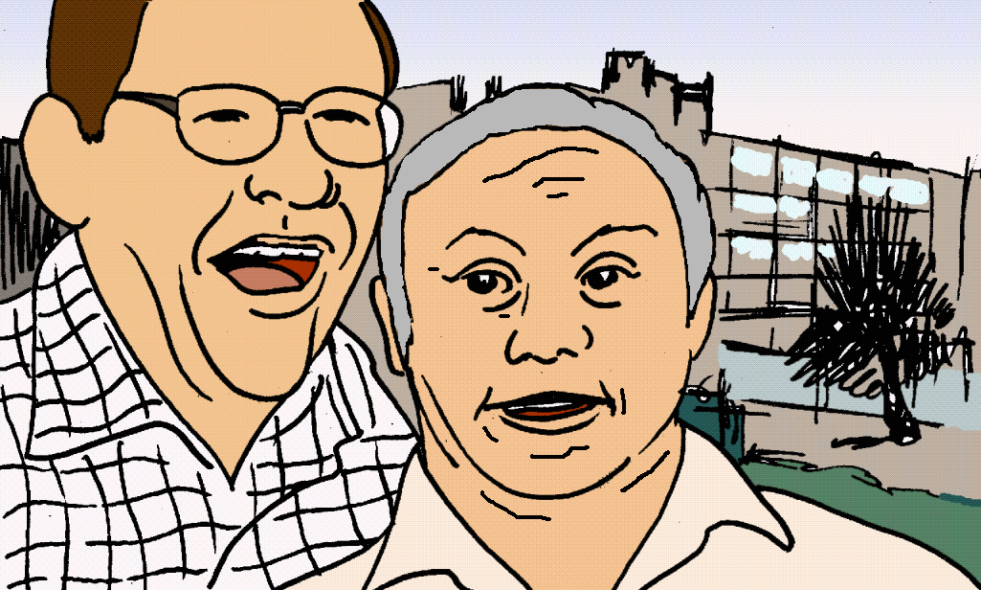
Care and support of people growing older with a learning disability
NICE quality standard (draft for consultation)

Slide 2
What is a learning disability?
When you have difficulty understanding information.
When you may need help and support with some everyday tasks.
You have had these difficulties since before you were 18.

Slide 3
This quality standard:
is about care and support for people with a learning disability as they grow older
describes 5 specific actions, called quality statements, that can make care and support better for people with a learning disability
should be used in all places where people get care and support.

Slide 4
What is this quality standard for?
To give people more choice and control in their life.
To make it better and easier to use services.
To make people’s lives better, and make life better for families and carers.

Slide 5
What do you think?
We are asking for your views
This quality standard is in consultation until 11 March 2019 - this means NICE is asking for your views about this document.
After hearing what you and other people think, NICE will make changes and publish the final quality standard in July 2019.

Slide 6
What do you think?
Questions for you:
Question 1
Do you think there is something more important that we should have included or anything more important we should say?
Question 2
How easy do you think it would be to do these actions?

Slide 7
List of quality statements
Statement 1 People with a learning disability are actively involved when their care and support needs are being assessed.
Statement 2 People with a learning disability have a named lead practitioner responsible for coordinating their care and support.
Statement 3 People with a learning disability have a plan for the future that is reviewed at least annually.
Statement 4 People with a learning disability have their health action plan updated after every annual health checks.
Statement 5 People with a learning disability have a meeting to discuss reasonable adjustments and complete pre-admission documentation before a planned hospital admission.

Slide 8
Quality statement 1
People with a learning disability are actively involved* when their care and support needs are being assessed.
*being actively involved means that you are able to say what you need and what you want from your life during the assessment

Slide 9
Why is quality statement 1 important?
People with a learning disability know best what they need and what they want. What is important to one person may not be as important to another person.
Being actively involved means that people should be able to say what they need and what they want from their life during their assessment.
Because things change, it is important for people to have an assessment regularly.

Slide 10
What does quality statement 1 mean for people with a learning disability?
People’s views come first during their assessment.
They are given time and support to say what help they need.
They can talk about what they are good at, what they like doing and what they want to do in the future – like meeting new people.
They feel listened to and in control.

Slide 11
What does quality statement 1 mean for families and carers?
The families and carers have the confidence that the services understand the care and support needs of the person with a learning disability.
The person doing care and support assessments also looks at what families and carers need.
Families and carers can have their own carer’s assessment.
They can get support when they need it.

Slide 12
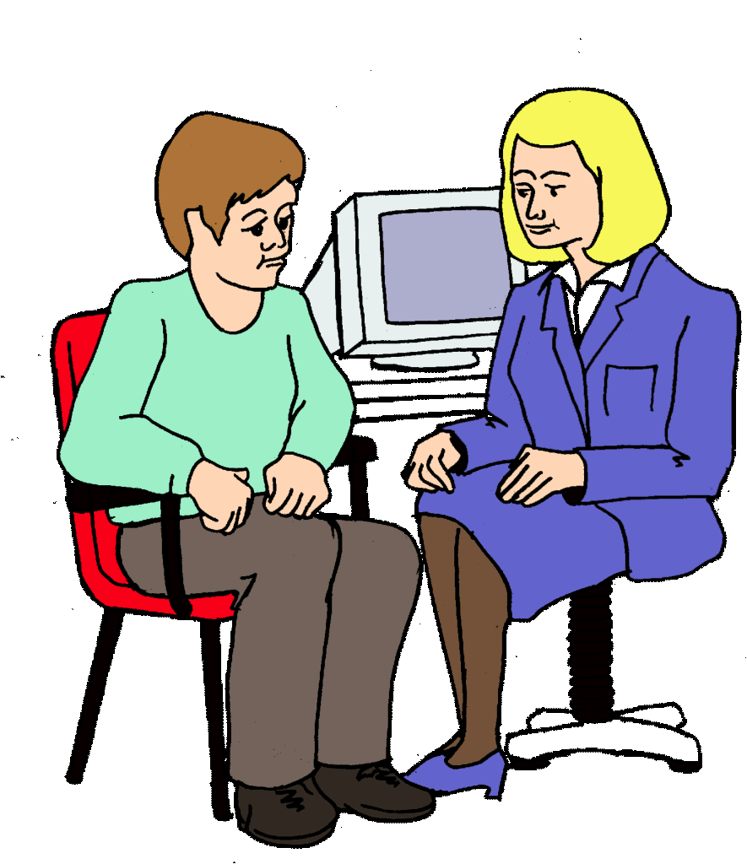
Hi! My name is Sue
Quality statement 2
People with a learning disability have a named lead practitioner responsible for coordinating* their care and support.
* To coordinate care and support means to bring everything together

Slide 13
Why is quality statement 2 important?
As people with a learning disability get older their care and support needs change.
People may be supported by many different services. They need to know who to speak to about their care.
A named lead practitioner can make sure all services have the information they need to support the person.

Slide 14
What does quality statement 2 mean for people with a learning disability and their families and carers?
They know who to talk to about their care and support.
They build a good relationship with the named practitioner.
They know they can ask this person questions and get help when they need it.
Family members and carers (and friends, partners or colleagues who help out) know who talk to when they need advice or information.

Slide 15
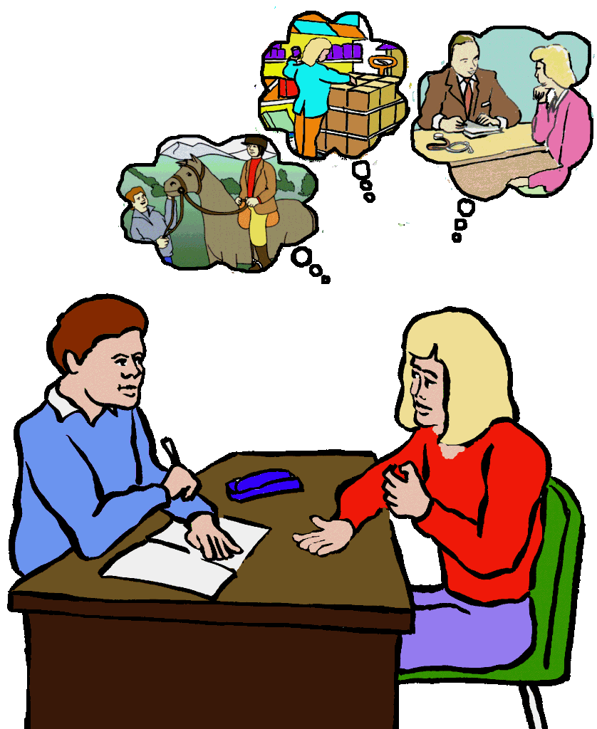
Quality statement 3
People with a learning disability have a plan for the future that is reviewed at least annually*
* To review the plan annually means to check if it is up to date at least every year.

Slide 16
Why is quality statement 3 important?
Thinking about how people’s needs may change as they grow older helps to avoid a crisis in the future.
Making plans helps people to decide what is really important to them.
Having a plan means that services know what to do when the person’s needs change.

Slide 17
What does quality statement 3 mean for people with a learning disability?
People are supported to think about how things might change in the future.
They can talk about things like where they want to live in the future and what to do if a family member can no longer care for them.
They think about changes to their life, health, and the care they will need if they get ill or near the end of their life.

Slide 18
What does quality statement 3 mean for families and carers?
Family members and carers (including friends, partners or work colleagues who help out) are involved in making plans for the future.
They are involved in agreeing things in the plan, such as who will help with money and decisions in the future.
They can also say how long they can care for the person.

Slide 19
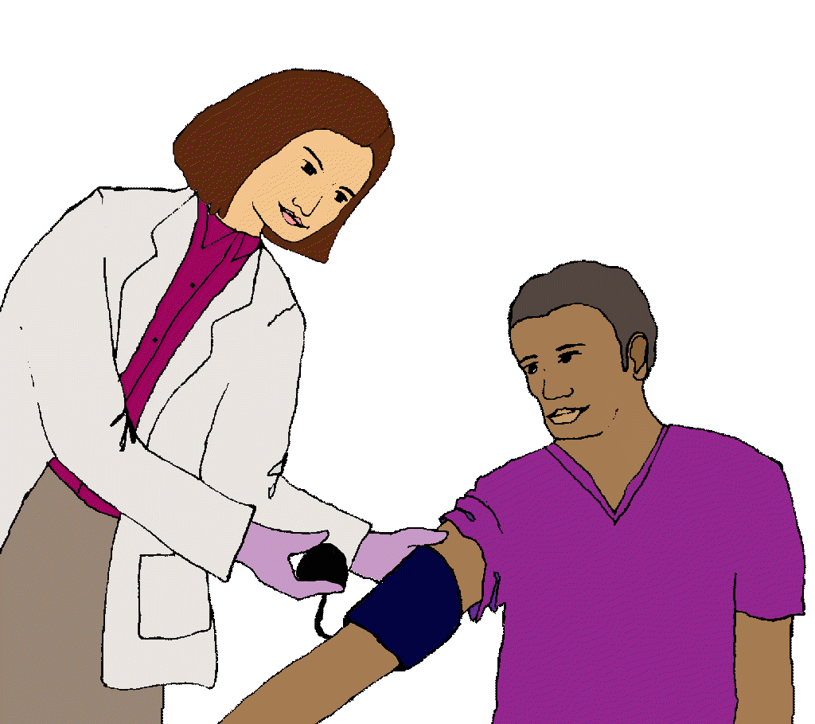
Quality statement 4
People with a learning disability have their health action plan updated after annual health checks*.
* Annual health check means that the health check happens every year

Slide 20
Why is quality statement 4 important?
People with a learning disability have worse health than the rest of the population.
This means they may need more support to look after their health.
People can stay well for longer if they have regular health checks and a health action plan that is kept up to date.

Slide 21
What does quality statement 4 mean for people with a learning disability?
Every year people with a learning disability have a health check with their GP or nurse.
The results of this check are added to the person’s health action plan. A health action plan helps people with a learning disability look after their health and stay healthy for longer.
The plan is put together and shared with the person in a way they can understand.

Slide 22
What does quality statement 4 mean for families and carers?
Family members and carers (including friends, partners or work colleagues who help out).
They can talk to the GP or nurse if they have any worries.
They can also learn about how to support the person to stay healthy.

Slide 23
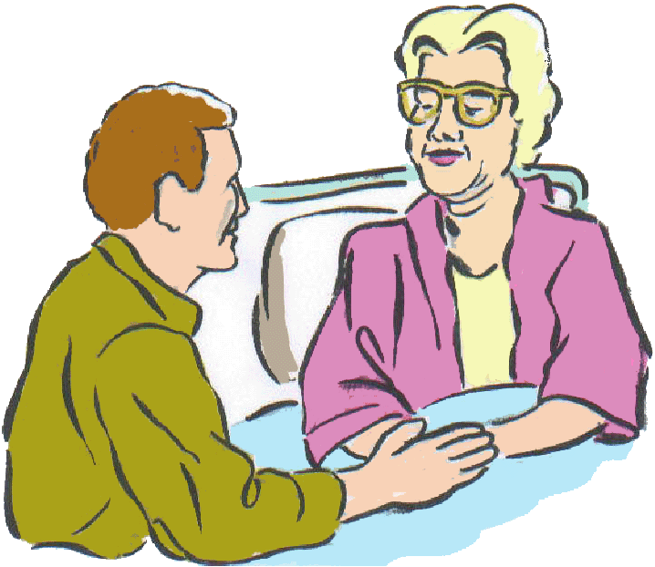
Quality statement 5
People with a learning disability meet with hospital staff before any planned hospital stay to agree reasonable adjustments* which would make the stay easier for them.
*Reasonable adjustments are anything that is needed to make sure that people with a learning disability get as good a service as anyone else.

Slide 24
Why is quality statement 5 important?
Going to hospital may be difficult for people with a learning disability.
Staff in hospital need to find out how to give care and support to the person if they don’t know them.
Having a meeting before the hospital stay can help staff learn about the person and tell them what to expect. The person can share their hospital passport, which includes important information about them.

Slide 25
What does quality statement 5 mean for people with a learning disability?
People with a learning disability who are going to stay in hospital can meet the hospital staff first.
During the meeting, the hospital staff can explain what will happen when the person comes to hospital.
The person can talk about their needs and worries. They can also decide if they want someone they know to stay with them for the night.

Slide 26
What does quality statement 5 mean for families and carers?
Family members and carers (including friends, partners or work colleagues who help out).
Family members and carers take part in the meeting and make sure the hospital staff understand the needs of the person with a learning disability.
They can stay in the hospital all night if the person they support wants them to.

Slide 27
NICE has other quality standards that are important for people with a learning disability. You can see the full list at quality standards topic library.
The most important ones for people with a learning disability as they growing older are:
Multimorbidity (QS153)
Learning disabilities: challenging behaviour (QS101)
End of life care for adults (QS13)

Slide 28
Artwork is from the Valuing People Clipart collection and cannot be used anywhere else without written permission from Inspired Services Publishing Ltd.
www.inspiredservices.org.uk
Notes:
Recs 1.9.8 to 1.9.10

