Slide 1
Maralixibat for treating cholestatic pruritus in Alagille syndrome [ID3941]
PART 1: For PROJECTOR – contains no CON information
Technology appraisal committee A [9 July 2024]
Chair: James Fotheringham
Lead team: Richard Ballarand, Mario Ganau, Becky Pennington
External assessment group: Warwick Evidence
Technical team: Sharlene Ting, Albany Chandler, Janet Robertson
Company: Mirum Pharmaceuticals
© NICE 2024. All rights reserved. Subject to Notice of rights.

Slide 2
Maralixibat for treating cholestatic pruritus in Alagille syndrome
Background and key issues
Clinical effectiveness
Modelling and cost effectiveness
Other considerations
Summary

Slide 3
Background on Alagille syndrome
Alagille syndrome is a rare genetic condition affecting many organs including liver, heart, skeleton, eyes, kidneys and vascular system
Cause: gene mutations (JAG1 or NOTCH2) in NOTCH signalling pathway
Epidemiology: incidence ranges from 1 in 30,000 to 1 in 70,000 live births (variation because of changes in diagnostic criteria over time)
Symptoms and prognosis
Cholestasis: most serious feature (~85% median age 12 months; 65% in first 3 months). Leads to liver cirrhosis (46%), ascites (57%), portal hypertension (40%) and pruritus
For some, symptoms may improve but no way to predict resolution or progression
Cholestatic pruritus (main symptom): bile acids in skin lead to stimulated nerve endings
For 74% to 88%, pruritus is severe and debilitating. At 2 years old, ~80% have severe and unremitting pruritus
15% to 50% have liver transplants before adulthood; 69% due to intractable pruritus
Mortality rate: 7.2% at age 5 and ~12% at age 18. Median age of death 2.6 years (22% due to transplant complications and 18% due to cardiac complications)
Notes:
Source: Company submission, Document B, section B.1.3.1. EAR, section 1.1.2. https://www.niddk.nih.gov/health-information/liver-disease/alagille-syndrome/definition-facts#:~:text=Many%20people%20with%20Alagille%20syndrome,due%20to%20blood%20vessel%20problems.

Slide 4
Patient and clinical perspectives
Cholestasis and pruritis can have a devastating impact on all aspects of life for the person and their families
Impact on person with Alagille syndrome and cholestatic pruritus
Physical distress, lack of sleep, constant fatigue, delay developmental and educational milestones because of difficulty concentrating due to itch, affect self-confidence and social relationships, psychological impact of living with a debilitating condition, anxiety, mental impact
Large impact on all aspects of life; can be debilitating and “normal”
Impact on parents, caregivers and family
Physical and mental impact of full-time caring, affect ability to work, impact on finances, affect care of other siblings, affect siblings’ mental and emotional wellbeing, relationship breakdown, separation/divorce, need for therapy and counselling
High unmet need
No licensed treatments available on NHS
Need for long-term cholestatic pruritus treatments that are safe and effective and can potentially delay liver transplants
Notes:
Source: Patient submission from Children’s Liver Disease Foundation. Patient expert statement.

Slide 5
Treatment pathway and positioning of maralixibat
No UK specific guidelines for treating cholestatic pruritus in Alagille syndrome: maralixibat is first approved medicine in UK
Current management
Bile acid binding resins such as cholestyramine
recommended in European Association for the Study of the Liver guideline as first-line treatment for cholestatic pruritus
tolerability issues: bloating, problems with absorbing fats and fat-soluble vitamins
Ursodeoxycholic acid (synthetic bile acid)
Rifampicin
make bile acids less pruritic and more excretable by kidneys; effective in >50%
side effects: acute renal failure, vomiting, hepatitis
Opioid antagonists (naltrexone)
reduce pruritis; blocks μ-opioid receptors, upregulated in cholestasis
side effects: nausea, diarrhoea, abdominal pain, irritability
Adjunctive therapies: antihistamines, sertraline
Surgeries: partial external biliary diversion, liver transplant
Maralixibat (MRX): add-on therapy
Does this reflect NHS practice in managing cholestatic pruritus in Alagille syndrome?
Are surgical biliary diversions used?
What diagnostic measures and associated thresholds are used to start treatments?
How well do these treatments work? Overall, what is the response rate to standard care?
Will maralixibat be used as an add-on therapy to standard care?
Notes:
Source: EAR, sections 1.1.2, 1.2.2 and 1.2.3.
MRX is licensed by the Medicines & Healthcare Products Regulatory Agency (MHRA) and European Medicines Agency (EMA) for the treatment of cholestatic pruritus in patients with ALGS two months of age and older.^{22, 24} The description of decision problem in Company Submission (CS) Document B suggested that MRX would be used in addition to established clinical management. Although this is broadly in line with how MRX was evaluated in its clinical studies included in the CS, patients in those studies were required to have not received, or to have stopped bile acid binding resins such as cholestyramine at least 28 days before study entry. The evidence presented in the CS, to some extent, deviates from the use of MRX in addition to established supportive therapy. This also raises an issue regarding the interpretation of effect estimates for MRX compared to SoC, which would typically have included bile acid resins as one of the treatments.

Slide 6
Maralixibat (Livmarli)
Marketing authorisation | Treatment of cholestatic pruritus in people with Alagille syndrome 2 months of age and older MHRA: 10 February 2023
Mechanism of action | Reversible, selective inhibitor of ileal bile acid transporter Acts locally in distal ileum to decrease reuptake of bile acids and increase clearance through the colon, reducing concentration of bile acids in the serum and associated pruritus
Administration | Oral solution Recommended target dose: 380µg/kg once daily Stopping rule (SmPC): “Alternative treatment should be considered in patients for whom no treatment benefit can be established following 3 months of continuous daily treatment with maralixibat”
Price | £43,970 per 30ml bottle of 9.5mg/ml maralixibat oral solution Proposed commercial arrangement
How would the stopping rule be implemented in the NHS? How would clinicians decide whether a treatment has no benefit?
SmPC, summary of product characteristics
Notes:
Source: Company submission, Document B, Table 2. EAR, section 1.3 (issue 2) and section 1.4 (issue 5). SmPC (https://www.ema.europa.eu/en/documents/product-information/livmarli-epar-product-information_en.pdf).

Slide 7
Key issues
Issue | ICER impact
1. Generalisability of maralixibat studies to NHS | Unknown
2. Definitions of treatment response | Large
3. Probability of treatment response in standard care | Large
4. Modelling overall survival in maralixibat | Small
5. Modelling mortality of non-response | Small
6. Health state utility values | Small
7. Caregiver disutility | Small
Other: stopping rule (loss of response) | Medium
Other: model structure (should surgical biliary diversion state be included?) | Medium
Other: equality, uncaptured benefits | Unknown
Other: severity modifier | Small
ICER, incremental cost-effectiveness ratio

Slide 8
Maralixibat for treating cholestatic pruritus in Alagille syndrome
Background and key issues
Clinical effectiveness
Modelling and cost effectiveness
Other considerations
Summary

Slide 9
Maralixibat trials and GALA cohort comparison study*
Background
Company presented results from ICONIC (RCT, MRX vs placebo) and GALA (Global ALagille Alliance) cohort comparison study (aggregated MRX cohort from ICONIC, ITCH/IMAGINE II and IMAGO/IMAGINE vs standard care from GALA registry cohort)
Company used MRX data from ICONIC in economic model. EAG used data from ITCH too
 | ICONIC n=31 (UK, Europe, Australia) | ITCH/IMAGINE II n=37 (USA, Canada) | IMAGO/ IMAGINE n=20 (UK)
Study design | Phase 2, multicentre, double-blind, placebo-controlled randomised trials with open-label extension
Population | 1-18 years; ItchRO(Obs) ≥2 for 2 wks (moderate to severe)
Maralixibat vs placebo | 4 wks (380μg/kg/day) | 13 wks (5-wk escalation, 8-wk stable dose) up to 280μg/kg/day
Primary endpoint | Mean change from baseline after 4 wks treatment in fasting sBA in ‘responders’ | Mean change from baseline at 13 wks in ItchRO(Obs) | Mean change from baseline at 13 wks in fasting sBA
GALA registry cohort (n=469)
Registry data from North America, Australia, Europe
Population: 1-18 years; no criterion for pruritus severity (aligned baseline covariates: age, bilirubin, GGT, ALT)
Intervention: standard care
Primary outcome: event free survival (LTx, SBD, liver decompensation, death)
ALT, alanine aminotransferase; GGT, gamma-glutamyl transferase; LTx, liver transplant; MRX, maralixibat; n, number; RCT, randomised controlled trial; sBA, serum bile acids; SBD, surgical biliary diversion; wk, week
*See Appendix: Clinical outcomes
Notes:
Source: Company submission, Document B, sections B.2.2 and B.2.3.1, Tables 5, 6, 7, 8 and 9. EAR, Figure 2.

Slide 10
ICONIC trial design*
Maralixibat (n=13)
≤380μg/kg/day
Maralixibat (n=31)
≤380μg/kg/day
Randomisation (1:1) n=29
Maralixibat (n=29)
≤380μg/kg/day
Maralixibat (n=29)
≤760μg/kg/day
Placebo (n=16)
Company used MRX response at 12 wks in economic model
Weeks 48-204
Long-term extension phases 1 and 2
Weeks 18-22
Randomised withdrawal phase
Weeks 22-48
Open-label stable dosing
Weeks 0-18
Open-label phase
ITCH/IMAGINE II trial design
Maralixibat (n=24)
70μg/kg/day (n=8)
140μg/kg/day (n=8)
280μg/kg/day (n=8)
Maralixibat (n=34)
≤280μg/kg/day
Maralixibat (n=26)
≤280μg/kg/day
Maralixibat
(n=25 phase 1;
n=21 phase 2)
≤280μg/kg/day
Randomisation (2:1) n=37
Placebo (n=12)
Week 0
Baseline
Weeks 0-13 Treatment
5-week dose escalation
8-week stable dose
Weeks 14-61
Open-label stable dosing
Weeks 62-96
Extension study
Weeks 97-220
Optional long-term extension phases 1 and 2
EAG used data on response (≥-50% sBA) for placebo only in base case
MRX, maralixibat; sBA, serum bile acids; wk, week
*See Appendix: ICONIC results
Notes:
Source: Company submission, Document B, Figures 6 and 8. EAR, sections 2.2.1, 2.2.2, 2.2.3, 2.2.4, 2.2.5 and 2.3.2; Table 15.

Slide 11
Issue 1: Generalisability of maralixibat studies
Differences between characteristics of maralixibat studies and MA and UK clinical practice increase uncertainty in its clinical-effectiveness estimates
EAG comments
Differences in characteristics of maralixibat studies and marketing authorisation (age, definition of pruritus, maralixibat doses) and UK clinical practice (no cholestyramine 28 days before study entry and throughout study vs commonly use bile acid resins in NHS)
Maralixibat studies:
No data for adults; maralixibat costs depend on bodyweight
Licensed and unlicensed doses → company did not investigate differential impact
Comparator arms may underestimate standard care treatment effect
Exploratory, not confirmatory; open-label 1-arm follow up; randomised treatment periods too short (no wash-out period in ICONIC); no long-term comparative efficacy
Statistical analyses not adjusted for multiple testing (inflated type I error)
ITCH: 80% statistical power to detect ≥1.12 in primary analysis (least squares mean change from baseline on average daily ItchRO(Obs) to Week 13
ITCH and IMAGO: used lower dose (280μg/kg/day); no statistically significant results
Are maralixibat studies generalisable to NHS (target population; diagnosis; standard care)?
What is the likely impact of age and dose on clinical effectiveness of maralixibat?
Notes:
Source: EAR, section 1.3 (issues 1, 2 and 3), section 1.4 (issue 4), section 2.2.1, 2.2.2, 2.2.3, 2.2.4, 2.2.5 and 2.3.2; Table 15. Company submission, Document B, section B.2.2. https://www.ema.europa.eu/en/documents/product-information/livmarli-epar-product-information_en.pdf

Slide 12
Issue 2: Treatment response in economic model
High impact
Company: used ≥50% decrease in sBA to define treatment response
EAG: company has not justified use of surrogate biomarker and arbitrary threshold; HST17 used ≥70% decrease in sBA. Maralixibat studies used ItchRO(Obs) for eligibility criteria. Data show results are sensitive to treatment response definitions and thresholds
Definition of treatment response | ICONIC (Week 0-18) | ITCH (Week 0-13)
 | Maralixibat (n=31) | Maralixibat | Placebo
sBA: ≥50% decrease from baseline | XXX | XXX | XXX
sBA: ≥70% decrease from baseline | XXX | XXX | XXX
ItchRO(Obs): ≥1 decrease from baseline | XXX | XXX | XXX
ItchRO(Obs): ≥1.5 decrease from baseline | XXX | XXX | XXX
ItchRO(Obs): ≥2 decrease from baseline | NR | XXX | XXX
CSS: ≥1 decrease from baseline | NR | XXX | XXX
CSS: ≥2 decrease from baseline | NR | XXX | XXX
Clinician Scratch Scale (CSS): 0 (none) to 4 (cutaneous mutilation, haemorrhage and scarring); ItchRO(Obs): 0 (not itchy) to 4 (very severe itch)
Is the surrogate sBA biomarker a validated endpoint?
How should treatment response be defined? sBA or ItchRO(Obs)?
If sBA, what threshold is considered clinically meaningful? 50% or 70%?
If ItchRO(Obs), what threshold is considered clinically meaningful? 1, 1.5 or 2?
Notes:
Source: Mirum 2018 ITCH CSR, Tables 34, 35 and 39. Mirum 2020 ICONIC CSR, Tables 5-6. EAR, section 1.3 (issue 2), section 1.4 (issue 5), section 1.5 (issue 8) and section 3.2.6.2. SmPC (https://www.ema.europa.eu/en/documents/product-information/livmarli-epar-product-information_en.pdf). Company submission, Document B, p102.
Validated surrogate endpoint: an endpoint supported by a clear mechanistic rationale and clinical data providing strong evidence that an effect on the surrogate endpoint predicts a specific clinical benefit. https://www.ncbi.nlm.nih.gov/books/NBK453484
Response: post-baseline average daily ItchRO score has decreased from baseline average daily ItchRO score by at least the number of points specified for each response definition (eg, change from baseline average daily ItchRO score is ≤-1.5). ItchRO scores have a range from 0 to 4, with the higher score indicating increasing itch severity. ItchRO average daily scores are calculated as the sum of daily scores (ie, morning and evening scores) divided by the number of days ItchRO is completed over the defined study week, consisting of the 7 days prior to the scheduled visit. Endpoint (Week 13/ET) represents the last post-baseline value obtained within 7 days of the date of last dose.
Clinician scratch scale uses a 5-point scale, where 0 = None, 1 = Rubbing or mild scratching when undistracted, 2 = Active scratching without evident skin abrasions, 3 = Abrasion evident, 4 = Cutaneous mutilation, haemorrhage and scarring evident. Endpoint (Week 13/ET) represents the last post-baseline value obtained within 7 days of the date of last dose.

Slide 13
Issue 3: Probability of response for standard care
High impact
Company preferred to use data from ICONIC open-label single arm phase for maralixibat treatment response and assume that 0% responded in standard care arm. EAG disagree with standard care assumption and preferred to use data from ITCH to inform response for this arm only
Company
Assumed probability of response (≥50% decrease in sBA from baseline at week 12) for standard care is 0 vs XXXXXXX in maralixibat
Rationale: ICONIC had provided no data for standard care comparator
EAG comments
ICONIC randomised withdrawal design lacks internal and external validity undermining its use for modelling response rate
EAG preferred data from ITCH which undermines company’s 0% assumption:
≥50% decrease in sBA: XXXXXXX on standard care vs XXXXXXX on maralixibat
How should treatment response for standard care be modelled? Company’s assumption of 0% probability vs EAG’s preferred XXX?
sBA, serum bile acids
Notes:
Source: EAR, section 1.5 (issue 8) and section 3.2.6.2.

Slide 14
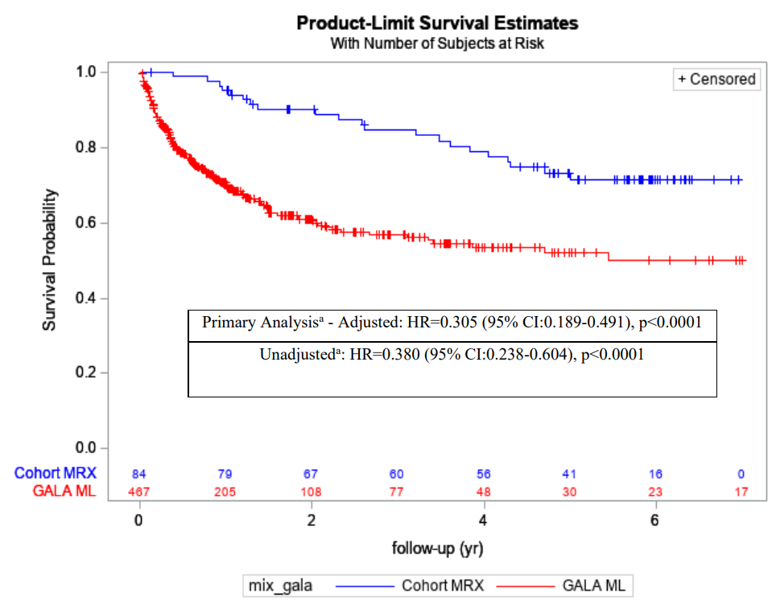
GALA cohort comparison study: event free survival
Maralixibat showed a 70% improvement in EFS compared to standard care
Kaplan-Meier plot for EFS – aggregated maralixibat (n=84) vs GALA registry standard care (n=469)
Clinical events included in Event free survival (EFS) | Maralixibat (n=84) | GALA standard care (n=469)
Event free survival | XXX | XXX
Liver transplant | XXX | XXX
Liver transplant because of pruritus | XXX | XXX
Surgical biliary diversion | XXX | XXX
Liver decompensation | XXX | XXX
Death | XXX | XXX
EFS: number of days from baseline to date of first clinical event
Maralixibat
GALA standard care
HR adjusted for: age, sex, baseline bilirubin, baseline ALT
Year
EAG comments
MRX studies: higher doses than MA from 100 weeks; 6-year data is immature
EFS: not appropriate proxy for mortality (post-liver transplant may have near-normal life expectancy); did not adjust for baseline sBA (prognostic factor → possible bias)
In its model, company assumed 47% have transplants by Year 4. Is this estimate credible?
ALT, alanine aminotransferase; HR, hazard ratio; MA, marketing authorisation; MRX, maralixibat; n, number; sBA, serum bile acids
Notes:
Source: Company submission, Document B, Figure 13. EAR, section 2.3.2. Mirum 2021 GALA, section 11.3.1. Primary Efficacy Endpoint and Analyses (p20-21), section 12.2. Primary Analysis: Event-Free Survival, Tables 3, 4 and 5.

Slide 15
Issue 4: Modelling overall survival in maralixibat
Small impact
Company assumed lower mortality risk for people whose condition responds to maralixibat than non-response. EAG assumes equivalent mortality risk
Company
Modelled overall survival in MRX ‘responders’ using HR (0.305) for ‘event free survival’ from GALA cohort comparison study (GCCS)
EAG comments
GCCS: XXXXXXXX deaths with MRX vs XXXXXXXX with standard care
HR sensitive to choice of starting point for baseline:
Company base case: time MRX cohort entered study (HR = 0.305)
Use of date of birth: HR = 0.618
Use of first eligible visits: HR = 0.504
Uncertainty in how HR should be estimated and possible XXXXXXX risk of death in MRX, EAG preferred to assume equivalent mortality risk (HR = 1)
How does the condition impact mortality?
How would maralixibat contribute to extending life?
HR, hazard ratio; MRX, maralixibat
Notes:
Source: EAR, section 1.5 (issue 7), Table 3 and section 3.2.6.3.

Slide 16
Adverse events: EAG comments
EAG consider high rates of stopping maralixibat in ICONIC after randomised withdrawal phase may be indicative of lack of long-term efficacy
EAG comments
ICONIC: most frequent AEs in MRX were Grade 1-2 (mild-to-moderate) such as abdominal pain, diarrhoea, vomiting, pyrexia, and nasopharyngitis (resolved spontaneously)
Stopping rates in maralixibat:
High: 20.7% (6/29) in Week 23 open-label stable dosing phase and 39.1% (9/23) in optional long-term follow-up phase from Week 48
Most frequent reasons: no consent to continue MRX (17%), AEs (13%), physician’s decision/caregiver withdrawal (4.3%)
EAG consider high stopping rates increase uncertainty in long-term efficacy of MRX
Company used ICONIC AEs excluding treatment failure (XXXX) in its model and assumed equivalence between stopping treatment and loss of response in ‘responders’
EAG notes that fewer people met company’s ≥50% decrease in sBA response threshold at week 18 (XXXXXXX) vs week 12 (XXXXXXX)
Are there any other reasons for stopping maralixibat besides adverse events?
What proportion of people is likely to stop maralixibat for any reason?
AE, adverse event; MRX, maralixibat; sbA, serum bile acids
Notes:
Source: EAR, sections 2.2.1, 2.2.2, 2.2.3, 2.2.4, 2.2.6 and 3.2.6.2.

Slide 17
Maralixibat for treating cholestatic pruritus in Alagille syndrome
Background and key issues
Clinical effectiveness
Modelling and cost effectiveness
Other considerations
Summary

Slide 18
Company model*
Population: baseline age 2 months, 39% female, 5th centile weight band, 30% cardiac complications
Post LTx
0.47
0.07
1
Maralixibat
Cirrhosis
0.23
No renal/cardiac involvement
LTx
0.387 (ICONIC at 12 wks)
Severe cholestasis with pruritis do not respond to treatment
0
0.44
0.4
0.21
Surgical biliary diversion
Post surgical biliary diversion
Cholestasis and pruritis respond to treatment
Portal hypertension
0.5
1
0.36
0.22
1
0.36
LTx
0 (Assumption)
Ascites
0.5
0.5
Death
Standard care
0.23
How maralixibat affects
Costs | QALYs
Higher unit price vs standard care Weight distribution of cohort Proportion of cohort ineligible for liver transplant | Treatment response rate Utility difference in response and non-response states Increased mortality risk for non-response
Probability of transitioning to death from:
Cirrhosis | 0.4
Portal hypertension | 0.52
Ascites | 0.64
Liver transplant (LTx) | 0.21
Post liver transplant | 0.29
Should surgical biliary diversion health states be included?
Are the transition probabilities clinically plausible?
QALY, quality-adjusted life year
*See Appendix: Transition probabilities
Notes:
Source: EAR, sections 1.2 and 3.2.2. Company submission, Economic model “Transitions”.

Slide 19
Issue 5: Modelling mortality of non-response*
Small impact
Company and EAG differ on preferred assumptions for modelling mortality
Company
Mortality risk for children with ALGS: used OS KM curves from GALA treatment-naïve population and extrapolated log-logistic distribution (median OS 216 years)
Assumed mortality risk in all non-response health states same as from GCCS and applied from beginning of cohort (baseline age 2 months) although GALA median age 4.3 years
EAG comments
All extrapolations are unrealistic because of immature KM data. Model applies general population life expectancy so median OS is attributed largely to background mortality → small impact on ICER
EAG preferred to use exponential distribution (median OS 77 years)
Mortality risk is independent of age and disease history
EAG base case: mortality risk applied from 2 years (lower quartile of GALA age)
EAG scenario: mortality risk applied at 4 years (median age of GALA)
Which distribution should be used to extrapolate overall survival? Company’s log-logistic or EAG’s exponential?
What age should mortality risk be applied? Company’s 2 months or EAG’s 2 years?
ALGS, Alagille syndrome; GCCS, GALA cohort comparison study; ICER, incremental cost-effectiveness ratio; KM, Kaplan-Meier; OS, overall survival
*See Appendix: OS extrapolations
Notes:
Source: EAR, section 1.5 (issues 6 and 9) and section 3.2.6.3.

Slide 20
Issue 6: Health state utility values*
Small impact
Company preferred utilities from vignette study. EAG preferred utilities from mapping study
State | Vignette study – Company base case | Kamath et al 2015 – EAG base case
Treatment response | XXX | 0.80
Loss of response | XXX | 0.76
Cirrhosis | XXX | 0.72
Portal hypertension | XXX | 0.68
Ascites | XXX | 0.63
Liver transplant | XXX | 0.784
Post-liver transplant | XXX | 0.859
EAG comments
Health states used in vignette study do not directly reflect those used in economic model
Results showed time trade off values were higher than EQ-5D-5L values for all states
Utilities lack external validity compared to HST17’s preferred values from Kamath et al. (2015)’s mapping study on 70 children with ALGS (5-18 years) and parent proxy PedsQL scores on 98 children with ALGS (2-18 years) [EAG base case]
Consider ICONIC’s PedsQL data should be mapped to EQ-5D
Which utility values are most plausible?
ALGS, Alagille syndrome; EQ-5D, EuroQol 5 dimensions; PedsQL, Paediatric Quality of Life Inventory
*See Appendix: Company vignette study
Notes:
Source: EAR, section 1.5 (issues 11 and 12), Table 26 and section 3.2.7.1. Company submission, Document B, Table 43.

Slide 21
Issue 7: Caregiver disutility
Small impact
Company and EAG differ in preferred assumptions for caregiver disutility
Company
Derived caregiver disutility from company-commissioned vignette study and applied it to 1.7 caregivers per patient in all health states up to age 18
Heath states disutility: treatment response (XXX) and non-response (XXX)
Company commissioned online survey of impact of caring on 105 caregivers of people with ALGS and cholestasis compared with 95 UK matched parents from general population
EAG comments
Company online survey: mean EQ-5D 0.82 for caregivers vs 0.79 for UK matched sample
Utilities lack external validity: treatment non-response disutility ~6x response disutility
HST17 (caregiver disutility applied until age 18): loss of response, PEBD response and post LTx states: -0.05. Loss of PEBD response: -0.10
EAG base case: no caregiver disutility (EAG scenario: caregiver disutility from HST17; 1 caregiver per patient until age 18)
Should caregiver disutility be included in the model? If so, how should it be modelled? Using company’s preferred utilities from vignette or EAG’s preferred assumptions from HST17?
How many caregivers should be assumed? 1 or 1.7?
ALGS, Alagille syndrome; EQ-5D, EuroQol 5 dimensions; LTx, liver transplant; PEBD, Partial External Biliary Diversion
Notes:
Source: EAR, section 1.5 (issue 10), section 3.2.7.3. HST17. Company submission, Appendix M.

Slide 22
Summary of company and EAG base case assumptions
Assumption | Company base case | EAG base case
Treatment response definition (issue 2) | ≥50% decrease in sBA | ≥50% decrease in sBA
Probability of treatment response for standard care (issue 3 – EAG02) | 0% (assumed) | XXX (ITCH)
Modelling OS in maralixibat (issue 4 – EAG03) | HR=0.305 (MRX response) | HR=1 (same OS for MRX response and non-response)
Mortality risk for non-response (issue 5 – EAG01) | Log-logistic (median OS 216 years) | Exponential (median OS 77 years)
Starting age for mortality risk in non-response (issue 5 – EAG06) | 2 months | 2 years
Health state utility values (issue 6 – EAG05) | Vignette study | Kamath et al. (2015)
Caregiver disutility (issue 7 – EAG04) | Included | Removed
Severity modifier (EAG07) | Meets 1.2x | Not applied
HR, hazard ratio; MRX, maralixibat; OS, overall survival; sBA, serum bile acids
Notes:
Source: EAR, section 5.1.1.

Slide 23
Cost-effectiveness results
Company consider cost-effectiveness estimates are confidential so all results are reported in PART 2 slides

Slide 24
Company base case and scenarios: deterministic; proposed commercial arrangement
CONFIDETIAL
No. | Scenario (applied to company base case) | ICER (£/QALY) + / - £30k
1 | Company base case | -
2 | Issue 2 response: ItchRO(Obs) at 18 weeks (52.92% MRX) from ICONIC | -
3 | Issue 2 response: ItchRO(Obs) at 13 weeks (XXX MRX) from ICONIC | -
4 | Issue 2 response: ICONIC ≥50% sBA decrease at 48-weeks (XXX / cycle MRX) | +
5 | Stopping MRX: halved | +
6 | Issue 5 Mortality risk: exponential | -
7 | Issue 5 Mortality risk: Weibull | -
8 | Issue 5 Mortality risk: Lognormal | -
9 | Issue 5 Mortality risk: Gamma | -
10 | Issue 5 Mortality risk: Generalised Gamma | -
11 | Issue 6 Health state utilities from Kamath | +
12 | Issue 7 Caregiver disutility not applied | +
13 | Include transition to surgical biliary diversion health states | +
14 | Weight band = 75th percentile | +
ICER, incremental cost-effectiveness ratio; MRX, maralixibat; QALY, quality-adjusted life year; bold – largest effect on ICER
Notes:
Source: Company addendum, Table 15.

Slide 25
Summary of EAG’s preferred assumptions on company’s base case using proposed commercial arrangement
Assumption on probability of response in standard care arm had largest effect on ICER
No. | Scenario | ICER (£/QALY) + / - £30k
1 | Company base case | -
2 | EAG01 OS extrapolation: log-normal to exponential (issue 5) | -
3 | EAG02 Probability of response for standard care: 0% to XXX (issue 3) | +
4 | EAG03 OS in MRX: HR=1 for response and non-response (issue 4) | -
5 | EAG04 Caregiver disutility: removed (issue 7) | +
6 | EAG05 Health state utility values: vignette study to Kamath (issue 6) | +
7 | EAG 06: Mortality risk from GALA applied to non-response from 2 years old (issue 5) | -
8 | EAG07: Removal of severity modifier | +
9 | EAG’s preferred base case – deterministic | +
10 | EAG’s preferred base case – probabilistic | +
HR, hazard ratio; ICER, incremental cost-effectiveness ratio; MRX, maralixibat; OS, overall survival QALY, quality-adjusted life year
Notes:
Source: EAG addendum, Table 2.

Slide 26
EAG deterministic scenario analysis using proposed commercial arrangement
CONFIDENTIAL
No | Scenario (applied to EAG base case) | ICER (£/QALY) + / - £30k
1 | EAG base case | +
1 | Issue 2 response from ICONIC: ≥70% sBA from baseline (HST17) [XXX MRX vs 0% standard care] | +
2a | Issue 2 response from ITCH: ItchRO(Obs) ≥1.5 from baseline XXX MRX vs XXX standard care | +
2b | ItchRO(Obs) ≥2 XXX MRX vs XXX standard care | XXX
3a | Probability of response loss in MRX increased to account for treatment failure independent of AEs by: 10% | +
3b | Probability of response loss in MRX increased by 30% | +
4 | Weight band increased to 25th percentile after 2 years | +
5 | Issue 5: mortality risk starting age in non-response set to 4 years (median age of GALA cohort) | +
6 | Issue 7 caregiver disutility based on HST17: disutility 0.05 response and –0.1 non-response (1 caregiver per patient) | +
7 | Include surgical biliary diversion health states | +
AE, adverse event; ICER, incremental cost-effectiveness ratio; MRX, maralixibat; QALY, quality-adjusted life year; sBA, serum bile acids; bold – largest effect on ICER
Notes:
Source: EAG addendum, Table 37.

Slide 27
Maralixibat for treating cholestatic pruritus in Alagille syndrome
Background and key issues
Clinical effectiveness
Modelling and cost effectiveness
Other considerations
Summary

Slide 28
Other considerations
Innovation
Maralixibat: innovative, oral, first UK licensed treatment option for cholestatic pruritus in Alagille syndrome, a rare multi-organ condition
‘Step-change’ in a treatment pathway addressing unmet need for people with no licensed available options
Company considered model underestimates emotional and financial burden of people and their caregivers because liver transplants are needed early on in childhood
Equality: Company considered most caregivers are women who may experience a greater caregiving burden
Managed access: Company has not submitted a managed access proposal
Are there any equality issues to be considered?
Are there any uncaptured benefits?
Notes:
Source: Company submission, Document B

Slide 29
Maralixibat for treating cholestatic pruritus in Alagille syndrome
Background and key issues
Clinical effectiveness
Modelling and cost effectiveness
Other considerations
Summary

Slide 30
Key issues
Issue | ICER impact | Link to:
Treatment pathway and frequency of liver transplants | - | Slide 5 and 15
1. Generalisability of maralixibat studies to NHS | Unknown | Slide 12
2. Definitions of treatment response | Large | Slide 13
3. Probability of treatment response in standard care | Large | Slide 14
4. Modelling overall survival in maralixibat | Small | Slide 16
5. Modelling mortality of non-response | Small | Slide 20
6. Health state utility values | Small | Slide 21
7. Caregiver disutility | Small | Slide 22
Other: stopping rule (loss of response) | Medium | Slide 7 and 17
Other: model structure (should surgical biliary diversion state be included?) | Medium | Slide 19
Other: equality, uncaptured benefits | Unknown | Slide 30
Other: severity modifier | Small | -

Slide 31
Thank you
© NICE 2024. All rights reserved. Subject to Notice of rights.

Slide 32
Maralixibat for treating cholestatic pruritus in Alagille syndrome
Supplementary appendix

Slide 33
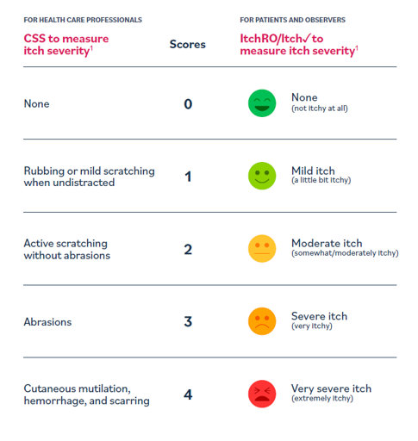
Clinical outcomes for pruritus: Clinician Scratch Scale and ItchRO
CSS: Clinician Scratch Scale
Clinician assessment of pruritus based on scratching and associated visible skin damage
5-point scale (0 = none; 4 = cutaneous mutilation, haemorrhage and scarring)
ItchRO: Itch Reported Outcome (Patient and Observer)
Single items that score itching severity by patient or observer
5-point scale (0 = no itch; 4 = most severe itch)
ItchRO(Obs)
Based on your observations or what your child told you about their itching, how severe were your child’s itch-related symptoms (rubbing, scratching, skin damage, sleep disturbances or irritability) at 2 timepoints:
Morning: from when they went to bed last night until they woke up this morning?
Night: from when the time they woke up this morning until they went to bed?
*Link to Maralixibat trials and GALA cohort comparison study
Notes:
Source: https://www.ncbi.nlm.nih.gov/pmc/articles/PMC5766715/pdf/40271_2017_Article_266.pdf
https://pbc-society.ca/images/shireeaslposter.pdf
https://www.ncbi.nlm.nih.gov/pmc/articles/PMC7327199/

Slide 34
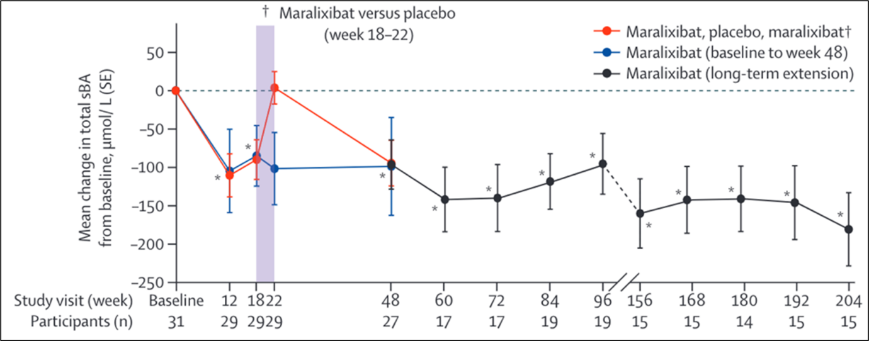
ICONIC: sBA and ItchRO
EAG consider statistically significant decrease in clinical outcomes are uncertain because of aforementioned limitations in trial design and analysis. Also, from week 100, maralixibat dose was doubled but clinical effectiveness decreased
Mean change from baseline in sBA in ITT population
LS mean change (SE) |  | LS mean change (SE) from baseline to:
Week 18 to 22 (RWP) |  | Week 18 | Week 48 | Week 100
Overall | ‘Responders’
MRX (n=13): XXX PBO (n=16): XXX Diff: XXX | MRX (n=5): XXX PBO (n=10): XXX Diff: XXX | XXX | XXX | XXX
Mean change from baseline in ItchRO(Obs) scores in ITT population
LS mean change (SE) | LS mean change (SE) from baseline to:
Week 18 to 22 (RWP) | Week 18 | Week 48 | Week 100
Overall
MRX (n=13): XXX PBO (n=16): XXX Diff: XXX | XXX | XXX | XXX
*XXX ITT, intention to treat; LS, least squares; RWP, randomised withdrawal phase; sBA, serum bile acid; SE, standard error
*Link to ICONIC trial design
Notes:
Source: EAR, Tables 11 and 12 and section 2.2.5. Company submission, Document B, Figures 10 and 14, Tables 18 and 21.

Slide 35
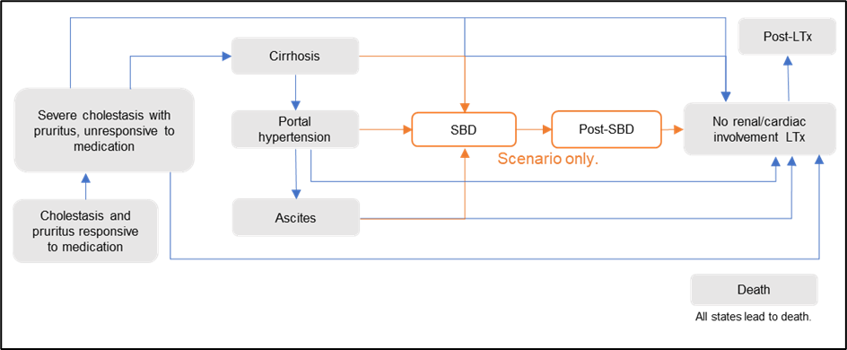
Company’s model overview
Technology affects costs by:
The higher unit price for MRX compared to current treatments
The proportion of cohort ineligible for liver transplant
Weight distribution of cohort
Technology affects QALYs by:
Response rate used for MRX and standard care
Inclusion of caregiver disutility
Inclusion of severity modifier of 1.2
Utility difference between response and non-response health states
Inclusion of surgical biliary diversion health state
Increased mortality risk for non-responders
Assumptions with greatest ICER effect:
Assumption of 0% response rate for standard care
Inclusion of caregiver utility
Utility value of response and non-response states
Application of severity modifier
Including SBD health state
Weight distribution of cohort
Markov: 8 health states (2 additional in scenario analyses), 12-week cycle
NHS/PSS perspective, 3.5% discounting
Company base case: everyone starts responsive to maralixibat, treatment response in standard care is 0%
After cycle 1, probability of stopping treatment (loss of response) = % who stopped maralixibat after 18 weeks due to AEs (ICONIC)
AE, adverse event; ICER, incremental cost-effectiveness ratio; MRX, maralixibat; QALY, quality-adjusted life year; SBD, surgical biliary diversion
Notes:
Source: EAR, sections 1.2 and 3.2.2.

Slide 36
Transition probabilities
Transition | Reported value | Value (12-week cycle) | Source
Response to maralixibat (MRX) | XXX | XXX | ICONIC (39)
Response to standard care (SC) | – | 0% | Assumption
Discontinuation of MRX | XXX | XXX | ICONIC (39)
Discontinuation of SC | XXX | XXX | Clinical opinion (Appendix M)
Unresponsive → Cirrhosis | 41/94 at 10 years | 1.31% | Lykavieris (12)
Cirrhosis → portal hypertension (PHT) | 40% at 30 years | 0.39% | Kamath (8)
PHT → ascites | 36% at 30 years | 0.34% | Kamath (8)
Unresponsive → liver transplant (LTx) | 47% at 4 years | 3.58% | Quiros-Tejeira (92)
Cirrhosis → LTx | 7.27% at 1 year | 1.72% | Hagstrom (93)
PHT → LTx | 23% at 1 year | 5.9% | Krasinskas (94)
Ascites → LTx | – | 5.9% | Assumed equal to PHT → LTx
Post-surgical biliary diversion (SBD) → LTx | 0% in the base-case 36% at 18 years | 0% or 0.6% | NAPPED (95)
LTx → LTx (re-transplantation) | 22% at 1 year | 5.55% | Adam (89)
Unresponsive → SBD | Base case: 0% Scenario: 50% at 29 months | Base case: 0% Scenario: 6.38% | Foroutan (85)
Cirrhosis → SBD
PHT → SBD
Ascites → SBD
*Link to Company model
Notes:
Source: Company submission, Document B, Table 34.

Slide 37
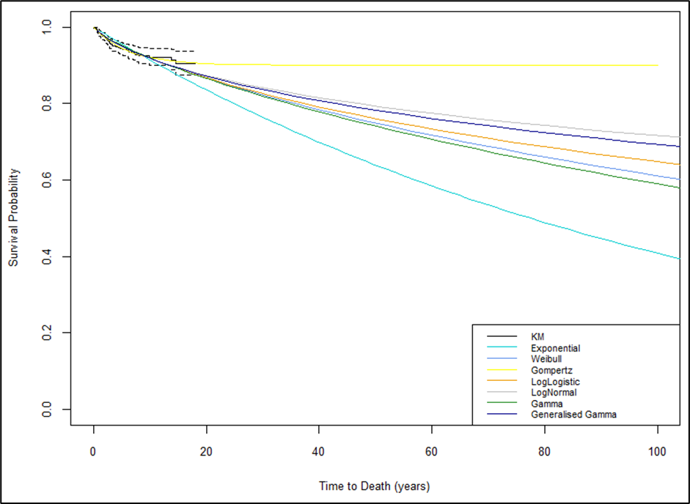
OS extrapolations
Parametric extrapolations of survival of children with ALGS who presented with neonatal cholestasis (GALA)
Survival probabilities at different ages
Distribution | % alive at year: |  |  |  | Median OS (years)
 | 10 | 18 | 50 | 100
Observed | 92.1 | 90.5 | - | - | NE
Exponential | 91.4 | 85.1 | 63.9 | 40.9 | 77.4
Weibull | 92 | 87.6 | 74.9 | 61.1 | 156
Log-normal | 91.8 | 88.1 | 79.3 | 71.6 | 497.4
Log-logistic | 91.9 | 87.7 | 76.1 | 64.8 | 216.6
Gompertz | 92 | 90.6 | 90 | 90 | NE
Gamma | 92 | 87.6 | 74.1 | 59 | 138.8
Generalised Gamma | 91.8 | 88 | 78.3 | 69.6 | 339
ALGS, Alagille syndrome; NE, not estimable; OS, overall survival
*Link to Issue 5
Notes:
Source: EAR, sections 3.2.3 and 3.2.6.3, Table 18.

Slide 38
Company vignette study
Company preferred utilities from vignette study
Company
ICONIC PedsQL could not be mapped to EQ-5D
Base case: used utilities from company-commissioned vignette study using EQ-5D-5L, time trade-off and visual analog scale valuation methods to determine patient and caregiver health-state utilities in ALGS on 200 people from UK general population
Vignettes for 4 patient states (progressive cholestasis, non-progressive cholestasis, successful liver transplant, chronic liver transplant rejection) and 3 caregiver states were developed from systematic review, clinical trial data and clinician interviews
NICE Manual
If evidence shows EQ-5D not appropriate then use, in order of preference:
Other generic preference-based measure
Condition-specific preference-based measure
Vignettes
Direct valuation of own health
ALGS, Alagille syndrome; EQ-5D, EuroQol 5 dimensions; PedsQL, Paediatric Quality of Life Inventory
*Link to Issue 6
Notes:
Source: EAR, section 1.5 (issues 11 and 12), Table 26 and section 3.2.7.1. Company submission, Document B, Table 43. Company submission, Appendix M.

Slide 39
Company health state utilities
State | Utility value: mean (standard error) | Justification
Responsive to medication | XXX | Vignette study (see Appendix M)
Unresponsive to medication | XXX
Cirrhosis | XXX | Sum of unresponsive utility and ‘liver disease’ disutility (–0.04) from Sullivan et al (105)
Portal hypertension | XXX | Sum of cirrhosis utility and ‘liver disease’ disutility (–0.04) from Sullivan et al (105)
Ascites | XXX | Sum of PHT utility and ‘gastrointestinal disorder’ disutility (–0.05) from Sullivan et al (105)
Surgical biliary diversion (SBD) | XXX | Assumed equivalent to LTx utility
Post-SBD | XXX | SBD utility multiplied by the stoma multiplier (0.72) used in HST17 (81)
Liver transplant (LTx) | XXX | Vignette study, weighted average of progressive cholestasis and LTx rejection (see Appendix M)
Post-LTx | XXX | Vignette study, successful LTx (see Appendix M)
*Link to Issue 6
Notes:
Source: Company submission, Document B, Table 43.

Slide 40
Severity modifier
CONFIDENTIAL
Small impact
 | QALYs of people without condition (based on trial population characteristics) | QALYs with ALGS on standard care | Absolute QALY shortfall (has to be >12) | Proportional QALY shortfall (has to be >0.85)
Company base case – vignette utilities | XXX | XXX | XXX | XXX
EAG base case – Kamath PedsQL utilities | XXX | XXX | XXX | XXX
QALY weightt | Absolute shortfall | Proportional shortfall
1 | Less than 12 | Less than 0.85
X 1.2 | 12 to 18 | 0.85 to 0.95
X 1.7 | At least 18 | At least 0.95
EAG comments
Severity weighting based on utilities which EAG considers underestimate HRQoL for ALGS
Provided alternative calculations using utilities from HST17 and values from mapped PedsQL scores reported by Kamath et al (2015)
ALGS, Alagille syndrome; HRQoL, health-related quality of life; PedsQL, Paediatric Quality of Life Inventory; QALY, quality-adjusted life year
Notes:
Source: Company submission, Document B, section B.3.6. EAR, section 3.2.9.

Slide 41
Company deterministic scenario analysis using proposed commercial arrangement
CONFIDENTIAL
No. | Scenario | ICER (£/QALY) + / - £30k
1 | Company base case | -
2 | Post liver transplant mortality = HST17 (0.03%) | +
3 | Ineligible for liver transplant = 0% | +
4 | Ineligible for liver transplant = 76% | -
5 | Liver transplant utility = XXX | -
6 | Adverse event rates from IMAGINE | -
ICER, incremental cost-effectiveness ratio; QALY, quality-adjusted life year
Notes:
Source: Company addendum, Table 15.

