Slide 1
Antimicrobials evaluation committee
Pre-meeting briefing
Cefiderocol for treating severe aerobic Gram-negative bacterial infections
February 2022

Slide 2
Information on slide set
This slide set is the pre-meeting briefing for this evaluation. It has been prepared by the NICE technical team with input from the committee chair, and vice-chair and lead team. It is sent to the committee before the committee meeting as part of the committee papers. It summarises:
the assessment report from EEPRU (the Policy Research Unit in Economic Methods of Evaluation in Health & Social Care Interventions)
the key evidence and views submitted by the company
consultation comments received on EEPRU’s report from APRHAI (Advisory Committee on Antimicrobial Prescribing, Resistance and Healthcare Associated Infections), BIA (British Infection Association), BSAC (British Society for Antimicrobial Chemotherapy) and RCPath (Royal College of Pathologists), MSD, NHS England and NHS Improvement, Pfizer and Shionogi
EEPRU’s response to consultation comments.
It highlights key issues for discussion at the committee meeting and should be read with the full supporting documents for this evaluation.
It does not contain the results of EEPRU’s additional analyses (methods are presented on slides 74 and 75) – these will be made available at a later date, in an addendum to EEPRU’s assessment report.
The lead team may use, or amend, some of these slides for their presentation at the committee meeting.

Slide 3
Comparing this evaluation with the evaluation of ceftazidime-avibactam
EEPRU used the same modelling approach and base case assumptions as for the ongoing NICE evaluation of ceftazidime-avibactam (CAZ-AVI), with the following exceptions:
EEPRU modelled different pathogens, resistance mechanisms and comparator antimicrobials (see slides 14, 15 and 18), because the populations in which cefiderocol is expected to have greatest clinical benefit differ from CAZ-AVI.
Different studies informed EEPRU’s estimates of cefiderocol’s relative effectiveness, although they used the same approach as for CAZ-AVI ie used in vitro susceptibility studies as a surrogate for clinical outcomes (see slides 19-42)
For one of the pathogens modelled (Pseudomonas), EEPRU assumed the eligible population would remain at its current level over the 20-year modelled time horizon. This contrasts the assumption applied in EEPRU’s CAZ-AVI model, and applied to the other pathogen in the cefiderocol model (Enterobacterales), whereby the population increases over time, either in the long term (‘persistent trend’ model) or short term (‘damped trend’ model). See slides 64-68.
The company (Shionogi) did not submit an economic model for this evaluation.
Results of EEPRU’s model are presented on slides 81-95

Slide 4
Table of contents
Context and background for the evaluation
Overview of EEPRU’s modelling approach
Clinical effectiveness evidence
Economic analysis
EEPRU model methods
Estimating patient-level QALYS for high value clinical scenarios
Estimating population-level QALYS for high value clinical scenarios
Estimating population-level QALYS for expected usage
EEPRU model results
Per-patient results
Population results
Additional elements of value
Key issues for committee discussion

Slide 5
Context and background for the evaluation

Slide 6
Evaluation background
Antimicrobial resistance a global challenge
Despite ↓ antimicrobial use, drug-resistant bloodstream infections in humans ↑ by 35% from 2013–2017 in England.
There are few alternative products in development, and fewer that target priority pathogens.
Investment in novel antimicrobials as commercially unattractive – high R&D costs and low returns have led to market failure.
The market for antimicrobials may be limited in several ways
New products active against priority pathogens should be subject to strict stewardship and used on a last in line basis. In the absence of significant outbreaks of drug-resistant infections, sales could be minimal
Under such strict stewardship, it might be several years before sales increase ie the majority of the value might be after the patent period, and manufacturers won’t recoup costs
New products offering alternative options to existing antibiotics, which could potentially be valuable as part of “cycling” stewardship regimes, tend not to be used due to their high cost compared to existing products (many of which are generics)
NICE are working with NHS England and NHS Improvement (NHSE&I) to test a new health technology evaluation process and a new payment model. This will mean the payments made to companies are based primarily on their value to the NHS, and not linked to the volumes of antimicrobial sold.

Slide 7
What is the aim of the evaluation?
Committee estimate the total value of the antimicrobial to the NHS in England, measured in population incremental net health effects (quality-adjusted life years [QALYs])
NSHE&I and company agree fixed annual fee for company for contract duration, regardless of volume of drug sold (‘delinked payment model’)

Slide 8
The contract
Subscription-based payments, independent of volumes sold
Payments based on value of benefits to patients and NHS
value estimated through NICE committee evaluation, informed by EEPRU analysis
Payments capped at £10 million per year, per drug
3–10 year term
Confidential hospital purchase price, set to encourage appropriate use and discourage inappropriate use
Contract also includes performance requirements to ensure availability and stewardship
Minimum stock holding within England and within supply chain
Compliance with stewardship, manufacturing, environmental and surveillance requirements

Slide 9
6 key questions for committee
What are the most relevant comparators?
What is the total lifetime value (Incremental Net Health Effects [INHE]) of the antimicrobial to the NHS (QALYs)?
→ Refers to lifetime of product rather than lifetime of treated individuals.
Are there any benefits that haven’t been adequately captured in this value estimate?
What is the annual value of the antimicrobial for the 10-year contract duration (QALYs)?
→ Refers to proportion of lifetime value that should be attributed to contract in order to address market failure, rather than simply the value accrued in first 10 years of product lifetime
What are the committee’s stewardship recommendations?
How can data collection and surveillance be improved to capture missing data and reduce uncertainty?

Slide 10
Overview of EEPRU’s modelling approach
What do we mean by high value clinical scenarios and why do we need them?

Slide 11
Cefiderocol has a broad marketing authorisation with a range of potential uses (not all expected in practice)
Different pathogens (eg Enterobacterales, Pseudomonas aeruginosa, Acinetobacter baumannii, Stenotrophomonas maltophilia)
Different resistance mechanisms
Carbapenemase-mediated (carbarpenemases = enzymes that hydrolyse carbapenem antibiotics) eg Klebsiella pneumoniae carbapenemase (KPC), oxacillinase (OXA), metallo-beta-lactamases (MBL)
Non-carbapenemase-mediated: reduced cell membrane permeability to antibiotics eg overexpression of efflux pumps, downregulation of porins
Different infection sites (eg lung, urinary tract, bloodstream)
Marketing authorisation:
“infections due to aerobic Gram-negative organisms in adults with limited treatment options.”

Slide 12
Not possible to model every population → selected ‘high value clinical scenarios’ for patient-level model
High value clinical scenarios (HVCS) = populations where greatest clinical benefit expected
EEPRU identified HVCS in consultation with clinical advisors during scoping and protocol development
Several HVCS, divided across 2 settings that cefiderocol would be used, included in patient-level model:
Empiric treatment for clinically urgent infections - strong clinical suspicion (risk) of the pathogen-resistance mechanism, based on fulfilling one of the following criteria:
patient previously hospitalised in setting with high prevalence of pathogen of interest
ward outbreak
previous cultures (during current/previous hospital stay) show infection/colonisation
Microbiology directed treatment for slower progressing infections - treatment based on pathogen’s susceptibility profile (microbiological susceptibility testing and gene testing performed)
To reflect value of cefiderocol’s expected usage, EEPRU estimated QALYs in other populations (not included in model) using patient numbers and assuming the same incremental health benefits as in HVCS.

Slide 13
EEPRU’s approach to modelling population benefit HVCS patient-level, HVCS population-level, Expected use population-level
1. Patient-level QALYs for HVCS
Quantitative modelling, akin to ‘normal’ NICE appraisal
Quantitative modelling, forecasting population size and trends in usage and resistance over time
Quantification of additional attributes ‘STEDI’ values*
2. Population-level QALYs for HVCS
*Spectrum, Transmission, Enablement, Diversity, Insurance
Rescaling, using
population sizes (SGSS PHE data) and assuming same benefit/cost (expert consultation)
3. Population-level QALYs for expected usage

Slide 14
High value clinical scenarios (patient-level model)
 | Microbiology-directed setting (MDS) | Risk-based empiric setting (ES)
Pathogen | Confirmed Enterobacterales and Pseudomonas for metallo-beta-lactamase (MBL) subtypes: NDM, VIM and IMP | Suspected Enterobacterales and Pseudomonas for MBL subtypes NDM, VIM and IMP
Infection site | complicated urinary tract infection (cUTI) hospital-acquired pneumonia & ventilator-associated pneumonia (HAP/VAP) | HAP/VAP
Intervention | Cefiderocol alone | Same as for MDS
Outcomes | All-cause mortality Clinical cure (complete resolution of signs/symptoms of the index infection, no further antimicrobial therapy needed) Microbiologic eradication Emergence of resistance Hospital days and intensive care unit (ICU) days Readmission rate within 90 days of treatment Number of treatment days Health-related quality of life Adverse events (AE) (including those associated with Clostridium Difficile infection and renal toxicity) | Same as for MDS

Slide 15
Additional expected usage
 | Additional expected uses included in model | Potential uses not included in EEPRU analysis | Rationale for not including in EEPRU analysis
Pathogen | Stenotrophomas (15% of infections) |  | Excluded 85% of Stenotrophomonas infections because may not require treatment at all or may be effectively treated with other antimicrobials
Resistance mechanism | Only the resistance mechanisms described as part of the high value clinical scenarios | OXA-40/24, -51, -58, -143 and MBL Acinetobacter Serine carbapenemases Non-carbapenemase mechanisms | A: Population size small B & C: Other effective treatment options available
Site of infection | Bloodstream (including sepsis) Intra-abdominal
Patients with specific underlying conditions |  | Burns Renal complications Compromised immune system Cystic fibrosis | Uncertain whether patients get infections at different sites, by different pathogens, to those in high value clinical scenarios

Slide 16
Consultation comments on population size
Population too narrow | Population too broad | EEPRU response
Shionogi: Wide array of infections not included. Each individually small but add up to a non-trivial change to the overall number. Plausible that more than 15% of infections by Stenotrophomonas are eligible for cefiderocol. SGSS data used to calculate population size dependent upon hospital having appropriate lab facilities for testing, so will likely lead to underestimate. MSD: High-value scenarios very narrow and may not reflect real world usage. | BIA: Empiric use is not appropriate should not have been modelled. Not all cases of HAP/VAP require antimicrobial treatment. There are clear alternative antibiotics in the microbiology-directed setting. Cefiderocol should be reserved for when there is no alternative due to resistance, intolerance, toxicity or allergy. | Expected usage was modelled based clinical advisers’ feedback on appropriate stewardship arrangements. Clinical advisers noted main areas of potential additional usage are in immunocompromised patients, patients with cystic fibrosis, burns patients and patients with renal compromise. To some extent, these patients will overlap with the pathogens and sites of infection already reflected in the modelling.

Slide 17
Accounting for benefit in the expected usage population – key issues
Is the magnitude of incremental health benefit in the high value clinical scenarios generalisable to wider expected usage?
Are there groups of patients which have been excluded from the analysis, who are likely to benefit from the intervention compared with current treatment options?
Is it reasonable to assume 85% of Stenotrophomas infections wouldn’t be treated with cefiderocol?
Is the magnitude of incremental health benefit in any excluded population the same as the benefit in the high value clinical scenarios?

Slide 18
Comparators
Enterobacterales:
Tigecycline + colistin
Fosfomycin + colistin
Aztreonam + colistin
Aminoglycosides (gentamicin, amikacin, tobramycin)
Pseudomonas aeruginosa:
Fosfomycin + colistin
Fosfomycin + meropenem
Comparators same in microbiology-directed and risk-based empiric settings
All comparators used to inform network meta analysis of susceptibility
Not all comparators included in model (see later slides)
Have all appropriate comparators been captured?

Slide 19
Clinical effectiveness evidence

Slide 20
EEPRU explored 3 possible sources of clinical evidence for economic analysis of HVCS
Evidence source | Strengths | Limitations
RCT data | High internal validity (low risk of bias) | Non-inferiority trials in susceptible infections → data not generalisable to populations of interest (resistant infection)
Observational studies | Potential for larger sample sizes | High risk of confounding and uncertainty due to imbalance between baseline prognostic and/or predictive factors Need individual patient data for adjustment methods Single arm studies require advanced techniques
In vitro susceptibility studies | All drugs tested in same set of isolates: high internal validity and reduced heterogeneity between arms Specific to pathogen /resistance mechanism of interest Better coverage of comparators Larger sample sizes Can be used alongside highly relevant data from PHE | Need to link susceptibility surrogate to clinical outcomes Minimal literature on link → EEPRU relied on expert elicitation in most cases No data for treatment combinations Many sources of heterogeneity, including: lab methods and breakpoints (EUCAST or CLSI) sample selection criteria, age and location comparators in other countries International results may not be generalisable to UK (different distribution of pathogens & resistance)

Slide 21
Limitations of the studies identified
RCTs (EEPRU identified 3 studies)
2 studies (APEKS cUTI, APEKS NP) excluded patients with carbapenem-resistant infections
CREDIBLE-CR recruited patients with carbapenem-resistant infections, plus subgroup data for patients with MBL infections
MBL subgroup contained 16 patients, high risk of chance covariate imbalance → bias
Conclusion: Low relevance of RCT data to HVCSs
Observational data (EEPRU identified 3 studies)
All studies reported outcomes of MBL infections treated with cefiderocol but:
small sample sizes (2-17 patients)
highly heterogeneous in terms of characteristics and prognostic factors
no subgroup data on site of infection
Conclusion: Low relevance of observational data to HVCSs
Because of these limitations, EEPRU used in vitro susceptibility studies to estimate comparative effectiveness in its economic analyses

Slide 22
EEPRU developed its own tool to quality assess susceptibility studies (no published tools exist)
EEPRU’s tool to assess bias and relevance of susceptibility studies was based on:
2 tools developed for assessing prevalence studies (because studies report the prevalence of susceptibility)
risk of bias in non-randomised studies (ROBINS)-1 checklist for non-randomised studies (because studies are comparative, but non-randomised)
Cochrane’s risk of bias 2 (RoB2) tool (because EEPRU’s network meta-analysis assumes the study arms are equivalent to randomised arms of an RCT),
Newcastle Ottawa Scale for assessing observational studies (because susceptibility studies are observational).
Questions from all tools considered for inclusion and adapted to the specifics of this review
Tool reviewed by other members of the EEPRU team, but no further validation work undertaken
Notes:
Tool developed by consulting
2 tools developed for the assessment of prevalence studies (since studies report the prevalence of susceptibility),
the risk of bias in non-randomised studies (ROBINS)-1 checklist for non-randomised studies (since the studies are comparative, but non-randomised),
Cochrane’s risk of bias 2 (RoB2) tool (since the network meta-analysis will assume the study arms are equivalent to randomised arms of an RCT),
the Newcastle Ottowa Scale (since these are observational studies).

Slide 23
How is susceptibility to antimicrobials assessed?
Key terminology
Minimum inhibitory concentration (MIC): Lowest concentration of drug required to stop bacterial growth
MIC90 = the concentration at which 90% of isolates are inhibited
Clinical breakpoint for an isolate: A concentration threshold used to assess the likelihood of a treatment succeeding or failing
Interpretation
MIC ≤ clinical breakpoint: susceptible infection (treatment likely to succeed)
MIC > clinical breakpoint: resistant infection (treatment likely to fail)
Infections can be classed as intermediate susceptibility – definitions vary
Bacterial isolate taken from patient and cultures grown in vitro
Antimicrobial applied at increasing concentrations to separate cultures – degree of microbial growth assessed
Percentage of isolates susceptible at or below breakpoint reported
Example of susceptibility testing results for 3 drugs (10 isolates each) – green cells indicate concentrations at or below breakpoint for each drug. Final column reports total % of isolates at or below breakpoint
Concentration (mg/L) | 0.25 | 0.5 | 1.0 | 4.0 | >8.0 | % susceptible
Drug X Breakpoint 2 mg/L |  |  |  | 6 | 4 | 0%
Drug Y Breakpoint 0.5 mg/L | 5 | 5 |  |  |  | 100%
Drug Z Breakpoint 1 mg/L | 4 | 3 | 2 | 0 | 1 | 90%

Slide 24
Different approaches to setting clinical breakpoints
EU based: Recommended by British Society for Antimicrobial Chemotherapy → used in base case in EEPRU economic model
US based → used in scenario analyses in EEPRU economic model
Different organisations use different analytical and laboratory methodologies to set breakpoints and measure minimum inhibitory concentrations → not directly comparable
Definitions of intermediate susceptibility vary between the organisations
Clinical breakpoints are routinely reassessed and can change over time based on new evidence or methodological changes
EEPRU used PHE data – it is unclear what breakpoints and laboratory methods were used in PHE dataset
EUCAST breakpoints are under review – update due in January 2022 (EUCAST have proposed no change, subject to consultation)

Slide 25
Network meta analysis informed by susceptibility evidence identified by systematic literature review
Studies which used EUCAST breakpoints and laboratory methods used in economic model base case, because EUCAST used in UK
Although the laboratory methods and breakpoints used in the PHE dataset were unclear, EEPRU assumed that majority would comply with BSAC recommendations (ie EUCAST), and therefore included PHE data in base case
Studies using CLSI breakpoints &/or laboratory methods excluded from base case, because unclear extent to which breakpoints and lab methods were interchangeable
PHE data alone was not selected for the base case because of the following limitations:
Data do not include cefiderocol
Variation in testing methods (may affect comparative effectiveness estimates)
PHE excluded isolates not tested for all comparators (may introduce selection bias)
Scenario analyses tested impact of using all studies (regardless of whether they used EUCAST or CLSI breakpoints), using cefiderocol or fosfomycin studies only, using studies which focussed on the resistance mechanism of interest
Full details of sensitivity analyses for the NMA are available in section 5.5.4.3 and appendix 7.3 of EEPRU’s report– the following slides focus on networks used in economic model base case and scenario analyses

Slide 26
Data informing network meta analysis (NMA) of susceptibility studies – Enterobacterales
Comparators
Cefiderocol, colistin, meropenem, tigecycline, aztreonam, fosfomycin, aminoglycosides
EUCAST
CLSI
Breakpoints
2 Cefiderocol studies (n=321)
5 Fosfomycin studies
(n=175)
PHE data
(n=159)
4 Cefiderocol studies (n=454)
3 Fosfomycin studies
(n=611)
Data sources
Used in economic model
2 additional scenarios in model focussed on PHE data, supplemented by only the cefiderocol and fosfomycin arms of published studies
Base case
Scenario analysis 1

Slide 27
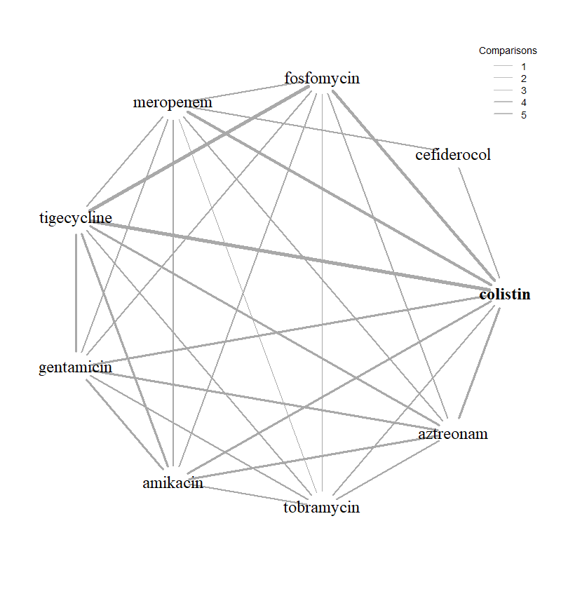
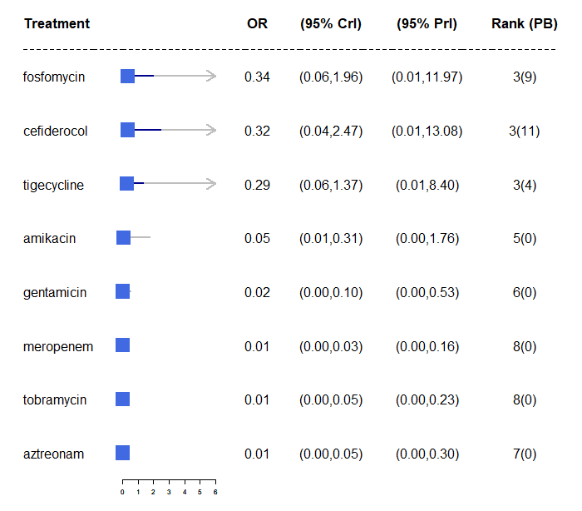
Susceptibility NMA results – Enterobacterales (1)
Base case network
Enterobacterales with EUCAST breakpoint for SIDERO, fosfomycin and PHE studies)
Susceptibility relative to colistin
PB = probability of being the most effective treatment

Slide 28
Susceptibility NMA results – Enterobacterales (2)
Scenario | Breakpoint | Data sources | Odds ratio vs colistin
Base Case | Assumed EUCAST + EUCAST | PHE data + NMA, all EUCAST studies | 0.32 95% CrI 0.04 to 2.47
Scenario 1 | CLSI | NMA, all CLSI studies | 1.38 95% CrI 0.16 to 12.05
Scenario 3 | Assumed EUCAST + CLSI | PHE Data + NMA, cefiderocol CLSI studies + NMA, fosfomycin CLSI studies | 15.70 95% CrI 0.83 to 320.72
Scenario 4 | Assumed EUCAST + EUCAST | PHE data + NMA, cefiderocol all EUCAST studies* | Same as base case
CrI: Credible interval
* Excludes fosfomycin because PHE data is missing fosfomycin data

Slide 29
Data informing network meta analysis (NMA) of susceptibility studies – Pseudomonas
Comparators
Cefiderocol, colistin, meropenem, aztreonam, fosfomycin
EUCAST
CLSI
Breakpoints
2 Cefiderocol studies (n=281)
1 Fosfomycin study
(n=7)
PHE data
(n=86)
2 Cefiderocol studies (n=281)
1 Fosfomycin study
(n=20)
Data sources
Used in economic model
1 additional scenario in model focussed on PHE data, supplemented by only the cefiderocol and fosfomycin arms of published studies
Base case
Scenario analysis 1

Slide 30
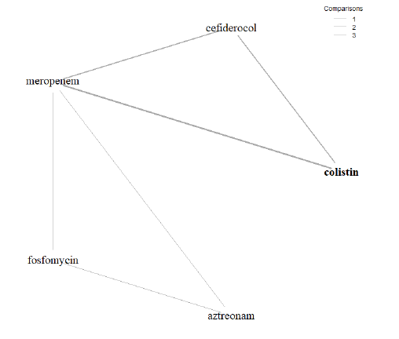
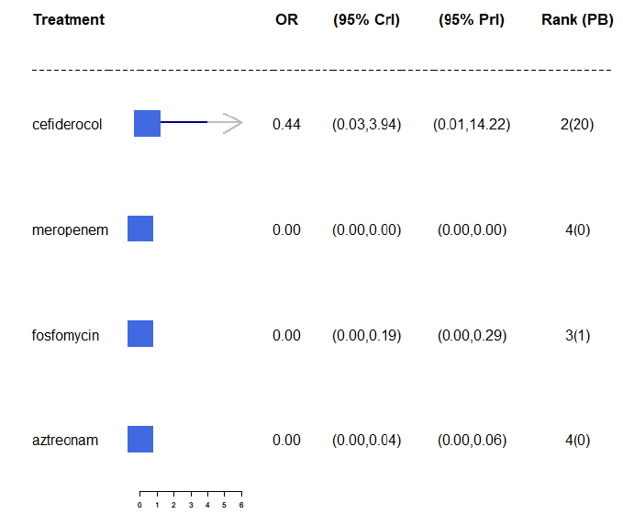
Susceptibility NMA results – Pseudomonas (1)
Base case network
Enterobacterales with EUCAST breakpoint for SIDERO, fosfomycin and PHE studies)
Susceptibility relative to colistin
PB = probability of being the most effective treatment

Slide 31
Susceptibility NMA results – Pseudomonas (2)
Scenario | Breakpoint | Data sources | Odds ratio vs colistin
Base Case | Assumed EUCAST + EUCAST | PHE data + NMA, all EUCAST studies | 0.44 95% CrI 0.03 to 3.94
Scenario 1 | CLSI | NMA, all CLSI studies | 71.34 95% CrI: 4.33 to 5934
Scenario 3 | Assumed EUCAST + CLSI | PHE Data + NMA, cefiderocol CLSI studies + NMA, fosfomycin CLSI studies | 66.73 95% CrI: 3.61 to 3284
Scenario 4 | EUCAST | NMA, all EUCAST studies + Absolute colistin susceptibility from SIDERO WT | Same as base case
CrI: Credible interval

Slide 32
Consultation comments - Susceptibility evidence and breakpoints
Consultee | Comment | EEPRU response
Shionogi | NMA underestimates in vitro efficacy of cefiderocol vs colistin: CLSI recently removed category of ‘susceptible’ for colistin. EUCAST consulting on similar proposal. CLSI and EUCAST don’t recommend colistin monotherapy because inadequate tissue concentration. → Isolates previously considered susceptible to colistin should now be grouped with resistant isolates as ‘non-susceptible.’ | Colistin is used as a combination treatment in the empiric setting in the modelling. Calculating susceptibility of combination treatments additively deemed plausible by clinical advisers
Shionogi | Fosfomycin studies should be excluded from the NMA because methods aren’t relevant, robust or comparable with studies of other drugs. Fosfomycin is not a relevant comparator (except in cUTIs). | Fosfomycin literature searches were limited from due to time but not biased
Shionogi | Base case should combine EUCAST and CLSI data, because although breakpoints differ, methods are comparable. EUCAST breakpoints can be applied to data generated by CLSI method and vice versa. | EUCAST recommendations have the highest applicability in the UK.

Slide 33
Linking susceptibility data to clinical outcomes
Outcomes of interest
Mortality
Length of hospital stay
Type of hospital ward patients would stay
EEPRU’s assumptions
Outcomes the same regardless of the specific pathogen-mechanism causing the infection
Outcomes only change conditional upon pathogen’s susceptibility to treatment
Risk of AKI with aminoglycoside/colistin factored in
Results of literature review
Empiric setting:
2 studies reported mortality or length of hospital stay conditional on susceptibility to empiric treatment
Studies used for economic model
Microbiology-directed setting:
No relevant studies identified
Expert elicitation required
Is the relationship between susceptibility and outcomes likely to be constant across all antimicrobials?

Slide 34
Expert elicitation informed outcomes following microbiology-directed treatment in economic model
EEPRU’s assumptions:
Outcomes the same regardless of specific treatment given.
Outcomes the same regardless of the pathogen type and resistance mechanism, considering only those relevant to NICE evaluations of CAZ-AVI and cefiderocol i.e. Enterobacterales with OXA-48 or MBL resistance mechanism, or Pseudomonas aeruginosa with MBL resistance mechanism.
Outcomes only change conditional upon pathogen’s susceptibility to treatment.
Questions were asked separately for:
Each of the 3 infection sites in the HVCSs: HAP, VAP and cUTI.
Pathogens susceptible to treatment in the microbiology-directed setting.
Pathogens not susceptible to any existing antibiotics (including CAZ-AVI and cefiderocol), and patient receives multi-drug salvage therapy instead.

Slide 35
Experts were asked to provide a point estimate and express their uncertainty using a histogram
Questions:
In this patient population, what proportion of patients will still be alive 30 days after starting microbiology directed treatment?
In the patient population described, what will be the average length of stay?
In the patient population described, what proportion of hospital stay would be spent on each of the following wards (intensive care unit [ICU], high dependency unit [HDU] and general medical ward)? This number should represent the average for all such patients, regardless of their outcome. Elicited as a deterministic value.

Slide 36
Results are presented as pooled summaries of responses from 5–7 experts
11 experts recruited, and 9 experts attempted the task
5 microbiologists
2 medical consultants
1 ICU consultant
1 pulmonary consultant
2 experts removed from base case analysis because EEPRU considered their responses implausible
Responses indicated that survival probability was lower in patients susceptible than not susceptible
2 experts stopped the exercise before answering all questions – their responses are included in the analyses for outcomes where they provided an estimate for both susceptible and not susceptible patients
Notes:
Responses for HAP and VAP were subsequently pooled (for the model) because EEPRU’s economic model groups these indications
Outcomes for HAP and VAP were weighted by their relative occurrence in Tumbarello et al. 2013
Relative occurrence in Tumbarello et al. (2013) was 0.283 (28/99) for HAP and 0.617 (71/99) for VAP.
Tumbarello was chosen as the study where participants were the most representative of patients in our HVCS, that reported the proportion of patients with hospital acquired pneumonia that was ventilator-associated.
Tumbarello M, De Pascale G, Trecarichi EM, et al. Clinical outcomes of Pseudomonas aeruginosa pneumonia in intensive care unit patients. Intensive Care Med 2013;39:682-92

Slide 37
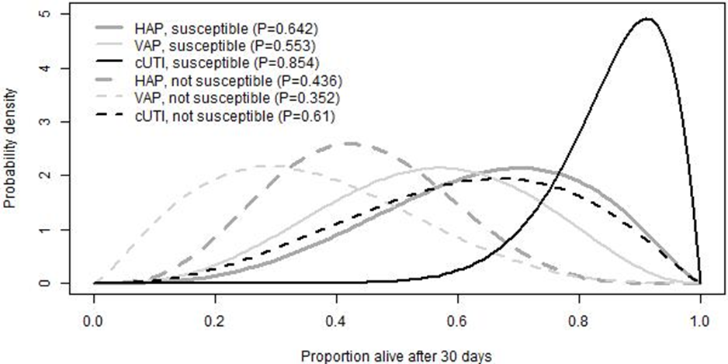
Expert elicitation results: 30-day survival
Survival lowest for VAP patients
Survival highest for cUTI patients
Susceptibility to treatment increases the probability of survival, for all 3 infection sites
Source: EEPRU’s report figure A9.1 - 30-day survival

Slide 38
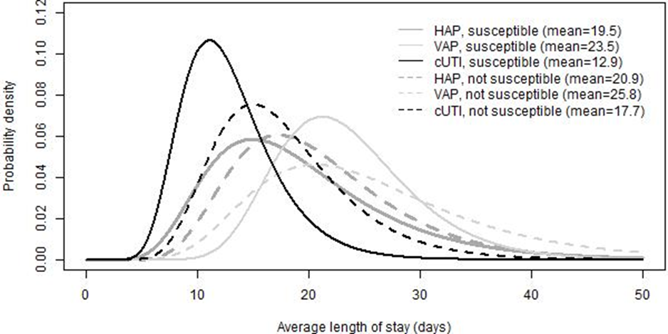
Expert elicitation results: length of hospital stay
Length of stay shortest in cUTI patients
Length of stay longest for patients with VAP
Susceptibility to treatment decreases length of stay, for all 3 infection sites
Source: EEPRU’s report figure A9.2 – Expected length of stay

Slide 39
Expert elicitation results: time spent on wards
Patients with VAP: most time in ICU and least time in general wards
Followed by HAP then cUTI
Patients susceptible to treatment expected to spend more time on general ward and less on ICU and HDU, for all 3 infection sites
 | ICU | HDU | General medical ward
HAP, susceptible | 24.3 | 19.0 | 56.7
VAP, susceptible | 60.0 | 13.3 | 26.7
cUTI, susceptible | 15.0 | 17.0 | 68.0
HAP, not susceptible | 39.3 | 20.7 | 40.0
VAP, not susceptible | 66.7 | 15.8 | 17.5
cUTI, not susceptible | 23.3 | 18.3 | 58.3
Source: EEPRU’s report Table A9.1 – Proportion (%) of hospital stay spent on ICU, HDU and general medical ward
HDU = high dependency unit; ICU = intensive care unit

Slide 40
EEPRU used UK study data to validate expert elicitation results for length of hospital stay
Source | Length of stay (LOS), days
Expert elicitation | 12.9–25.8 (mean)
Merrick et al. (UK) | 24 (median)
CARBAR (UK) | 47.2 (mean)
CARBAR study
Considerably longer LOS (47.2) than experts’ estimates.
But CARBAR measured LOS from hospital admission, rather than from start of microbiology directed treatment.
Time from hospitalisation to onset of infection was 8 days (median), but differed according to method of diagnosis: 16.8 days (mean) for sputum samples and 13.9 days (mean) for UTI-related samples.
Time from onset of infection to starting microbiology directed treatment was 5 days (median).
Assuming 13 (8 + 5) to 21.8 (16.8 + 5) days passed between admission and starting microbiology directed treatment, LOS from start of microbiology directed treatment in CARBAR (25.4 to 34.2 days) was comparable to experts’ estimates.
Merrick et al.
Mean LOS not reported.
Median LOS after infections caused by carbapenem-resistant organisms comparable to the mean estimates from experts.
Notes:
CARBAR mean LOS: 47.2 days
Muscedere median LOS: 27.9 days with appropriate empiric treatment and 42.2 days with inappropriate treatment
Estimated to equate to mean LOS of 43.1 days and 85.7 days, respectively (further detail provided in section 7.2.3).
LOS in both studies considerably longer than experts’ estimates (~20 and ~24 days from the start of microbiology directed treatment in susceptible and resistant patients, respectively).
However, the LOS in both studies was measured from hospital admission, rather than from the start of microbiology directed treatment following infection onset.

Slide 41
Consultation comments – Expert elicitation
Consultee | Comment
Pfizer | Approaches were not as robust or thorough as a Delphi Panel and not validated against historical data.
MSD | Support use of expert elicitation methodology to help fill evidence gaps but question robustness of results given small number of experts involved.
Shionogi | Expert elicitation should have been employed more extensively in areas of limited data, e.g. epidemiological parameters, STEDI values Responses that lacked face validity were not addressed.

Slide 42
Consultation comments – Linking susceptibility data to clinical outcomes
Consultee | Comment
Pfizer | In vitro data can’t always be extrapolated to clinical outcomes → underestimates the antibiotic’s effectiveness.
Shionogi | Implausible to assume susceptibility of pathogen is same as probability that patient will be clinically cured Incorrect to assume outcomes do not differ according to specific antibiotic used or specific pathogen-mechanism causing the infection, conditional upon susceptibility to that antibiotic. Inappropriate to use in vitro data as a surrogate for clinical outcomes, because it doesn’t account for factors that will affect in vivo efficacy eg different tissue penetration at different infection sites.

Slide 43
EEPRU model methods
Overview of economic analysis approach

Slide 44
EEPRU’s approach to modelling population benefit HVCS patient-level, HVCS population-level, Expected use population-level
1. Patient-level QALYs for HVCS
Quantitative modelling, akin to ‘normal’ NICE appraisal
Quantitative modelling, forecasting population size and trends in usage and resistance over time
Quantification of additional attributes ‘STEDI’ values*
2. Population-level QALYs for HVCS
*Spectrum, Transmission, Enablement, Diversity, Insurance
Rescaling, using
population sizes (SGSS PHE data) and assuming same benefit/cost (expert consultation)
3. Population-level QALYs for expected usage

Slide 45
EEPRU model methods
Estimating patient-level QALYs for high value clinical scenarios

Slide 46
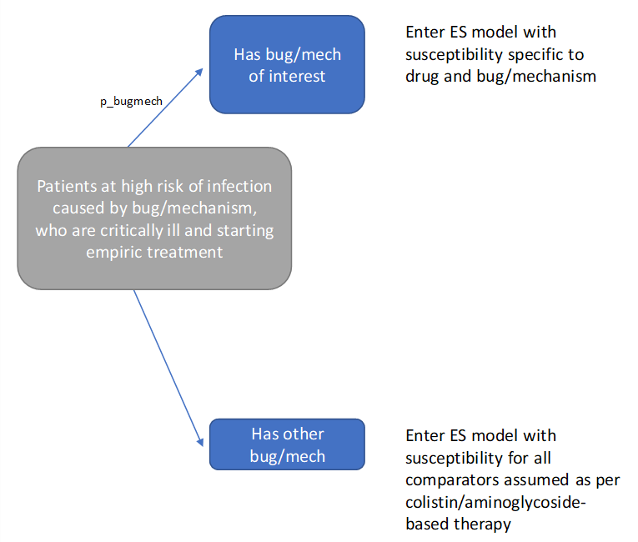
EEPRU’s model– empiric setting (ES)
Treatment susceptibility unknown before starting empiric treatment
Outcomes are modelled separately for patients who:
have the suspected drug-resistant pathogen-mechanism (‘correctly suspected’) → different treatment effectiveness
have a different causative pathogen or mechanism (‘wrongly suspected’) → same effectiveness regardless of the choice of empiric treatment (although safety differs)
Some patients have further treatment in microbiology-directed setting, via 3 possible pathways:
ES1: Cefiderocol in empiric setting + existing treatments in microbiology-directed setting
ES2: existing therapies in empiric setting + Cefiderocol in microbiology-directed setting
ES3: existing therapies in both empiric setting and microbiology-directed setting
First component of 30-day outcomes model for ES: risk of carrying pathogen-mechanism of concern
NB: Probability that a patient carries the pathogen-mechanism of interest (“p_bugmech”) is varied in scenario analyses
Source: EEPRU’s report, Figure 11

Slide 47
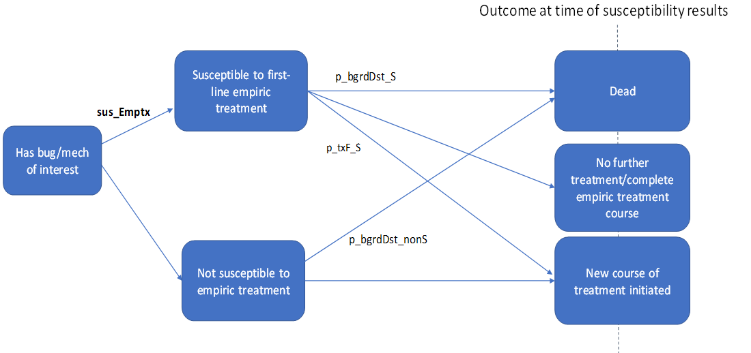
EEPRU’s model – empiric setting (ES)
Patients who have the suspected drug-resistant pathogen-mechanism (‘correctly suspected’) are classified as susceptible or not susceptible to empiric therapy → different treatment effectiveness
Note: differences in susceptibility to empiric treatments are modelled, even though clinicians will not observe it until patients start microbiology-directed treatment
Patients who received empiric treatment to which they are later found not to be susceptible all assumed to require further treatment in microbiology-directed setting
2nd component of 30-day outcomes model for empiric setting: outcomes at the point at which patients are assessed for microbiology-directed treatment
NB: Susceptibility probability varied with scenario analyses on NMA
Source: EEPRU’s report, Figure 12

Slide 48
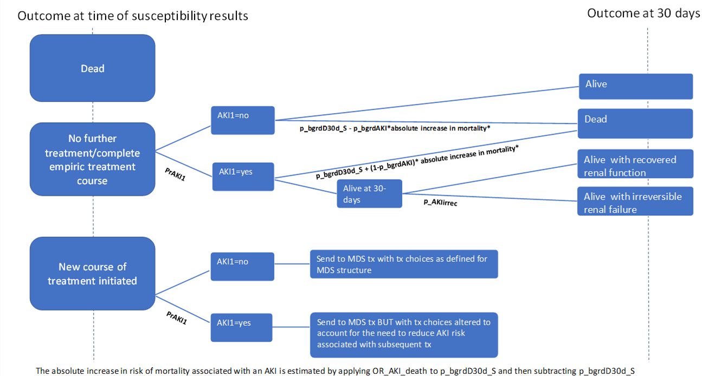
EEPRU’s model– empiric setting (ES)
3rd component of 30-day outcomes model for ES: 30-day outcomes following assessment for MDS treatment
Patients who survive until assessment for microbiology-directed treatment enter 3rd part of decision tree
Patients requiring no further treatment: outcomes depends on whether they have acute kidney injury (AKI)
Patients requiring further treatment enter the microbiology-directed setting component of model
NB: Long-term mortality varied in scenario analyses
Source: EEPRU’s report, Figure 13

Slide 49
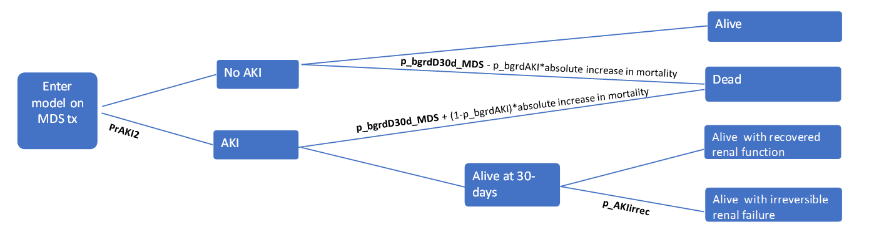
EEPRU’s model – Microbiology directed setting (MDS)
Assumes susceptibility is the only predictor of treatment effectiveness
Following microbiology-directed treatment, patients experience 1 of 4 alternative 30-day outcomes:
death
alive no acute kidney injury (AKI)
alive post-AKI with recovered renal function
alive post-AKI with irreversible renal failure
Decision tree used to estimate distribution of patients across the 4 different 30-day outcomes
30-day outcomes determine long-term outcomes (e.g. post AKI recovery or chronic kidney disease [CKD])
NB: probability of AKI, odds ratio of AKI, mortality for AKI vs no AKI and long-term mortality varied in scenario analyses
Source: EEPRU’s report, Figure 9 Decision tree used to calculate impact of AKIs on 30-day outcomes in MDS
NB: Risk of CKD and associated mortality varied in scenario analyses
Source: EEPRU’s report, Figure 10, Markov model used to calculate post-30-day outcomes in patients with recovered renal function and irreversible renal failure

Slide 50
EEPRU’s model – Subgroups within MDS and treatment choice
In microbiology-directed setting, susceptibility to available treatment options is known → tailored treatment
Outcomes driven by the distribution of patients across the different susceptibility categories
Susceptibility to existing drugs | Susceptibility to cefiderocol | Therapy under existing care | Therapy with new drug available
Susceptible to one or more non-colistin/aminoglycosides option | Susceptible | Non-colistin/amino | Non-colistin/amino
 | Resistant | Non-colistin/amino | Non-colistin/amino
Susceptible only to colistin or aminoglycosides | Susceptible | Colistin/amino-based | Cefiderocol
 | Resistant | Colistin/amino-based | Colistin/amino-based
Not susceptible to any available treatment options | Susceptible | Multi-drug salvage | Cefiderocol
 | Resistant | Multi-drug salvage | Multi-drug salvage
Green: clinician initiates new treatment course with drug with appropriate efficacy and safety
Orange: clinician initiates new treatment course with drug with poor safety.
Red: clinician initiates new treatment course with drug with poor efficacy (and possibly poor safety).
Bold: patient groups for whom susceptibility evidence would indicate treatment with cefiderocol.
Source: EEPRU’s report, table 16

Slide 51
EEPRU’s model –data sources for patient level
Parameter | Source | Estimates
Probability patient has pathogen-resistance mechanism of interest | PHE Second Generation Surveillance System (SGSS) data on positives as a % of isolates tested | MBL Enterobacterales: 15% MBL Pseudomonas: 14%
Susceptibility (to inform comparative effectiveness estimates) | EEPRU evidence synthesis: NMA of in vitro studies and PHE data | Various
Acute kidney injury (AKI) risk with non-aminoglycoside/colistin | Published systematic review | 31%
AKI risk with aminoglycoside/colistin | Published systematic review | 45%
Link between susceptibility and short-term clinical outcomes: AKI | Literature (published systematic review and observational study) | Various
Link between susceptibility and short-term clinical outcomes: 30-day mortality | Expert elicitation | Various
Link between susceptibility and short-term clinical outcomes: hospitalisation | Expert elicitation and literature (RCT) | Various
Long-term mortality | CARBAR study – Retrospective study | Median life expectancy 1.5 years

Slide 52
Consultation comments – Comparators
Consultee | Comment | EEPRU response
BIA | Aminoglycosides should not be grouped with colistin, because nephrotoxicity risk with aminoglycosides is half the risk with colistin. | Comparators selected were based on extensive consultation with clinical advisors
Shionogi | A proportion of patients will not receive colistin in practice due to renal concerns, contraindications or drug interactions. Unclear what regimen(s) included in non-colistin /aminoglycoside therapy options in MDS. All comparators in PICO table contain either colistin or aminoglycosides. Treating patients with regimens that exclude colistin and/or aminoglycosides is not consistent with current practice. | Clinical advisors indicated that adverse events will be tolerated by clinicians - only a small proportion considered completely contraindicated to colistin. EEPRU has produced additional scenario analyses in which a proportion of patients are unable to take colistin PICO table contains only combination therapies. However, in the microbiology-directed setting monotherapies are modelled, meaning efficacy of comparators is likely underestimated and incremental net health effects of comparators is overestimated.

Slide 53
Consultation comments – Model assumptions
Consultee | Comment | EEPRU response
Shionogi | Model doesn’t consider false negatives. Infections not identified as resistant in the empiric setting but are subsequently treated as such in the microbiology-directed setting are omitted from the modelling No option to discontinue cefiderocol after the pathogen and resistance mechanism has been confirmed, and substitute it for an equally efficacious product (part of good stewardship) Incorrect to assume that if a patient is wrongly suspected of having the pathogen and resistance mechanism of interest, that all empiric treatments have the same effectiveness | Challenging to model because only the total number of tests carried out for MBL was known, not the setting where they were conducted. Based on expert advice we therefore assumed that false negatives in empiric setting did not occur.

Slide 54
EEPRU model methods
Estimating population-level QALYs for high value clinical scenarios and expected usage

Slide 55
Estimating population-level QALYs
To scale up patient-level QALY results to population-level QALYs, EEPRU needed to forecast changes in population size and trends in usage and resistance over time (see next slides for detailed methods)
Population-level QALYs derived by multiplying patient-level QALYs by the population size
Patient-level QALYS for the infection sites defined in the high value clinical scenarios (cUTI and HAP/VAP) were estimated using the patient-level model (as described on previous slides)
Patient-level QALYS for the other expected uses of cefiderocol (blood stream and intra-abdominal infections) were assumed to be the same as in HAP/VAP and cUTI, respectively, based on the following feedback from clinical advisors:
BSI and HAP/VAP are both severe infections where cefiderocol is expected to be used predominantly empirically.
Consequences of intra-abdominal infection can be more severe than consequences of cUTI because they are very difficult to treat (requiring a combination of antimicrobials and surgery), but benefits of cefiderocol may be smaller in intra-abdominal infection than in cUTI due to complexity of treating these infections and the lesser role of antimicrobials compared to other treatment modalities in their management.

Slide 56
Estimating the patient population over time
AIM: Predict how the size of the patient population in the modelled clinical scenarios will change over the model time horizon (20 years)
1
2
3
How many patients currently eligible for treatment?
How will eligible population change over time?
How will rates of resistance to cefiderocol and its comparators change over time?
Notes:
Source: Cefiderocol assessment report Section 8.2.5.1 (p145)

Slide 57
Estimating the patient population over time
1
2
3
How many patients currently eligible for treatment?
How will eligible population change over time?
How will rates of resistance to cefiderocoI and its comparators change over time?
Notes:
Source: Cefiderocol assessment report Section 8.2.5.1 (p145)

Slide 58
Determining size of current patient population
Data used to inform population estimates
Public Health England Second Generation Surveillance System (SGSS) Antimicrobial Resistance module – national database of laboratory data provided by 98% of hospital microbiology labs in England
Timeframe: October 2020 to April 2021 (because reporting of acquired carbapenemase-producing gram-negative bacteria became mandatory in October 2020)
Site of infection not available directly → inferred from specimen type
SGSS Data
PHE classification of infection sites
Several samples removed → clinical experts considered estimates conservative
Clinical expert classification of infection sites
Broader classification – may include samples that don’t relate to infections of interest
High value clinical scenarios
Other expected uses
HAP/
VAP
cUTI
Bloodstream infections (BSI)
Intra-abdominal infections (IAI)
Stenotro-phonomas
Notes:
Source: Cefiderocol assessment report p156

Slide 59
The clinical expert classification of infection sites is broader than the PHE classification
 | HAP/VAP | cUTIs | BSIs | IAIs
PHE classification | Lower respiratory tract only | Urine/kidney specimens from all male patients. Nephrostomy specimens in male and female patients | Blood samples only | Wound specimens (surgical and traumatic wounds)
Clinical expert classification | Lower respiratory tract and other sites (including but not limited to lung, chest, sputum) | Urine/kidney specimens in scenario 1 in all hospitalised patients (both male and female), upper genital tract in male and female hospitalised patients | Blood samples and other samples (including but not limited to, heart valve, prosthesis, grafts, bone biopsy sample) | None additional to PHE
EEPRU conducted survey on HAP/VAP infections in empiric setting to provide alternative estimates
Survey targeted infectious disease specialists; disseminated to members of British Society for Antimicrobial Chemotherapy (BSAC) and EEPRU’s clinical advisors
Due to small sample size of respondents, estimates varied considerably between experts → results not included in model

Slide 60
Scenarios for size of current population (/year, Enterobacterales)
 | HAP/VAP (tested) | cUTIs (confirmed positive) | BSIs (tested) | IAIs (confirmed positive) | Total
PHE classification | 25 | 62 | 155 | 51 | 293
Clinical expert classification | 157 | 84 | 155 | 51 | 447
BSIs, bloodstream infections; cUTIs, complicated urinary tract infections; HAP/VAP, hospital-acquired pneumonia or ventilator associated pneumonia; IAIs intraabdominal infections
Estimates based on SGGS: subject to considerable uncertainty due to issues with completeness of dataset
Notes:
Source: Cefiderocol assessment report p160 – Table 32

Slide 61
Scenarios for size of current population (/year, Pseudomonas)
 | HAP/VAP (tested) | cUTIs (confirmed positive) | BSIs (tested) | IAIs (confirmed positive) | Total
PHE classification | 6 | 17 | 13 | 12 | 48
Clinical expert classification | 87 | 10 | 13 | 12 | 122
BSIs, bloodstream infections; cUTIs, complicated urinary tract infections; HAP/VAP, hospital-acquired pneumonia or ventilator associated pneumonia; IAIs intraabdominal infections
Estimates based on SGGS: subject to considerable uncertainty due to issues with completeness of dataset
Notes:
Source: Cefiderocol assessment report p160 – Table 32

Slide 62
Scenarios for size of current population (/year, Stenotrophomonas)
 | HAP/VAP (confirmed positive) | cUTIs (confirmed positive) | BSIs (confirmed positive) | IAIs (confirmed positive) | Total
PHE classification | 100 | 64 | 63 | 38 | 265
Clinical expert classification | 547 | 63 | 63 | 38 | 711
BSIs, bloodstream infections; cUTIs, complicated urinary tract infections; HAP/VAP, hospital-acquired pneumonia or ventilator associated pneumonia; IAIs intraabdominal infections
Estimates based on SGGS: subject to considerable uncertainty due to issues with completeness of dataset
Notes:
Source: Cefiderocol assessment report p160 – Table 32

Slide 63
Estimating the patient population over time
1
2
3
How many patients currently eligible for treatment?
How will eligible population change over time?
How will rates of resistance to cefiderocoI and its comparators change over time?

Slide 64
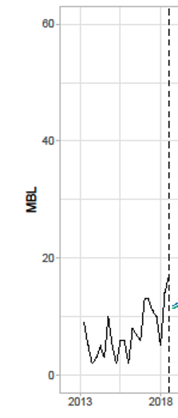
Predicting changes in population over time
How will the eligible population change over time?
Historical data used to inform the extrapolation (2012–2018)
Public Health England (PHE) antimicrobial resistance and healthcare associated infections (AMRHAI) national reference library
Timeframe available: 2004 to 2021. Excluded data before Oct 2012 due to small patient numbers. Excluded data after Mar 2018 due to “artificial” decrease in referrals caused by change in guidelines
Primary analysis: Invasive isolates (eg bloodstream infections) – assumed generalisable to HVCS)
Secondary analysis screening isolates (eg swabs, wounds) – only used to confirm trends
Methods used to perform the extrapolation
Time-series models with state-spaced exponential smoothing
Rationale for this approach, instead of other time-series models: can specify models which include a trend, and express uncertainty in forecasts
Historical population size data for pathogen of interest
Model time horizon – 20 years
Notes:
Source: Cefiderocol report p145-148 and figure 14

Slide 65
Predicting changes in population over time
3 models were explored . . .
Persistent growth: Growth persists over time horizon
Damped trend: Growth in short term, stabilises in long term
No trend: Population remains constant over time
Model time horizon – 20 years
Assessed statistical measures of fit and visual evidence of trend
PHE data
Notes:
Source: Cefiderocol report p145-148 and figure 14

Slide 66
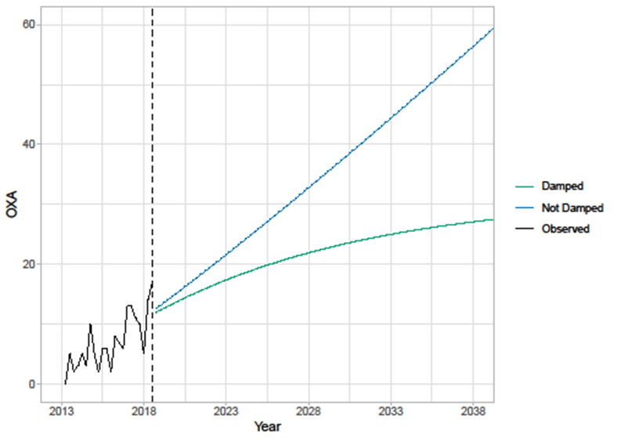
Estimating the patient population over time Results for Enterobacterales
Extrapolation of population size
(primary analysis – invasive isolates)
For both isolate types, persistent trend provided the best fit
Difference in extrapolations very large
largest population growth estimated for the screening isolates with a non-damped trend
smallest (non-constant) population growth was for the invasive isolates with a damped trend model
Visual evidence of a potential trend, however:
empirical evidence from literature shows that long-term forecasts from models with damped trend generally outperform similar models without damped trend
continual improvements to antimicrobial stewardship strategies may lead to reduced rate of resistance gain (favouring the damped trend model)
Long term estimates sensitive to choice of extrapolation → persistent growth and damped trend both considered in base case model
Notes:
Source: Cefiderocol report p145-148 and figure 14

Slide 67
Estimating the patient population over time Results for Pseudomonas
Model with no trend gave best statistical fit for both invasive isolates (primary analysis) and screening isolates (secondary analysis)
No visual evidence of a trend
No trend in population used in model – population remains at baseline value for full time horizon
Notes:
Source: Cefiderocol report p145-148 and figure 14

Slide 68
Consultation comments – Population growth trend
Consultee | Comment
Shionogi | Persistent growth model should be used for Enterobacterales because: Data used to inform the extrapolation (which excluded data after 2018) does not reflect impact of COVID-19, which is likely to have increased antimicrobial use and therefore resistance. Persistent growth model is a better fit to available time series data. EEPRU do not provide rationale for assuming increases would not persist into the future. Clinical experts consider it intuitively inaccurate to apply ‘damping’. Different growth trends for Enterobacterales and Pseudomonas is not justified: AMRHAI data shows resistance mechanisms to both pathogens are increasing over past decade

Slide 69
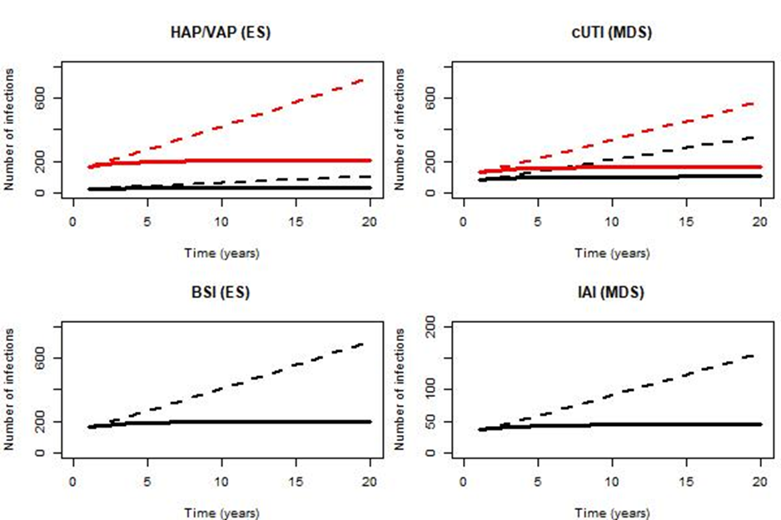
Estimating the population size over modelled time horizon
Population size over 20 years derived by applying year-on-year population growth to current annual population size
Population size estimates used to rescale estimate of patient-level incremental net health effects (INHEs) to population-level INHEs
4 scenarios used to model eligible population over time:
P1G1: baseline population based on PHE categorisation of infection sites, damped growth rate (most conservative)
P1G2: baseline population based on PHE categorisation of infection sites, growth rate not damped
P2G1: Baseline population based on clinical advisors’ categorisation of infection sites, damped growth rate
P2G2: Baseline population based on clinical advisors’ categorisation of infection sites, growth rate not damped (least conservative)
Differences in scenarios largely driven by assumptions about long term growth in infection numbers
Notes:
Source: Cefiderocol report p156-167 and figure 15

Slide 70
Estimating expected total drug usage of cefiderocol
Expected total drug usage for cefiderocol influences some of the scenarios relating to resistance emergence as it is expected that resistance increases with increased use of antimicrobial
Derived by adjusting the population size for the proportion eligible for treatment with cefiderocol:
In the empiric setting, all infections assumed to be eligible for empiric treatment.
In the microbiology-directed treatment setting, infections confirmed to have the relevant resistance mechanisms adjusted for the mean proportion of patients who were not susceptible to non-colistin/aminoglycoside-based treatments, but were susceptible to cefiderocol
Total number of patients initiating cefiderocol over 20 years
 | HAP/VAP | cUTI | BSI | IAI
Scenario P1G1 | 1,559 | 815 | 5,741 | 556
Scenario P1G2 | 2,487 | 1,057 | 9,218 | 726
Scenario P2G1 | 9,669 | 725 | 5,727 | 548
Scenario P2G2 | 14,032 | 1,027 | 9,196 | 714
Notes:
Source: Cefiderocol report p156-167 and Table 33

Slide 71
Estimating the patient population over time
1
2
3
How many patients currently eligible for treatment?
How will eligible population change over time?
How will rates of resistance to cefiderocoI and its comparators change over time?

Slide 72
Predicting resistance over time
AIM: Predict how rates of resistance to antimicrobials will change over time
1
2
3
Predict future rates of resistance to current practice (ie the comparators)
Predict future rates of resistance to cefiderocol
Predict the impact of reduced comparator use on resistance to comparators
Attempted an analysis using similar methods to estimating changes in population size, but sparse data to inform extrapolations
Evidence that resistance will develop to new antimicrobials as usage increases
Evidence mixed: reducing use of antimicrobials may increase, decrease or have no effect on resistance to them. Complicated by other drivers of resistance (use in other countries, use in animals etc.)
Several scenarios exploring different rates of resistance to cefiderocol incorporated into model (1–30%) – see subsequent slides
Scenario examining when comparator susceptibility is set to 0%
Not incorporated into model
Notes:
Source: Cefiderocol report p148-152

Slide 73
Consultation comments – Resistance to comparators
Consultee | Comment | EEPRU response
Pfizer | Resistance to all comparators should be modelled | Evidence on resistance to non-carbapenem antimicrobials was obtained from Public Health England. This was insufficient to suggest a trend EEPRU has done additional scenario analyses that include increased levels of resistance to comparator antimicrobials.
Shionogi / NHSE&I | Should model increased resistance to current treatments, including low probability event but high impact catastrophic scenarios where high levels of resistance emerge, making existing treatments ineffective.
APRHAI | National trends in resistance have not necessarily followed reduced usage, for example cephalosporins.

Slide 74
Scenario analysis to explore resistance to comparators
EEPRU assumes
Comparator antimicrobials completely ineffective - 0% susceptibility
No differences in safety between treatments, because EEPRU expects that if treatments become completely ineffective, clinicians will offer either safe antimicrobials or no treatment
Effectiveness of cefiderocol maintained long-term susceptibility of 90% - likely to overestimate benefits
These highly resistant pathogens are different from the pathogens in main analyses ie different population to the population in EEPRU’s base case model
Following parameters informed by expert opinion (n=1)
Other parameters set at the values for the high value clinical scenarios
Parameter | Base case value (scenario range)
Probability of emergence of highly resistant strains | 1% (0.5%–5%)
Time to event from beginning of model | 10 years (5–15 years)
Number patients affected in 1st year | 25 individuals (25–100)
Annual growth in number of infections from beginning of model | 20% (3%–30%)
Analysis time horizon | 50 years (20–50)
Do these assumptions detail a useful scenario for considering insurance value?

Slide 75
Scenario analysis on subgroup who cannot take colistin/aminoglycosides
EEPRU assumes
Lack of empiric evidence on the proportion of patients who would have salvage therapy despite being susceptible to colistin/aminoglycosides – Suggested plausible range: 20% to 40%
In empiric treatment, represent 20%-40% of population
In microbiology-directed, assumed that those not susceptible to non-colistin/aminoglycosides (35%) would be considered for colistin/aminoglycosides, so this subgroup represent 9% (Enterobacterales), 72% (Pseudomonas) and 40.5% (Stenotrophomonas) Following parameters used:
User defined parameter | Base-case
Probability of event (emergence of highly resistant strains) | 100%
Time of event (from now) | 0 years
The number of patients affected in the first year | 2 scenarios: SGSS vs clinical experts (slides 59-62)
The annual growth in the number of infections (from baseline) | Enterobacterales: 5.5% (damped) or 19.1% (persistent) Pseudomonas: 0% Stenotrophomonas: 2.7% (damped) or 9.5% (persistent)
Analysis time horizon (years) | 20

Slide 76
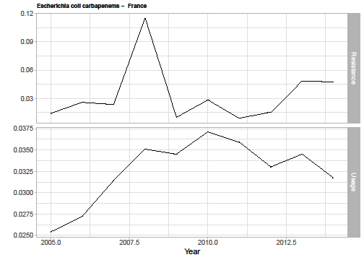
Data sources for estimating resistance to cefiderocol over time
Trends on resistance to cefiderocol available from PHE, but did not suggest any trend in resistance to cefiderocol over time → EEPRU use resistance data for established antimicrobials to predict how resistance to cefiderocol may change over time
Wide search for antimicrobial resistance data
Filtering of data to identify antimicrobial pathogen combinations most similar to cefiderocol
Data on resistance and usage over time used in analysis (example below for E.coli and carbapenems in France)
European Antimicrobial Resistance Surveillance Network (EARS-Net) – used for analysis
Included countries with data for:
Pathogens in high value clinical scenarios
Cephalosporins and carbapenems
≥5000 isolates
Low baseline resistance
Notes:
Source: Cefiderocol report p148-152 (and appendices 15-17)

Slide 77
Linking antibiotic use to resistance over time
Methods used to link usage to resistance
AutoRegressive Integrated Moving Average (ARIMA) time series model
Rationale for this approach, instead of other time-series models: can fit models to include covariate effects
Differential equation model not used as provided biased parameter estimates
Estimated impact of increasing antimicrobial use on resistance in the following year
Results (Pseudomonas aeruginosa):
Pseudomonas aeruginosa (n=7)
Significant association (n=4)
Positive association (n=3)
Negative association (n=1)
Data used:
23 pathogen-drug country combinations
Pseudomonas aeruginosa, carbapenems (n=7)
Escherichia coli, carbapenems (n=4)
Escherichia coli, cephalosporins (n=12)
Coefficients for association (range 1.07 to 10.11) used in economic model to reflect weak and strong associations. Similar process for Escherichia coli (results not shown)
Notes:
Source: Cefiderocol report p148-152 (and appendices 15-17)

Slide 78
Incorporating changes in resistance to cefiderocol into the economic model
Applying the strongest assumptions for changes in resistance over time to the estimated number of patients in the high value clinical scenarios treated with cefiderocol resulted in a small increase in resistance over 20 years
Enterobacterales – 0.04% over 20 years
Pseudomonas aeruginosa – 0.16% over 20 years
EEPRU considered this may be an underestimate – projections don’t account for cefiderocol use outside of UK and the relationship between usage and resistance is based on all tested isolates in community and hospital settings, whereas resistance may develop more quickly in the high value clinical scenarios
Performed scenario analyses using absolute increases in resistance bounded by the highest absolute increase (a projected 20 year increase of 33%)
EEPRU explored 4 assumptions in its base case model, of resistance reaching either 1%, 5%, 10% or 30% (the 30% scenario was considered extreme)

Slide 79
Consultation comments – PHE SGSS data limitations
SGSS data likely to underestimate patient numbers | SGSS data likely to overestimate patient numbers
Shionogi: Not all hospitals have microbiology laboratories Only 98% of existing laboratories provide data (Shionogi consider this to be optimistic, because reporting rates to the system that preceded SGSS were only 45-70% ) Data often incomplete Under-reporting further exacerbated by COVID pressures | BSAC/RCPath: Estimates based on lower respiratory tract samples will significantly overestimate incidence, because HAP/VAP is diagnosed using clinical and radiological results (not just cultures).

Slide 80
Estimating the population over time – key questions
Is the true size of the eligible population closer to estimates using PHE’s categorisation (conservative) or the clinical advisers’ categorisation (resulting higher estimates of population size)?
Is growth in the eligible Enterobacterales population mostly in the short-term (‘damped trend’) or will it persist over time?
Is it reasonable to assume no growth in the eligible Pseudomonas population over time? What is the likely magnitude of any uncaptured value in the QALY estimates?
What is the likely increase in resistance to cefiderocol over the 20-year time horizon? 1/5/10/30%?
Is resistance to comparator antimicrobials likely to change over time? In what direction?

Slide 81
EEPRU model results
Per-patient results

Slide 82
Patient level model – Comparator pathway in empiric setting
3 possible pathways modelled in empiric to microbiology-directed setting:
ES1: Cefiderocol empiric setting + existing treatments in microbiology-directed setting
ES2: existing therapies in both empiric setting and microbiology-directed setting
ES3: existing therapies in empiric setting + cefiderocol in microbiology-directed setting
Empiric treatment | Microbiology-directed treatment (if indicated in the microbiology-directed setting)
Cefiderocol (ES1) | Existing therapies
Non-colistin or aminoglycoside-based (ES2nca) | Existing therapies
Colistin or aminoglycoside-based (ES2ca) | Existing therapies
Non-colistin or aminoglycoside-based (ES3nca) | Cefiderocol
Colistin or aminoglycoside-based (ES3ca) | Cefiderocol

Slide 83
Per-patient base case results (probabilistic): HAP/VAP, empiric setting Enterobacterales
 | Incremental results
 | ES1 vs ES2ca | ES1 vs ES3ca
Patients with MBL Enterobacterales (‘correctly suspected’)
Total costs | £4,570 | £4,591
Life years | 0.06 | 0.06
QALYs | 0.04 | 0.04
Per person NHE (QALYs) | -0.188 | -0.191
Patients without MBL Enterobacterales (‘wrongly suspected’)
Total costs | -£304 | -£304
Life years | 0.28 | 0.28
QALYs | 0.19 | 0.19
Per person NHE (QALYs) | 0.209 | 0.209
All patients in empiric setting (weighted average of correctly and wrongly suspected)
Total costs | £447 | £451
QALYs | 0.17 | 0.17
Per person NHE (QALYs) | 0.148 | 0.147
Cefiderocol associated with QALY benefit overall (≈0.148 QALYs)
NB Cefid is not compared to non-colistin/aminoglycoside therapy in emipric setting for MBL Enterobacterales
QALY loss in patients ‘correctly suspected’ of having MBL Enterobacterales (≈–0.19 QALYs)
Cefid had higher costs vs colistin /aminoglycoside therapy due to lower susceptibility and longer hospital length of stay
QALY benefit in patients wrongly suspected of having MBL Enterobacterales
Cefiderocol had similar susceptibility but improved safety compared with colistin/aminoglycoside therapy, resulting in lower mortality and AKI-related costs.
Source: EEPRU’s report addendum 2, table 3
NHE = net health effect (measured in QALYs)
QALYs = quality-adjusted life-years

Slide 84
Per-patient base case results (probabilistic): HAP/VAP and cUTI, microbiology-directed setting (MDS), Enterobacterales
Cefiderocol benefits smaller in microbiology-directed setting than in the empiric setting, because once susceptibility results are known, many patients (65%) treated with a non-colistin/aminoglycoside-based option to which they are susceptible and do not receive cefiderocol.
Benefits of cefiderocol driven by avoiding safety issues of colistin and aminoglycosides in patients susceptible to these agents (7% of the microbiology-directed setting patients).
 | MDS pathway with cefiderocol | MDS pathway without cefiderocol | Incremental values
HAP/VAP
Total costs | £37,297 | £37,457 | -£117
Life years | 2.69 | 2.68 | 0.02
QALYs | 1.89 | 1.87 | 0.02
Per person NHE | 0.024 | 0.003 | 0.021
cUTI
Total costs | £20,152 | £20,261 | -£108
Life years | 3.71 | 3.69 | 0.02
QALYs | 2.61 | 2.59 | 0.02
Per person NHE | 1.599 | 1.579 | 0.021
Source: EEPRU’s report addendum 2, table 5
NHE = net health effect (measured in QALYs)
QALYs = quality-adjusted life-years

Slide 85
Per-patient base case results (probabilistic): HAP/VAP, empiric setting Pseudomonas
 | Incremental results
 | ES1 vs ES2nca | ES1 vs ES2ca
Patients with MBL Pseudomonas (‘correctly suspected’)
Total costs | -£12,589 | -£32
Life years | 0.66 | 0.26
QALYs | 0.47 | 0.18
Per person NHE (QALYs) | 1.094 | 0.184
Patients without MBL Pseudomonas (‘wrongly suspected’)
Total costs | -£10 | -£339
Life years | 0.00 | 0.28
QALYs | 0.00 | 0.19
Per person NHE (QALYs) | 0.00 | 0.211
All patients in empiric setting (weighted average of correctly and wrongly suspected)
Total costs | -£1,770 | -£296
QALYs | 0.07 | 0.19
Per person NHE (QALYs) | 0.153 | 0.207
Cefiderocol associated with QALY benefit overall (0.153–0.207)
Versus non-colistin/aminoglycoside based:
No QALY gain in patients wrongly suspected of having MBL Pseudomonas due to similar safety and susceptibility profile
QALY gain in patients ‘correctly suspected’ of having MBL Pseudomonas, driven by large susceptibility improvement
Versus colistin/aminoglycoside based:
QALY gain in both patients with and without MBL Pseudomonas, driven by safety improvement
Source: EEPRU’s report addendum 2, table 7
NHE = net health effect (measured in QALYs)
QALYs = quality-adjusted life-years

Slide 86
Per-patient base case results (probabilistic): HAP/VAP and cUTI, microbiology-directed setting (MDS), Pseudomonas
The advantages of cefiderocol are relatively high in patients with MBL Pseudomonas aeruginosa as most patients are only susceptible to colistin/aminoglycoside-based treatment
Benefits of cefiderocol driven by avoiding safety issues of colistin and aminoglycosides in patients susceptible to these agents (71% of the microbiology-directed setting patients).
 | MDS pathway with cefiderocol | MDS pathway without cefiderocol | Incremental values
HAP/VAP
Total costs | £36,987 | £37,563 | -£576
Life years | 2.69 | 2.52 | 0.18
QALYs | 1.89 | 1.177 | 0.12
Per person NHE | 0.043 | -0.108 | 0.151
cUTI
Total costs | £19,848 | £20,434 | -£586
Life years | 3.72 | 3.55 | 0.17
QALYs | 2.61 | 2.49 | 0.12
Per person NHE | 1.618 | 1.471 | 0.147
Source: EEPRU’s report addendum 2, table 9
NHE = net health effect (measured in QALYs)
QALYs = quality-adjusted life-years

Slide 87
Assumptions driving the results of patient-level economic model
For HAP/VAP in empirical setting, main areas of uncertainty relate to:
probability an individual have MBL Enterobacterales and MBL Pseudomonas aeruginosa,
the different scenarios on estimates of relative effectiveness (informed by NMA of susceptibility studies)
long-term survival following discharge from hospital.
For HAP/VAP and cUTI in microbiology-directed setting, main areas of uncertainty relate to:
the different scenarios on estimates of relative effectiveness (informed by NMA of susceptibility studies)
the impact of colistin/aminoglycoside-based therapy on acute kidney injury (AKI) risk and its long-term implications
long-term survival following discharge from hospital.

Slide 88
EEPRU model results
Population results

Slide 89
EEPRU was unable to select a base case for population-level results and present several different approaches
Assumptions
PHE categorisation of infection sites
Short-term population growth (‘damped trend’)
30% increase in resistance to cefiderocol
Clinician classification of infection sites
Persistent population growth
1% increase in resistance to cefiderocol
Less QALYs (896)
Base case analysis
More QALYs (3,559)
Less QALYs (–132 to 1,990)
Probabilistic sensitivity analysis (no cefiderocoI resistance)
More QALYs
(–163 to 6,652)

Slide 90
Total net health benefits (QALYs) across 20 years of usage - Overview of results
QALY ranges bound by highest estimate of increase in resistance to cefiderocol (30%) and lowest estimate (1%)
Alternative base case assumptions |  |  | Incremental net health effect (QALYs)
Baseline population | Population growth rate | Patients initiating cefiderocol | HAP/VAP | cUTI | BSI | IAI | Total
PHE categorisation of infection sites | Short-term (‘damped trend’) P1G1 | 8,671 | 131-162 | 122-147 | 562-686 | 81-98 | 896-1,093
 | Persistent growth P1G2 | 13,488 | 193-247 | 158-195 | 836-1,053 | 104-130 | 1,291-1,625
Clinical advisors’ categorisation of infection sites | Short-term (‘damped trend’) P2G1 | 16,669 | 1,322-1,592 | 99-123 | 562-686 | 81-98 | 2,064-2,499
 | Persistent growth P2G2 | 24,969 | 1,785-2,203 | 136-173 | 836-1,053 | 104-130 | 2,861-3,559
Note: Growth rates apply to Enterobacterales and Stenotrophomonas infections only. No growth assumed for Pseudomonas population in all scenarios
Notes:
Source: EEPRU assessment report addendum 2, Table 11

Slide 91
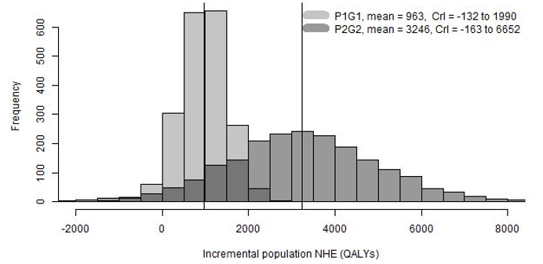
The uncertainty around results was examined using a probabilistic sensitivity analysis
Distribution of total population-level INHEs of cefiderocol (2,000 simulations) - based on most conservative and optimistic assumptions, under assumption of no resistance emergence to cefiderocol
P1G1 | mean = 963, range –132 to 1,990
P2G2 | mean = 3,246, range –163 to 6,652
P1G1: baseline population (point estimate) based on PHE categorisation of infection sites, growth rate damped (uncertain)
P2G2: baseline population (point estimate) based on clinical advisors’ categorisation of infection sites, growth rate not damped (uncertain)
Right hand side of distribution may capture low probability high cost scenarios (ie insurance value)
Notes:
Source: EEPRU assessment report addendum 2, Figure 6

Slide 92
Main areas of uncertainty: probability patient has pathogen & relative effectiveness estimates
Scenario | Base case assumption | Scenario assumption | INHE (QALYs)
Base case |  |  | 1,100-3,583
Probability pathogen | Probability patient has MBL Enterobacterales (15%) or Pseudomonas (14%) (PHE SGSS data) | Probability = 30% (hypothetical) | 880-3,041
Probability pathogen | Probability patient has MBL Enterobacterales (15%) or Pseudomonas (14%) (PHE SGSS data) | Probability = 50% (hypothetical) | 551-2,145
Probability pathogen | Probability patient has MBL Enterobacterales (15%) or Pseudomonas (14%) (PHE SGSS data) | Probability = 71% (based on BSAC survey data, n=9 respondents) | 420-1,785
NMA scenario 1 | Susceptibility based on NMA of EUCAST studies + PHE data | Susceptibility based on NMA of CLSI studies | 1,001-2,823
NMA scenario 3 | Susceptibility based on NMA of EUCAST studies + PHE data | Susceptibility based on PHE data + cefiderocol and fosfomycin arms from CLSI studies | 1,111-3,010
NMA scenario 4 | Susceptibility based on NMA of EUCAST studies + PHE data | Susceptibility based on NMA of EUCAST studies with absolute colistin susceptibility from SIDERO WT | 1,185-4,042
Results also sensitive to assumptions about AKI risk (absolute risk and increased risk with colistin/aminoglycosides), and the short and long-term consequences of AKIs. Across these scenarios, INHE varied between 889 and 4,864
INHE: incremental net health effect (range reflects lowest & highest population size, assuming no cefiderocol resistance)
Notes:
Source: EEPRU assessment report addendum 2, Table 12

Slide 93
EEPRU’s scenario results: value of being prepared for emergence of resistance Patient-level incremental net benefits by infection site and setting
Scenario hypothesises emergence of new resistant pathogen susceptible only to cefiderocol and not to any comparator therapies
Increase highest in the microbiology-directed setting as all patients benefit from cefiderocol
In empiric setting, only a proportion of people have the suspected pathogen-mechanism
 | Base-case | New scenario
HAP/VAP Empiric setting | Enterobacterales: 0.147 (ca) Pseudemonas: 0.153 (nca); 0.207 (ca) | 0.280
HAP/VAP Microbiology directed setting | Enterobacterales: 0.021 Pseudemonas: 0.151 | 1.031
cUTI Microbiology directed setting | Enterobacterales: 0.021 Pseudemonas: 0.147 | 1.032
ca, colistin/aminoglycosides; cUTI, complicated urinary tract infection; HAP/VAP, hospital acquired pneumonia/ventilator associated pneumonia; nca, non-colistin/aminoglycosides

Slide 94
EEPRU’s scenario results: value of being prepared for emergence of resistance Population-level incremental net benefit for most influential infection site and setting: cUTI in microbiology directed setting
Base case (blue box) and scenarios | Probability of event | 1% | 0.5% | 5% | 1% | 1% | 1% | 1% | 1% | 1%
 | Event date (years from now) | 10 | 10 | 10 | 5 | 15 | 10 | 10 | 10 | 10
 | Annual population size in year 1 | 25 | 25 | 25 | 25 | 25 | 100 | 25 | 25 | 25
 | Population growth (annual, from baseline) | 20% | 20% | 20% | 20% | 20% | 20% | 3% | 30% | 20%
 | Time horizon | 50 | 50 | 50 | 50 | 50 | 50 | 50 | 50 | 20
Results | Total number of patients | 4,720 | 4,720 | 4,720 | 6,195 | 3,245 | 18,880 | 1,388 | 6,680 | 145
 | Total incremental net health benefit in QALYs conditional on event occurring | 1,460 | 1,460 | 1,460 | 2,180 | 870 | 5,839 | 452 | 2,053 | 79
 | Expected incremental net health benefit QALYs | 14.6 | 7.3 | 73.0 | 21.8 | 8.7 | 58.4 | 4.5 | 20.5 | 0.8
Is the base case estimate plausible?

Slide 95
Scenario analysis on subgroup who cannot take colistin/aminoglycosides
Population-level benefits compared to base-case are higher in microbiology-directed than empiric setting because the benefit of cefid in patients who cannot take colistin is higher
EEPRU considers results may overestimate total benefits because
20%-40% high compared to EEPRU’s advisers estimates
Scenario assumes comparable outcomes in patients who can and cannot take colistin
Scenario assumes contraindicated to colistin and aminoglycosides, concern mostly about colistin only
 | HAP/VAP | cUTI | BSI | IAI | Total
0% of patients cannot take colistin/aminoglycosides (base-case)*
Enterobacterales | 79-775 | 28-59 | 448-764 | 23-36 | 856-2,995
Pseudomonas | 12-185 | 19-31 | 28-28 | 22-22
Stenotrophomonas | 48-925 | 57-64 | 48-72 | 32-46
20% of patients cannot take colistin/aminoglycosides
Enterobacterales | 115-1,207 | 50-143 | 677-1,198 | 46-78 | 1,616-5,566
Pseudomonas | 17-274 | 31-57 | 45-45 | 49-49
Stenotrophomonas | 191-2,003 | 148-207 | 134-201 | 219-330
40% of patients cannot take colistin/aminoglycosides
Enterobacterales | 150-1,639 | 73-226 | 906-1,632 | 68-119 | 2,383-8,138
Pseudomonas | 22-363 | 44-83 | 61-61 | 76-76
Stenotrophomonas | 334-3,081 | 246-349 | 219-330 | 145-217
Ranges represent 2 scenarios regarding population size and growth: PHE+damped, clinical experts+ persistent
* In base-case, resistance to cefiderocol assumed to increase by 1% over 20 years. Assumption not applied here

Slide 96
Additional elements of value

Slide 97
Additional elements of value
Several elements of value that are particularly important for or unique to antimicrobials,
Spectrum value – Benefits of a new antimicrobial replacing broad spectrum antimicrobials, reducing problems associated with their overuse
Transmission value – Benefits of a new antimicrobial reducing the rate of transmission of a given pathogen from patients treated with that product to other individuals, potentially reducing the rate of resistant infection.
Enablement value – Benefits of additional medical procedures being possible as a result of new antimicrobials being available to manage otherwise resistant infections with few alternative treatment options
Diversity value – Benefits of new antimicrobials adding to the range of treatments currently available, potentially reducing selection pressure on and resistance to other available treatments
Insurance value – Benefits of reserving a new antimicrobial until resistance eliminates current alternatives as options or as insurance against a catastrophic emergence of widespread multi drug resistant infections
Notes:
Source: Cefiderocol report p167 and table 44

Slide 98
Taking account of additional elements of value
At outset of evaluation it was clear that these elements of value may not be fully captured in the model
The following slides summarise the assessment groups considerations regarding:
The extent to which the element of value has been captured in the economic model
The expected impact of each element of value on population net health benefits if not captured in the model
The degree of uncertainty around the magnitude of population net health benefit associated with each element of value
The views of consultees on whether each element of value has been captured are also noted
Other benefits which may not have been captured in the model have also been summarised
Notes:
Source: Cefiderocol report p167 and table 44

Slide 99
Spectrum Value
Benefits of a new antimicrobial replacing broad spectrum antimicrobials, reducing problems associated with their overuse
Potential source of additional benefit | Included in AG model? | Rationale for excluding/additional comment if included
Reduced colonisation with drug-resistant bacteria, leading to reduced drug-resistance of future infections | No | Cefiderocol has a broad spectrum of activity → clinical advisers and other stakeholders did not consider spectrum value to be a key driver of incremental population benefits
Is spectrum value relevant? If it is, has spectrum value been adequately captured in the QALY estimates? What is the magnitude of any uncaptured benefits?
Notes:
Source: Cefiderocol report p200-204 and table 45

Slide 100
Transmission Value
Benefits of a new antimicrobial reducing the rate of transmission of a given pathogen from patients treated with that product to other individuals, potentially reducing the rate of resistant infection
Potential source of additional benefit | Included in AG model? | Rationale for excluding/additional comment if included
Reduced number of resistant infections | No | Challenging to model: drivers of transmission are broad, with countervailing effects (↓ length of hospital stay → ↓ transmission, but cefiderocol could ↑ hospital stay by reducing mortality in patients with poor prognosis) and driven by transmission beyond high value clinical scenarios. Clinical advisers indicated transmission value isn’t a key driver of incremental benefits, because cefiderocol has small impact on hospital stay (↓ by <1 day), and treatment doesn’t eradicate colonisation.
Is cefiderocol likely to eradicate gut colonisation?
Has transmission value been adequately captured in the QALYs estimates?
What is the magnitude of any uncaptured benefits?
Notes:
Source: Cefiderocol report p200-204 and table 45

Slide 101
Enablement Value (1 of 2)
Benefits of additional medical procedures being possible as a result of new antimicrobials being available to manage otherwise resistant infections with few alternative treatment options
Potential source of additional benefit | Included in AG model? | Rationale for excluding/additional comment if included
Improved treatment of post-operative infections | Yes
Improved treatment of pre-operative infections | Partially | Partially quantified in HVCSs and extrapolation to expected usage. All patients who survive >30 days experience same survival outcomes, however patients whose infections are resolved quicker may benefit from having operations earlier.
Increasing the number of procedures that can go ahead (eg for patients for whom existing treatments are not an option) | No | EEPRU considers enablement value could be a driver of key incremental benefits if risk of multi-drug-resistant infection or clinicians' ability to treat these infections influences their decision to bring a patient in for a procedure (eg myeloma patients with renal impairment could not be treated with colistin), but did not model because of the uncertainty in the number of affected patients and consequences for patients not receiving planned therapy
Notes:
Source: Cefiderocol report p200-204 and table 45

Slide 102
Enablement Value (2 of 2)
Benefits of additional medical procedures being possible as a result of new antimicrobials being available to manage otherwise resistant infections with few alternative treatment options
Potential source of additional benefit | Included in AG model? | Rationale for excluding/additional comment if included
Ability to keep wards open during an outbreak | No | EEPRU considered it unlikely that cefiderocol will have this effect as most patients have alternative treatment options available.
Reduced use of resources enabling procedures and healthcare for other patients | Yes | Where possible the impact of cefiderocol on resource use has been captured. When calculating population incremental net health benefit, cost savings have been concerted to health benefits using standard measures of health opportunity cost.
Has enablement value been adequately captured in the QALYs estimates?
What is the magnitude of any uncaptured benefits?
Notes:
Source: Cefiderocol report p200-204 and table 45

Slide 103
Consultation comments – Spectrum, transmission and enablement value
Consultee | Comment | EEPRU response
Spectrum value |  | Main areas of uncertainty are enablement value and transmission value, with the magnitude of the former likely to be greater than the latter, but both are highly uncertain.
Shionogi | EEPRU have underestimated value. Evidence for minimal/reduced impact on gut microbiota
Transmission value
Shionogi | Counter-intuitive and contradictory to assume that an antibiotic that improves infection management will not have transmission value
Enablement value
Shionogi | Key enablement from facilitating broader functioning of the health system, particularly in potential high resistance future scenarios, is a key element of missing value

Slide 104
Diversity Value
Benefits of a new antimicrobial replacing broad spectrum antimicrobials, reducing problems associated with their overuse
Potential source of additional benefit | Included in AG model? | Rationale for excluding/additional comment if included
Replacing broad spectrum antimicrobials with narrow spectrum antimicrobials | No | Within HVCS: Clinical advisors indicated that diverse prescribing strategies unlikely to be appropriate given lack of safe and effective alternative treatments. Outside HVCS: Clinical advisors not supportive of cefiderocol use in broader populations as part of diverse prescribing strategies due to desire to reduce emergence of resistance to cefiderocol. Also uncertainty about how reduced use of existing agents due to availability of cefiderocol will impact resistant to these drugs
Has diversity value been adequately captured in the QALYs estimates?
What is the magnitude of any uncaptured benefits?
Notes:
Source: Cefiderocol report p200-204 and table 45

Slide 105
Consultation comments – Diversity value
Consultee | Comment | EEPRU response
Shionogi | Argument that diversity will result in a net zero benefit due to countervailing effects (length of stay reduction vs increase in transmission from life extension) suggests no diversity value. | Stewardship policies with relatively low usage in the short term are modelled by EEPRU. In principle, this strategy helps to preserve the effectiveness of available antimicrobials to the emergence of greater numbers of patients with challenging pathogens and resistance mechanisms in the future.
Pfizer | Incorporating diversification prolongs the efficacy of existing antimicrobials, and introducing a new antimicrobial increases the effectiveness of diversification. Current EEPRU model does not assess the diversity value of novel antibiotics.
BSAC and RCPath | NHS Trusts are put under pressure to avoid prescribing carbapenems

Slide 106
Insurance Value
Benefits of reserving a new antimicrobial until resistance eliminates current alternatives as options or as insurance against a catastrophic emergence of widespread multi drug resistant infections
Potential source of additional benefit | Included in AG model? | Rationale for excluding/additional comment if included
Restricting usage of cefiderocol to preserve efficacy in the long term | Yes | Quantified in high value clinical scenarios – scenarios modelled reflect restricting usage
Avoidance for catastrophic health losses | Yes | Quantified in high value clinical scenarios (presented as distributions of population level net health benefits from the probabilistic sensitivity analysis) – but may be valued differently by society
Has insurance value been adequately captured in the QALYs estimates?
What is the magnitude of any uncaptured benefits?
Notes:
Source: Cefiderocol report p200-204 and table 45

Slide 107
Consultation comments – Insurance value
Consultee | Comment | EEPRU response
Shionogi | Value of avoiding and/or managing low probability but high consequence ‘catastrophic’ outbreaks of resistant infections is missed and therefore overall value underestimated | Insurance value is not captured in the base case model given the profound uncertainty regarding these future developments. EEPRU has done additional scenario analyses.
Pfizer | There are well-established insurance modelling techniques which could capture value of new antibiotics in mitigating future probabilistic events - this value would likely need to be considered collectively across the antibiotic spectrum.

Slide 108
Summary of additional source of value
Value | Potential source of additional benefit | Driver of benefit of cefiderocol | Included in EEPRU model | Source of uncertainty*
Spectrum | Reduced colonisation with drug-resistant bacteria, leading to reduced drug-resistance of future infections | No | No | No
Transmission | Reduced number of resistant infections | No | No | Yes
Enablement | Improved treatment of post-operative infections | Yes | Yes | No
Enablement | Improved treatment of pre-operative infections | Yes | Partially | Yes
Enablement | Increasing the number of procedures that can go ahead | Yes | No | Yes
Enablement | Ability to keep wards open during an outbreak | No | No | No
Enablement | Reduced use of resources enabling procedures and healthcare for other patients | Yes | Yes | No
Diversity | Replacing broad spectrum antimicrobials with narrow spectrum antimicrobials | No | No | Yes
Insurance | Restricting usage of cefiderocoI to preserve efficacy in the long term | Yes | Yes | Yes
Insurance | Avoidance for catastrophic health losses | Yes | Yes | Yes
*If included, EEPRU consider there is uncertainty in their assumptions. If not included, EEPRU considers

Slide 109
Considerations for apportioning value to the contract period

Slide 110
Total value and contract duration
The HTA estimates total value of the antimicrobial to the NHS in England, over a 20-year horizon
Contract duration: 10 years
What proportion of the total value should be assigned to the 10-year period?

Slide 111
Option 1: assign 100% of the total value to the contract duration
Advantages | Disadvantages
Easiest option | No economic rationale to pay for the drug after year 10
Provides the greatest reward to company and therefore most likely to support the delivery of a “pull incentive” | NHS likely to end up paying >100% of value if drug is used beyond contract period
May be appropriate if the Committee considers there to be additional benefits not captured in the health economic analyses

Slide 112
Option 2: assign <100% of the total value to the contract duration
Advantages | Disadvantages
Reserves some of the value for the post-contract period of use when normal market mechanisms will apply | Unclear what the appropriate percentage should be that should be rewarded
Lowers risk that the NHS will end up paying >100% of the total value over the period the drug (and future generics) will be on the UK market | Might not provide a sufficiently attractive reward for company (especially if total contract value ends up being lower than what they would be expected to make under normal market mechanisms)
 | May exacerbate under valuing INHB in the contract period if there are additional benefits not captured in the health economic analyses

Slide 113
What do the assessment reports tell us?
Across scenarios, the proportion of value accruing in the first 10 years is 41-65% for CAZ-AVI and 41-58% for cefiderocol
Scenarios where resistance increases more slowly see lower proportions of value accrue to the first 10 years
For other drugs (not AMs) where usage is expected to be stable over time, the proportion of value accruing in the first 10 years is 59%
Value accruing in first 10 years of the AMs therefore is lower than for other drugs under normal market mechanisms
Policy aim of the project is to provide a ‘pull incentive’ – reward should therefore be at least as attractive as those typically received for other drugs

Slide 114
Potential approach
To ensure that the antibiotics are treated at least as favourably as other drugs, the Committee should assign a minimum of 60% of the value to the 10 year contract period
To support a meaningful pull incentive, the Committee may wish to increase the proportion of the total value assigned to the contract period – so >60%
If the Committee considers that there may be uncaptured value even in its best estimate of INHB, the Committee could decide to assign 100% of the estimated INHB to the 10 year contract period.

Slide 115
© NICE [insert year]. All rights reserved. Subject to Notice of rights.

