Slide 1

NICE quality standard:
Care and support for people growing older with learning disabilities

Slide 2
What is this quality standard about?
How to make services work better for people with learning disabilities as they grow older.

Slide 3

What will it cover?
How staff and services find out what kinds of help and support people need.

Slide 4

What will it cover?
How staff and services support people to make their own decisions and to speak up.

Slide 5
What will it cover?
How staff and services support people to continue doing things they enjoy doing.

Slide 6



What evidence will we use?
We will use Care and support of people growing older with learning disabilities NICE guideline NG96.

Slide 7


We would like to hear your views!
What needs to change the most?
How can services be made better for people with a learning disability as they get older?
What would make the biggest difference?

Slide 8
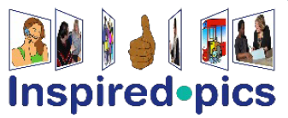
Credits
Artwork includes material from the Inspired EasyRead Collection and cannot be used anywhere else without written permission from Inspired Services.
www.inspired.pics

