Slide 1
Futibatinib for previously treated advanced cholangiocarcinoma with FGFR2 fusion or rearrangement
Slides for public – redacted
Technology appraisal committee C [02 July 2024] – PART 1
Chair: Stephen O’Brien
Lead team: Satish Venkateshan, Stella O’Brien, Mike Chambers
External assessment group: Kleijnen Systematic Reviews (KSR)
Technical team: Anna Willis, Caron Jones, Ross Dent
Company: Taiho
© NICE 2024. All rights reserved. Subject to Notice of rights.

Slide 2
Futibatinib for previously treated advanced cholangiocarcinoma with FGFR2 fusion or rearrangement
Background and key issues
Treatment pathway and clinical effectiveness
Modelling and cost effectiveness
Other considerations
Summary

Slide 3
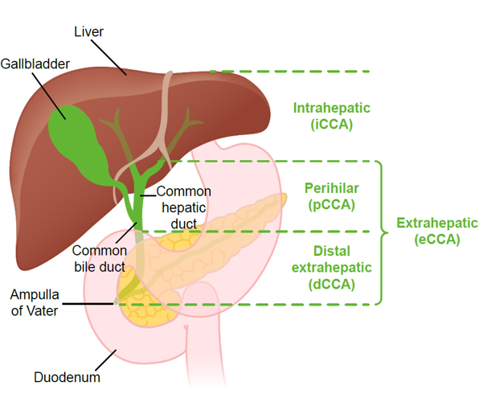
Cholangiocarcinoma
Background
Cholangiocarcinoma (CCA) is a rare cancer of the biliary tract: classified as intrahepatic (iCCA) or extrahepatic (eCCA)
Proportion of iCCA cases estimated as 10%-74%
Fibroblast growth factor receptor 2 (FGFR2) alterations occur in up to 15% of iCCAs
Epidemiology
England per year: ~2,800 adults diagnosed with cholangiocarcinoma equating to an estimated age-adjusted incidence rate of 4.3 per 100,000
Symptomology
Often asymptomatic but can include jaundice, itchy skin, weight loss, abdominal pain, fatigue and fever
Figure 1: Classification of CCA
Notes:
Source: Company submission and NICE final scope

Slide 4
Perspectives on living with CCA
“opportunity for those with this particular fusion to have a further treatment [if] resistance [develops to] first targeted therapy.”
Submissions from the patient expert and AMMF – The Cholangiocarcinoma Charity
People living with CCA have unmet needs for:
Earlier diagnosis before the cancer is inoperable, current diagnosis is at late stage with limited overall survival
Timely molecular profiling and multidisciplinary care at ‘centres of expertise’
Greater range of effective treatment options that improve what is currently a very poor quality of life and to extend life
Generic FOLFOX comes with unpleasant side effects and the inconvenience of drug administration
Optimism that futibatinib works differently to pemigatinib through irreversible binding, and may produce more durable responses and reduced resistance
Acceptance of potential side-effects for benefit of targeted options
“Serious side effects appear to be similar [between pemigatinib and futibatinib], however nail disorders are common with futibatinib, this can be psychologically disturbing.”
Abbreviations: AMMF, Alan Morement Memorial Fund; CCA, cholangiocarcinoma; FOLFOX, folinic acid, fluorouracil and oxaliplatin.
7

Slide 5
Clinical perspectives
Submissions from Cholangiocarcinoma UK and The Royal College of Pathologists
Prognosis for people with CCA who cannot have curative surgery is poor
There is a need for treatments that increase the quality of life and survival
Guidelines recommend the use of FGFR2 inhibitors (such as pemigatinib) for FGFR fusion positive CCA
Futibatinib would be used as an alternative to pemigatinib or “in cases where resistance to pemigatinib has developed”
No additional FGFR2 fusion testing would be required as this should already be undertaken
Convenient oral therapy with manageable toxicities
Use outside of experienced centres should be limited until greater understanding of testing and novel toxicities is established
Abbreviations: CCA, cholangiocarcinoma; FGFR, fibroblast growth factor receptor.

Slide 6
Futibatinib (Lytgobi, Taiho)
CONFIDENTIAL
Marketing authorisation | Futibatinib received an MHRA marketing authorisation in August 2023 for: “the treatment of adult patients with locally advanced or metastatic CCA with an FGFR2 fusion or rearrangement that have progressed after at least one prior line of systemic therapy”
Mechanism of action | FGFR1-4 inhibitor Reduces tumour cell proliferation and increases cell death in tumours with FGFR1-4 genetic aberrations
Administration | Recommended dose – 20mg once daily orally, dose may be reduced for the management of toxicities
Price | List price per pack ******** per pack ******************************* List price for 12 months of continuous treatment ******** A simple discount patient access scheme (PAS) is in place for futibatinib
Abbreviations: CCA, cholangiocarcinoma; FGFR, fibroblast growth factor receptor; MHRA, Medicines & Healthcare products Regulatory Agency.

Slide 7
Issues
See appendix: Other issues
# | Issue | ICER impact
Key issues for discussion
1 | Comparators – is modified FOLFOX a comparator? | Unknown
2 | a) Efficacy of futibatinib versus pemigatinib | Large
 | b) Proportional hazards assumption | Large
 | c) Curve/model selection | Large
3 | Modelling of time on treatment (ToT) | Large
4 | Severity modifier | Moderate
Other issues
5 | Generalisability of FOENIX-CCA2 – literature search | Unknown
6 | Generalisability of FOENIX-CCA2 – subgroup analysis and effect modifiers | Unknown
7 | Further subgroup analysis | Unknown
8 | Model verification | Unknown
Abbreviations: FOLFOX, folinic acid, fluorouracil and oxaliplatin; ICER, incremental cost-effectiveness ratio.

Slide 8
Futibatinib for previously treated advanced cholangiocarcinoma with FGFR2 fusion or rearrangement
Background and key issues
Treatment pathway and clinical effectiveness
Modelling and cost effectiveness
Other considerations
Summary

Slide 9
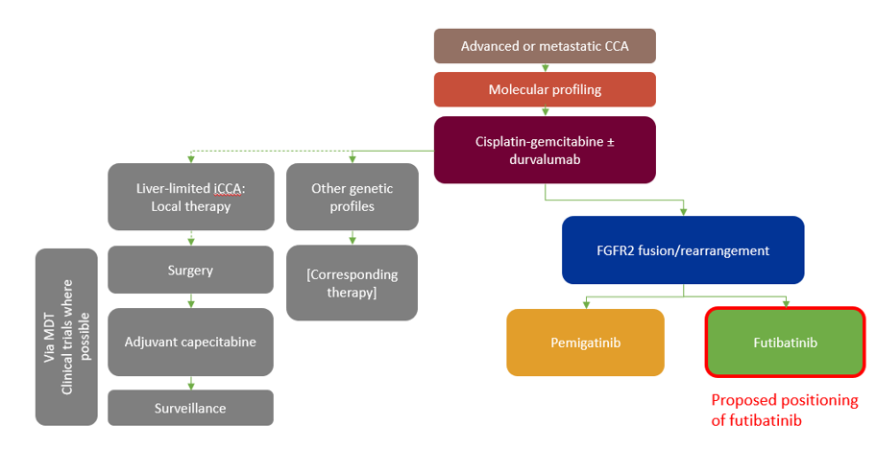
Treatment pathway and proposed positioning of futibatinib – company submission
See appendix: Decision problem
Figure 1: Treatment pathway for CCA, adapted from the ESMO 2022 guidelines, including the proposed positioning of futibatinib – CS Figure 4
Appropriate drug
Modified FOLFOX?
TA722
Abbreviations: CCA, cholangiocarcinoma; CS, company submission; ESMO, European Society for Medical Oncology; FGFR, fibroblast growth factor receptor; FOLFOX, folinic acid, fluorouracil and oxaliplatin; MDT, multidisciplinary team; TA, technology appraisal.
Notes:
Source: Company submission, Figure 4.

Slide 10
Key issue 1: Comparators – is modified FOLFOX a comparator?
Background
Comparators in the final NICE scope include pemigatinib, modified FOLFOX (folinic acid, fluorouracil and oxaliplatin) and best supportive care (BSC)
Company
Pemigatinib is the only relevant comparator as it is the only FGFR2 targeted treatment
This is supported by ESMO 2022 and BSG 2023 guidelines and clinical expert opinion
EAG comments
Agrees with omission of BSC, however modified FOLFOX should be included as a comparator as it may still be used in this group
If pemigatinib and futibatinib were considered equally effective and futibatinib less costly, this is not an issue as TA722 found pemigatinib CE versus modified FOLFOX
NHSE
If recommended by NICE, futibatinib would be an alternative to pemigatinib
Pemigatinib is the only comparator included in NHSE’s budget impact analysis
Abbreviations: BSG, British Society of Gastroenterology; CE, cost effective; ESMO, European Society for Medical Oncology; FGFR, fibroblast growth factor receptor; NHSE, NHS England; TA, technology appraisal.
Is modified FOLFOX a comparator?

Slide 11
Key clinical trials
 | FOENIX-CCA2 (futibatinib) N=103 | FIGHT-202 (pemigatinib) N=108*
Design | Open-label, single arm, phase 2 study | Open-label, single arm, phase 2 study
Population | Adults with locally advanced, metastatic, unresectable iCCA with FGFR2 gene fusions or other FGFR2 rearrangements treated with at least one prior systemic gemcitabine and platinum-based chemotherapy | Adults with advanced/metastatic or surgically unresectable CCA with FGFR2 translocation that has progressed after at least 1 previous treatment
Duration | Median follow up 25 months | Median follow up 42.9 months
Outcomes | Primary: Objective response rate Secondary: OS, PFS and others | Primary: Objective response rate Secondary: OS, PFS and others
Locations | Multinational, 47 sites | Multicentre
Used in model | Yes | Yes
Trial ID | NCT02052778 | NCT02924376
Notes: *Cohort A – subgroup of patients with FGFR fusions or rearrangements.
Abbreviations: CCA, cholangiocarcinoma; FGFR, fibroblast growth factor receptor; OS, overall survival; PFS, progression-free survival.
Notes:
Source: EAR Tables 3.4, 3.21, 3.24, clinical trials.gov

Slide 12
Key clinical trials – baseline characteristics
 |  | FOENIX-CCA2 (futibatinib) N=103 | FIGHT-202 (pemigatinib) N=108*
Median age (range), years |  | 58 (22–79) | 56 (26–77)
Male (%) |  | 43.7 | 39.3
ECOG PS 0 (%) |  | 46.6 | 42.0
Albumin <35 g/L (%) |  | 19.4 | 19.6
One prior therapy line |  | 46.6 | 60.7
Prior surgery(%) |  | 39.8 | 35.5
TP53 alteration(%) |  | 12.6 | 8.4
White** (%) |  | 49.5 | 73.8
Region | N. America | 45.6 | NR
 | Europe | 27.2
 | Asia pacific | 13.6
 | Japan | 13.6
Prior neoadjuvant treatment (%) |  | 3.9 | NR
Patients with solid tissue (%) |  | 96.1 | NR
FGFR2 fusion (%) |  | 77.7 | 95.3
FGFR2 rearrangement (%) |  | 22.3 | 4.7
Notes: *Cohort A – subgroup of patients with FGFR fusions or rearrangements; **13% had unknown race in FOENIX-CCA2
Notes:
Source: EAR Tables 3.11, 3.7

Slide 13
Key clinical results
CONFIDENTIAL
See appendix: Adverse events
 | FOENIX-CCA2 (futibatinib) | FIGHT-202 (pemigatinib)
Objective response rate (unadjusted) | 41.7% (median follow-up 25 months) | 37.0% (median follow-up 30.4 months)
Progression-free survival, months, median (95% CI) | 8.94 (6.74, 11.00) | 7.0 (6.1, 10.5)
Overall survival, months median (95% CI) | 20.0 (16.4, 24.6) | 17.5 (14.4, 22.9)
Abbreviations: CI, confidence interval.
Notes:
Source: EAR Table 3.24, 3.26, 3.28.

Slide 14
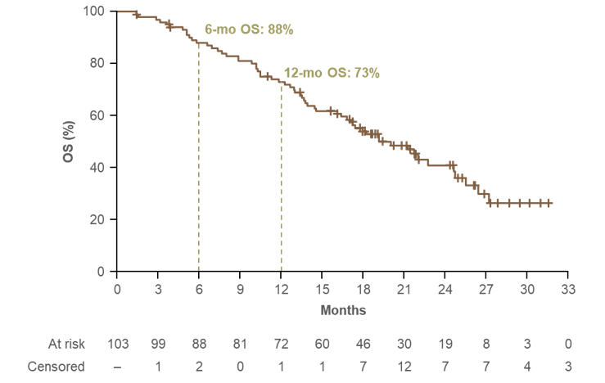
Key clinical results – futibatinib OS, FOENIX-CCA2
Figure 1: Kaplan–Meier curve for OS, final data cut-off
Abbreviations: OS, overall survival.
Notes:
Source: EAR Figure 3.1, CS Figure 10

Slide 15
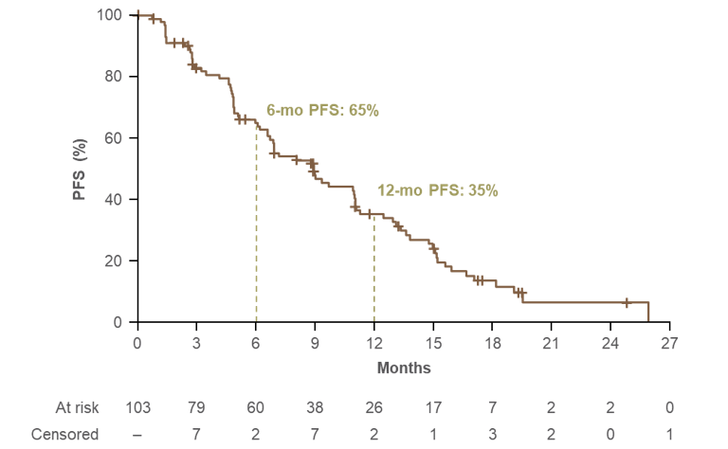
Key clinical results – futibatinib PFS, FOENIX-CCA2
Figure 1: Kaplan–Meier curve for PFS, final data cut-off
Abbreviations: PFS, progression-free survival.
Notes:
Source: EAR Figure 3.2, CS Figure 9

Slide 16
Key issue 2a: Efficacy of futibatinib versus pemigatinib (1/2)
Company
No direct trial comparison, so an unanchored matching-adjusted indirect comparison (MAIC) compares results of FOENIX-CCA2 (futibatinib) and FIGHT-202 (pemigatinib)
MAIC used individual patient data (IPD) from FOENIX and pseudo-IPD from FIGHT
Baseline characteristics in FOENIX were adjusted to align more closely to FIGHT
7 confounding factors included in base case MAIC:
age, gender, ECOG, prior lines, prior surgery, baseline hypoalbuminemia, and TP53
Small reduction in effective sample size showing good overlap in baseline characteristics
Results suggest futibatinib and pemigatinib have a very similar efficacy profile
supported by UK clinical expert opinion.
A sensitivity analysis including the confounding factor - race, showed very similar results, as did comparing naïve and adjusted outcomes
A simulated treatment comparison (STC) was also conducted which showed similar results to the unanchored MAIC.
Abbreviations: ECOG, Eastern Cooperative Oncology Group; TP53, tumour protein p53.

Slide 17
Key issue 2a: Efficacy of futibatinib versus pemigatinib (2/2)
EAG comments
[In general], unanchored indirect treatment comparisons have questionable validity
The 7 confounding factors chosen for the MAIC are relevant and appropriate
Some uncertainty remains over the possible confounding effect of different types of concomitant treatments
However, it is reassuring that the company’s analyses showed similar results to the naïve comparison, which seems to show that there is little difference in PFS and OS between futibatinib and pemigatinib
An assumption of equal effectiveness (in terms of OS and PFS) seems reasonable
A MAIC of health-related quality of life outcomes was not provided
Note: equal effectiveness assumption not applied in company or EAG base case
Abbreviations: MAIC, matching-adjusted indirect comparison; OS, overall survival; PFS, progression-free survival.

Slide 18
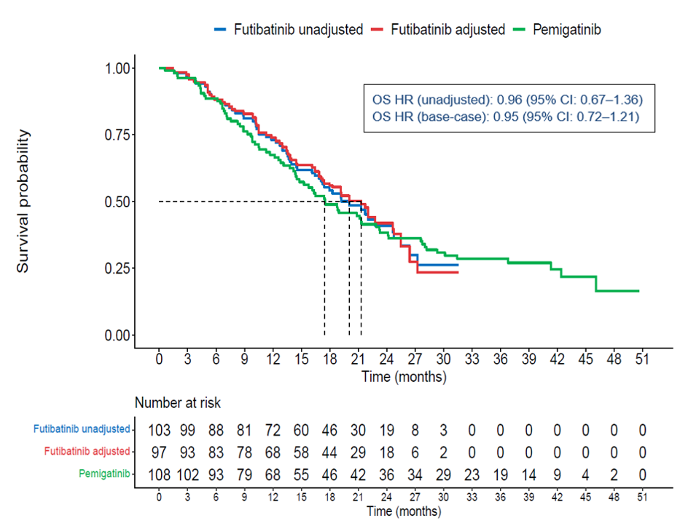
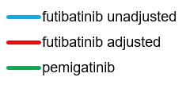
MAIC results – OS
Figure 1: Kaplan–Meier plot of unadjusted and MAIC-adjusted OS for futibatinib versus pemigatinib
No statistically significant difference, high uncertainty
Abbreviations: CI, confidence interval; HR, hazard ratio; MAIC, matching-adjusted indirect comparison; OS, overall survival.
Notes:
Source: CS Figure 14

Slide 19
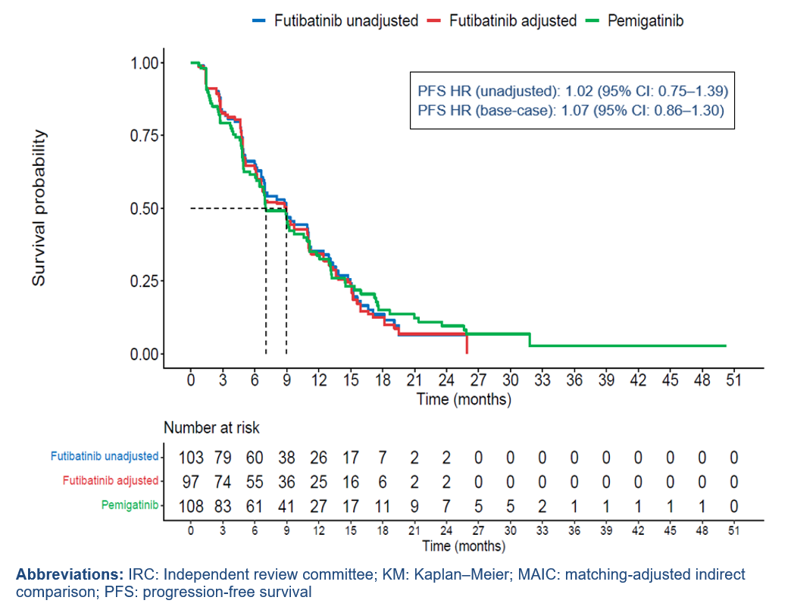
MAIC results – PFS
Figure 1: Kaplan–Meier plot of unadjusted and MAIC-adjusted PFS for futibatinib versus pemigatinib
No statistically significant difference, high uncertainty
Abbreviations: CI, confidence interval; HR, hazard ratio; MAIC, matching-adjusted indirect comparison; PFS, progression-free survival.
Notes:
Source: CS Figure 13

Slide 20
MAIC results – objective response rate
Table 1: Unadjusted and MAIC-adjusted objective response rates, futibatinib versus pemigatinib
Model | ORR hazard ratio | 95% CI; p value
Unadjusted | 1.22 | 0.70–2.13; p=0.487
Adjusted | 1.15 | 0.66–2.02; p=0.618
No statistically significant difference, high uncertainty
Abbreviations: CI, confidence interval; MAIC, matching-adjusted indirect comparison; ORR objective response rate.
Notes:
Source: EAR, Table 3.25.

Slide 21
Futibatinib for previously treated advanced cholangiocarcinoma with FGFR2 fusion or rearrangement
Background and key issues
Treatment pathway and clinical effectiveness
Modelling and cost effectiveness
Other considerations
Summary

Slide 22
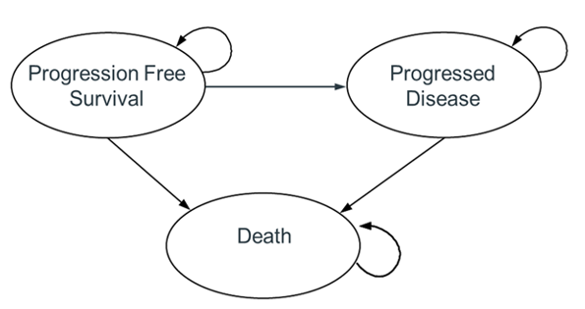
Company’s model overview
See appendix: Company’s model inputs
Partitioned survival model with health states for progression-free (PF), progressed disease (PD) and death
Technology affects QALYs by:
Decreased QALYs in PF state
Increased QALYs in PD state
Overall increase in QALYs
Slightly reduced QALYs lost
due to AEs
Technology affects costs by:
Slightly decreased AE costs
Slightly increased monitoring costs
Assumptions with greatest ICER effect:
Proportional hazards assumption
Hazard ratios for OS and PFS
Figure 1: Company’s model structure
Abbreviations: AE, adverse event; ICER, incremental cost-effectiveness ratio; QALY, quality-adjusted life year; OS, overall survival; PFS, progression-free survival
Notes:
Source: EAR, Figure 4.1; CS, Figure 16.

Slide 23
Key Issue 2b: Proportional hazards assumption
Company
Modelled OS and PFS using unadjusted data for futibatinib, and applying hazard ratios derived from the MAIC to determine OS and PFS for pemigatinib
Assumed proportional hazards assumption holds as:
Schoenfeld residual plots and log-cumulative hazard plots do not suggest a violation of proportional hazards
Both treatments are FGFR2 inhibitors with same mechanism of action and similar efficacy
EAG:
Prefers independent modelling for both OS and PFS – proportional hazards assumption invalid as the log-cumulative hazard plots cross at several time points
Kaplan-Meier curves for OS also cross at ~24 months (see next slide)
Log-cumulative hazard plots and Schoenfeld residual plots presented in appendix
MAIC-adjusted data for futibatinib and unadjusted data for pemigatinib should be used
Abbreviations: MAIC, matching-adjusted indirect comparison; OS, overall survival; PFS, progression-free survival
Does the proportional hazards assumption apply?
Should MAIC-adjusted data be used for futibatinib?

Slide 24
Recap: MAIC results – OS
Figure 1: Kaplan–Meier plot of unadjusted and MAIC-adjusted OS for futibatinib versus pemigatinib
No statistically significant difference, high uncertainty
Abbreviations: CI, confidence interval; HR, hazard ratio; MAIC, matching-adjusted indirect comparison; OS, overall survival.
Notes:
Source: CS Figure 14

Slide 25
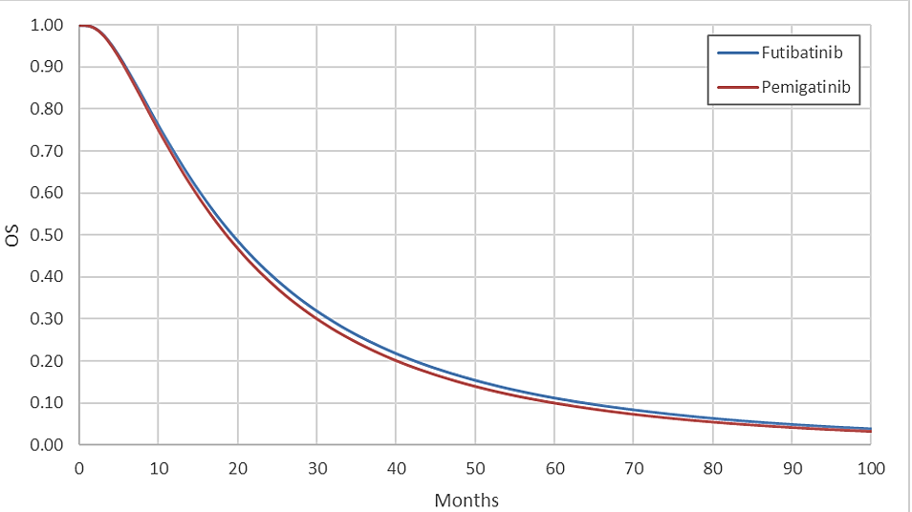
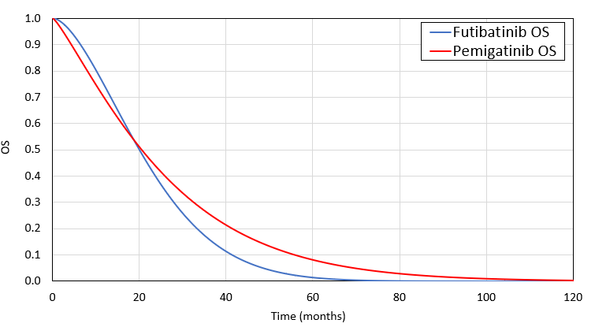
Key Issue 2b: Proportional hazards assumption
Company and EAG OS extrapolations
Figure 1: Company OS extrapolations
Figure 2: EAG OS extrapolations
HR: 1.05
Abbreviations: HR, hazard ratio; OS, overall survival.
Notes:
Sources: Company - EAR Figure 4.5; CS, Figure 25. EAG – taken from model, adapted from EAR Figure 6.1

Slide 26
Recap: MAIC results – PFS
Figure 1: Kaplan–Meier plot of unadjusted and MAIC-adjusted PFS for futibatinib versus pemigatinib
Notes:
Source: Company submission Figure 13

Slide 27
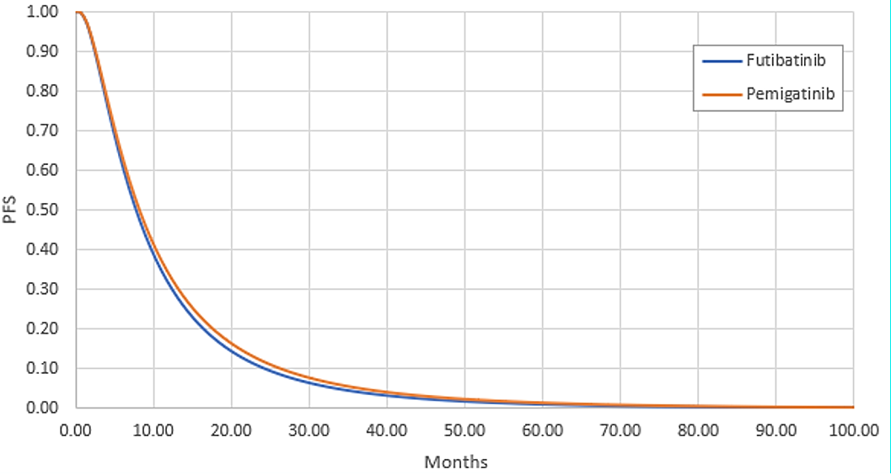
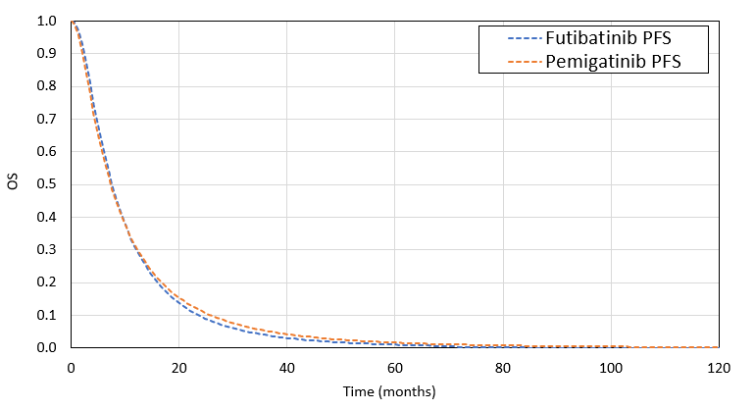
Key Issue 2b: Proportional hazards assumption
Company and EAG PFS extrapolations
Figure 1: Company’s PFS extrapolations
Figure 2: EAG’s PFS extrapolations
HR: 0.93
Abbreviations: HR, hazard ratio; PFS, progression-free survival.
Notes:
Sources: Company – EAR Figure 4.10; CS Figure 21. EAG – taken from model, adapted from EAR Figure 6.1

Slide 28
Key Issue 2c: Curve/model selection
See appendix: Fitted curves, AIC & BIC statistics and survival estimates
Company
Sought clinical opinion on the unadjusted extrapolations for futibatinib only
Log-normal models preferred for futibatinib OS and PFS
No OS or PFS benefit after 24 months when most people had stopped treatment
EAG :
Model selection should be based on both adjusted futibatinib and unadjusted pemigatinib curves as clinical experts have more experience using pemigatinib
Independent Weibull models for OS and log-normal models for PFS preferred – same distribution selected for both treatments in line with TSD14 due to similar mechanisms of action
Table 1: Clinical expert input
 | 5-yr OS | 10-yr OS | 5-yr PFS
Company (futi.) | 5-10% | 1-5% | Small but >0%
EAG*** | 3-10% | 0-2% | 1-2%
TA722 | 5%* 10-13%** | NR | NR
Which parametric models are most appropriate?
Notes: *pre-ACM, ** post-ACM; *** assumed standard care. Abbreviations: OS, overall survival; PFS, progression-free survival; TSD, Technical Support Document.

Slide 29
Key issue 3: Modelling of time on treatment (ToT)
Company
Base case assumes time on treatment (ToT) equals PFS for both pemigatinib and futibatinib
Median PFS and ToT for futibatinib 8.9 vs 9.07 months – FOENIX-CCA2
Median PFS and ToT for pemigatinib 6.9 months vs 7.2 months – TA722
Scenario where ToT modelled independently
Futibatinib ToT modelled via extrapolation of unadjusted data from FOENIX-CCA2
Pemigatinib ToT modelled using inverse of estimated MAIC PFS HR (that is, a HR of 0.93) applied to futibatinb ToT curve, in line with approach for PFS
EAG comments
Prefers to use independent modelling for ToT, company’s scenario more appropriate
This is because ToT for futibatinib often lies above PFS curve
However, by assuming ToT equal to PFS and applying the inverse of the PFS estimated HR, the potential difference is likely reduced
EAG also set the PFS curves as an upper bound of the ToT curves for both arms
What is the preferred approach to modelling ToT?

Slide 30
Key issue 4: Severity modifier
CONFIDENTIAL
Company
Table 1: Company’s QALY shortfall analysis
QALYs of people without condition | QALYs with the condition on pemigatinib | Absolute QALY shortfall | Proportional QALY shortfall | QALY weight
14.13 | **** | ***** | ***** | 1.2
EAG: Validated company results
QALY weight | Absolute shortfall | Proportional shortfall
1 | Less than 12 | Less than 0.85
X 1.2 | 12 to 18 | 0.85 to 0.95
X 1.7 | At least 18 | At least 0.95
NICE tech team:
QALY weights are also applied in the southwest (SW) quadrant of the cost-effectiveness plane
Is a severity modifier of 1.2 appropriate?
Abbreviations: QALY, quality-adjusted life year.
Notes:
Source: EAR, Table 4.17; CS Table 43

Slide 31
Summary of company and EAG base case assumptions
Assumptions in company and EAG base case
Assumption | Company base case | EAG base case
Modelling OS and PFS | Hazard ratio applied to unadjusted futibatinib data | Independent models based on MAIC adjusted data: OS – Weibull PFS – Log-normal Removing restriction on equal OS and PFS hazard rates after 24 months
Modelling ToT | ToT = PFS | Independent models ToT restricted by PFS
Genetic testing costs | Excluded | Included
Note: No impact on ICER when genetic testing costs included
Abbreviations: ICER, incremental cost-effectiveness ratio; MAIC, matching-adjusted indirect comparison; OS, overall survival; PFS, progression-free survival; ToT, time on treatment.
Notes:
Source: EAG report, Table 6.8

Slide 32
Cost-effectiveness results
All ICERs are reported in PART 2 slides
because they include confidential
comparator PAS discounts

Slide 33
Cost effectiveness results – company and EAG, severity modifier of 1.0 and 1.2
Increasing incremental costs
North-east quadrant
Figure 1: Company and EAG cost-effectiveness results on cost-effectiveness plane
Company base case
Increasing incremental QALYs
EAG base case
South-west quadrant
Abbreviations: QALY, quality-adjusted life year.

Slide 34
Cumulative impact of EAG’s assumptions, severity modifier 1.2
No | EAG preferred assumption (cumulative) | Inc. costs | Inc. QALYs | ICER (£/QALY) | NHB (£20k /QALY) | NHB (£30k /QALY)
1 | Company base case | +ve | +ve | Above £30K (north-east quadrant) | -ve | -ve
2 | Independent models for OS and PFS based on MAIC-adjusted data for futibatinib and unadjusted data for pemigatinib | +ve | -ve | Pemigatinib dominates | -ve | -ve
3 | Independent models for ToT Tot restricted by PFS (EAG base case) | -ve | -ve | Below £30K (south-west quadrant) | -ve | -ve
Abbreviations: ICER, incremental cost-effectiveness ratio; MAIC, matching-adjusted indirect comparison; NHB, net health benefit; OS, overall survival; PFS, progression-free survival; QALY, quality-adjusted life year; ToT, time on treatment.
Notes:
Source: Appendix to EAG cPAS appendix, Table 3

Slide 35
Futibatinib for previously treated advanced cholangiocarcinoma with FGFR2 fusion or rearrangement
Background and key issues
Treatment pathway and clinical effectiveness
Modelling and cost effectiveness
Other considerations
Summary

Slide 36
Other considerations
Equality considerations?
No potential equalities issues raised at scoping or in company, patient group or professional organisation submissions
Potential for managed access?
Company submission: "Since no further data cuts are planned in the FOENIX-CCA2 trial, a managed access proposal is not applicable for futibatinib.”
Innovation/uncaptured benefits?
No considerations raised

Slide 37
Futibatinib for previously treated advanced cholangiocarcinoma with FGFR2 fusion or rearrangement
Background and key issues
Treatment pathway and clinical effectiveness
Modelling and cost effectiveness
Other considerations
Summary

Slide 38
Issues - recap
See appendix: Other issues
# | Issue | ICER impact
Key issues for discussion
1 | Comparators – is modified FOLFOX a comparator? | Unknown
2 | a) Efficacy of futibatinib versus pemigatinib | Large
 | b) Proportional hazards assumption | Large
 | c) Curve/model selection | Large
3 | Modelling of time on treatment (ToT) | Large
4 | Severity modifier | Moderate
Other issues
5 | Generalisability of FOENIX-CCA2 – literature search | Unknown
6 | Generalisability of FOENIX-CCA2 – subgroup analysis and effect modifiers | Unknown
7 | Further subgroup analysis | Unknown
8 | Model verification | Unknown
Abbreviations: FOLFOX, folinic acid, fluorouracil and oxaliplatin; ICER, incremental cost-effectiveness ratio.

Slide 39
Futibatinib for previously treated advanced cholangiocarcinoma with FGFR2 fusion or rearrangement
Supplementary appendix

Slide 40
Decision problem
Return to main deck
Population, intervention, comparators and outcomes from the scope
 | Final scope | Company | EAG comments
Population | Adults with locally advanced or metastatic CCA with FGFR2 fusion or rearrangement that has progressed after at least 1 prior systemic therapy | Same as scope | -
Intervention | Futibatinib | Same as scope | -
Comparators | Pemigatinib Modified FOLFOX BSC | Pemigatinib only | See key issues
Outcomes | OS, PFS, response rates, AEs, HRQoL | Same as scope + additional | -
Abbreviations: AE, adverse event; BSC, best supportive care; CCA, cholangiocarcinoma; FGFR, fibroblast growth factor receptor; FOLFOX, folinic acid, fluorouracil and oxaliplatin; HRQoL, health-related quality of life; OS, overall survival; PFS, progression-free survival.
Notes:
Source: Adapted from EAR Table 2.1

Slide 41
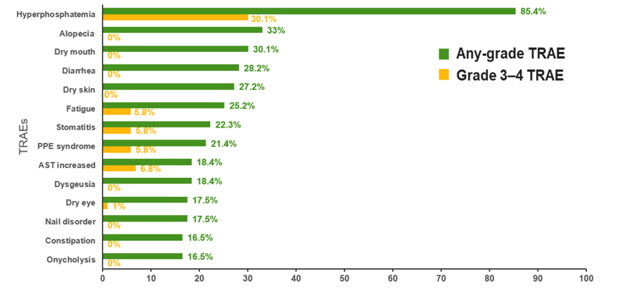
Adverse events
Return to main deck
Figure 1: Most common treatment-related adverse events for futibatinib, FOENIX-CCA2
Abbreviations: AST, aspartate aminotransferase; PPE, palmar-plantar erythrodysesthesia; TRAE, treatment-related adverse event.
Notes:
Source: EAR Figure 3.8, CS Figure 15

Slide 42
Company’s model inputs
CONFIDENTIAL
Return to main deck
Input | Assumption and evidence source
Baseline chars. | Mean age: 55.7 years; % female: 56.3%; FOENIX-CCA2
Intervention efficacy | Unadjusted OS and PFS data from FOENIX-CCA2
Comparator efficacy | Hazard ratios derived from unanchored MAIC
Utilities | PF – *****; PD – *****; FOENIX-CCA2 (EQ-5D-3L)
Costs | Treatment costs – company and BNF Administration costs – not applicable Subsequent treatment costs – excluded for simplicity Health state costs – include costs for clinical examination, CT scans, retinal scans, blood tests and pain medication. Resource use frequencies based on TA722, costs based on NHS reference costs 2021/2022 Adverse events – NHS reference costs 2021/2022 and BNF Terminal care costs – £6,870 (TA722)
Abbreviations: BNF, British National Formulary; CT, computed tomography; EQ-5D-3L, EuroQol-5 Dimensions 3 Level; MAIC, matching-adjusted indirect comparison; OS, overall survival; PD, progressed disease; PF, progression free; PFS, progression-free survival.

Slide 43
Log-cumulative hazard plots and Schoenfeld residual plots

Slide 44
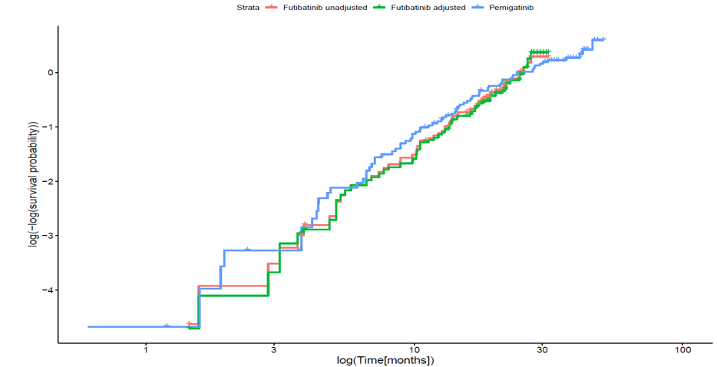
Log-cumulative hazard plot – OS
Figure 1: Log-cumulative hazard plot for futibatinib versus pemigatinib for OS
Abbreviations: OS, overall survival.
Notes:
Source: EAR Figure 4.2; CS figure 22.

Slide 45
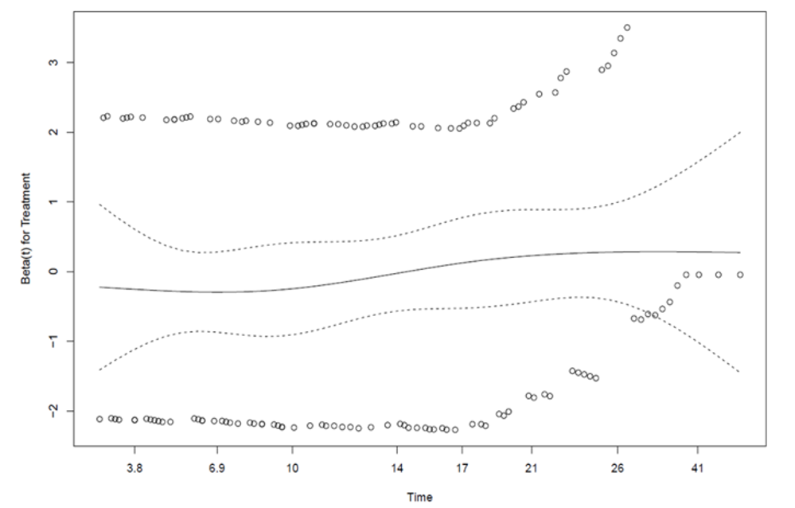
Schoenfeld residual plot – OS
Figure 1: Schoenfeld residual plot for futibatinib (adjusted) versus pemigatinib for OS
p = 0.19
Abbreviations: OS, overall survival.
Notes:
Source: EAR figure 4.3, CS figure 23

Slide 46
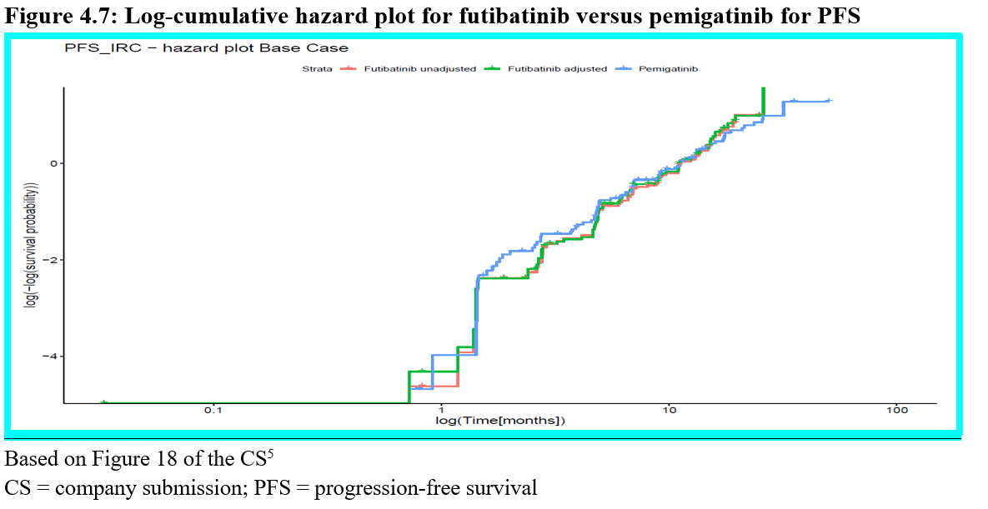
Log-cumulative hazard plot – PFS
Figure 1: Log-cumulative hazard plot for futibatinib versus pemigatinib for PFS
Abbreviations: PFS, progression-free survival.
Notes:
Source: EAR figure 4.7, CS figure 18.

Slide 47
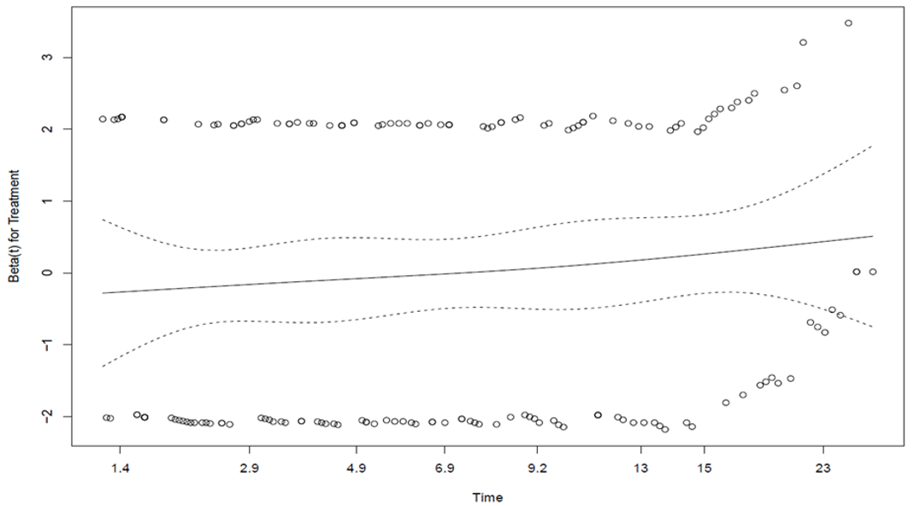
Schoenfeld residual plot – PFS
Figure 1: Schoenfeld residual plot for futibatinib (adjusted) versus pemigatinib for PFS
p = 0.17
Abbreviations: PFS, progression-free survival.
Notes:
Source: EAR figure 4.8, CS figure 19

Slide 48
Fitted curves, AIC & BIC statistics and long-term survival estimates

Slide 49
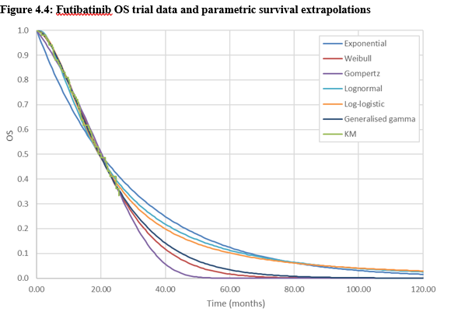
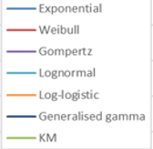
Key Issue 2c: Curve/model selection (OS) – company
Figure 1: Futibatinib OS extrapolations, based on unadjusted data
Table 1: Fit statistics and landmark estimates, OS
Model | AIC | Rank | BIC | Rank | 2-yr | 5-yr
Exp. | 507.65 | 6 | 510.29 | 6 | 43.41% | 12.42%
Wei. | 495.96 | 1 | 501.23 | 1 | 38.69% | 1.67%
Gom. | 499.24 | 5 | 504.51 | 4 | 39.10% | 0.01%
LN | 497.94 | 4 | 503.21 | 3 | 40.87% | 11.27%
LL | 496.66 | 2 | 501.93 | 2 | 39.89% | 10.19%
GG | 497.78 | 3 | 505.68 | 5 | 38.96% | 3.39%
Red box shows company’s selected OS extrapolation (log normal)
Abbreviations: AIC, Akaike information criterion; BIC, Bayesian information criterion; OS, overall survival.
Notes:
Sources: Extrapolations - EAR Figure 4.4, CS Figure 24 AIC/BIC statistics – EAR Table 4.4, CS Table 32 Landmark estimates – Appendix to EAG cPAS appendix, Table 4

Slide 50
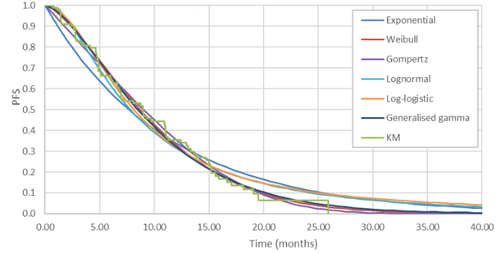
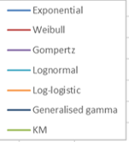
Key Issue 2c: Curve/model selection (PFS) – company
Figure 1: Futibatinib PFS extrapolations, based on unadjusted data
Table 1: Fit statistics and landmark estimates, PFS
Model | AIC | Rank | BIC | Rank | 2-yr | 5-yr
Exp. | 532.94 | 6 | 535.57 | 6 | 11.42% | 0.44%
Wei. | 520.09 | 1 | 525.36 | 1 | 4.71% | 0.00%
Gom. | 523.90 | 3 | 529.17 | 2 | 3.33% | 0.00%
LN | 523.97 | 4 | 529.24 | 3 | 10.34% | 1.10%
LL | 524.92 | 5 | 530.19 | 5 | 10.80% | 1.99%
GG | 521.84 | 2 | 529.75 | 4 | 5.61% | 0.01%
Red box shows company’s selected PFS extrapolation (log normal)
Abbreviations: AIC, Akaike information criterion; BIC, Bayesian information criterion; PFS, progression-free survival.
Notes:
Sources: Extrapolations - EAR Figure 4.9, CS Figure 20 AIC/BIC statistics – EAR Table 4.6 Landmark estimates – Appendix to EAG’s cPAS appendix, Table 5

Slide 51
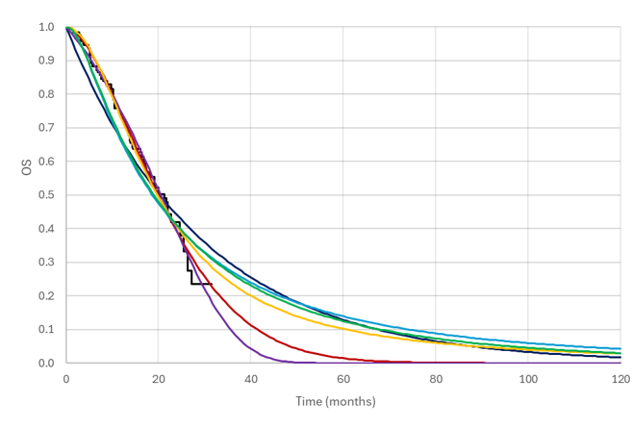
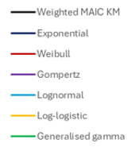
Key Issue 2c: Curve/model selection (OS futibatinib) – EAG
CONFIDENTIAL
Figure 1: Futibatinib OS extrapolations, based on adjusted data
Table 1: Fit statistics and landmark estimates, OS adjusted
Model | AIC | Rank | BIC | Rank | 5- year OS
Exp. | 473.93 | 6 | 476.56 | 6 | 13.19%
Wei. | 461.51 | 1 | 466.78 | 1 | 1.53%
Gom. | 463.56 | 4 | 468.83 | 3 | 0.00%
LN | 464.60 | 5 | 469.87 | 4 | 11.49%
LL | 463.21 | 2 | 468.48 | 2 | 10.35%
GG | 463.50 | 3 | 471.40 | 5 | 1.13%
Red box shows EAG’s selected OS extrapolation for futibatinib
Abbreviations: AIC, Akaike information criterion; BIC, Bayesian information criterion; PFS, progression-free survival.
Notes:
Sources: AIC/BIC and landmark estimates - EAR Table 4.5 Extrapolations – Appendix to EAG’s cPAS appendix, Figure 2

Slide 52
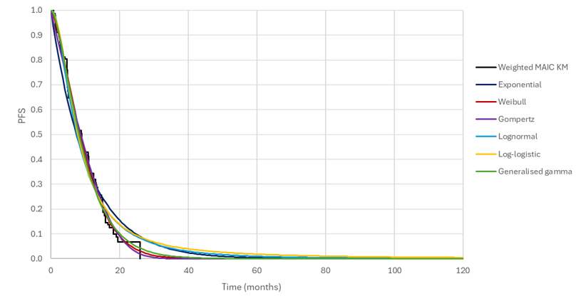
Key Issue 2c: Curve/model selection (PFS futibatinib) – EAG
CONFIDENTIAL
Figure 1: Futibatinib PFS extrapolations, based on adjusted data
Table 1: Fit statistics and landmark estimates, PFS adjusted
Model | AIC | Rank | BIC | Rank | 5-year PFS
Exp. | 508.83 | 6 | 511.46 | 6 | 0.40%
Wei. | 497.20 | 1 | 502.47 | 1 | 0.00%
Gom. | 501.73 | 5 | 507.00 | 5 | 0.00%
LN | 500.00 | 3 | 505.27 | 2 | 1.02%
LL | 500.61 | 4 | 505.88 | 3 | 1.87%
GG | 498.59 | 2 | 506.49 | 4 | 0.03%
Red box shows EAG’s selected PFS extrapolation for futibatinib
Abbreviations: AIC, Akaike information criterion; BIC, Bayesian information criterion; PFS, progression-free survival.
Notes:
Sources: AIC/BIC and landmark estimates - EAR Table 4.7 Extrapolations – Appendix to EAG’s cPAS appendix, Figure 3

Slide 53
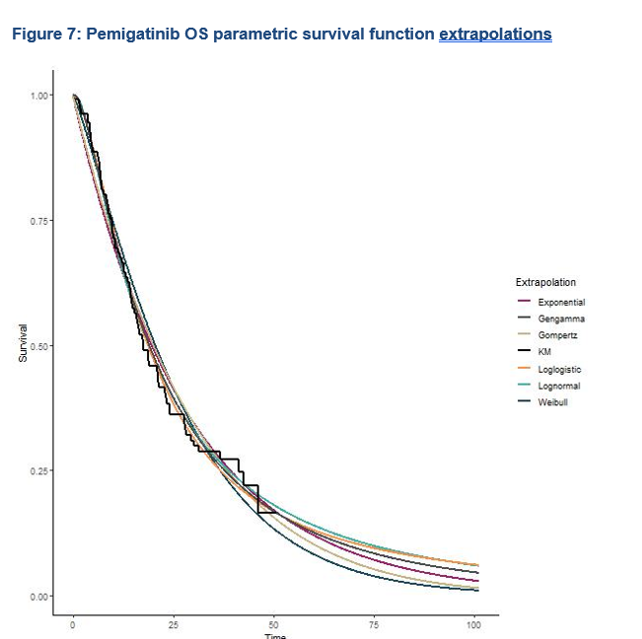
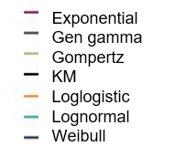
Key Issue 2c: Curve/model selection (OS pemigatinib) – EAG
CONFIDENTIAL
Figure 1: Pemigatinib OS extrapolations
Table 1: Fit statistics and landmark estimates, OS
Model | AIC | Rank | BIC | Rank | 5- year OS
Exp. | 652.98 | 5 | 655.66 | 3 | 12.21%
Wei. | 651.72 | 4 | 657.09 | 5 | 8.39%
Gom. | 654.77 | 6 | 660.14 | 6 | 10.42%
LN | 647.15 | 2 | 652.51 | 2 | 14.14%
LL | 646.10 | 1 | 651.47 | 1 | 13.15%
GG | 648.81 | 3 | 656.85 | 4 | 12.72%
Red box shows EAG’s selected OS extrapolation for pemigatinib
Time (months)
Abbreviations: AIC, Akaike information criterion; BIC, Bayesian information criterion; OS, overall survival.
Notes:
Sources: Extrapolations – Company clarification response Figure 7 AIC/BIC - EAR Table 4.5

Slide 54
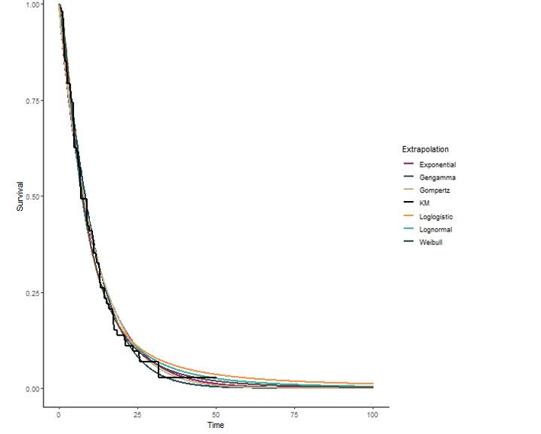
Key Issue 2c: Curve/model selection (PFS pemigatinib) – EAG
CONFIDENTIAL
Figure 1: Pemigatinib PFS extrapolations
Table 1: Fit statistics and landmark estimates, PFS
Model | AIC | Rank | BIC | Rank | 5-year PFS
Exp. | 602.78 | 5 | 605.46 | 4 | 0.49%
Wei. | 601.07 | 4 | 606.44 | 5 | 0.10%
Gom. | 604.59 | 6 | 609.96 | 6 | 0.26%
LN | 594.95 | 1 | 600.31 | 1 | 1.66%
LL | 597.95 | 3 | 603.32 | 2 | 2.65%
GG | 596.62 | 2 | 604.67 | 3 | 1.11%
Red box shows EAG’s selected PFS extrapolation for pemigatinib
Abbreviations: AIC, Akaike information criterion; BIC, Bayesian information criterion; PFS, progression-free survival.
Notes:
Sources: Extrapolations – Company clarification response Figure 6 AIC/BIC - EAR Table 4.7

Slide 55
Other issues

Slide 56
Other issues 5: Generalisability of the FOENIX-CCA2 study – literature search
Company
Presented baseline characteristics from FOENIX-CCA2
As CCA is a rare cancer, no UK studies were identified which reported demographic or disease characteristics for people with advanced, previously treated CCA with FGFR2 fusions or gene rearrangements
However, clinical experts confirmed that baseline characteristics of people in FOENIX-CCA2 were broadly generalisable to UK clinical practice
EAG comments
The company did not specify their search strategy, so it remains unconfirmed that data do not exist
The reliance on clinical opinion means that uncertainty remains
Abbreviations: CCA, cholangiocarcinoma; FGFR, fibroblast growth factor receptor.

Slide 57
Other issues 6: Generalisability of the FOENIX-CCA2 study – subgroup analysis and effect modifiers
Company
Presented results of pre-planned subgroup analysis of FOENIX-CCA2 (see next slide)
Results of the subgroup analysis were consistent across subgroups and supported the conclusions of the primary analysis
Statistical analysis of subgroup analysis was not carried out because of underpowering
EAG comments
Subgroup analyses show a trend for age and prior systemic therapy to be treatment effect modifiers
Even though 95% confidence intervals in all subgroup analyses overlap, this does not mean differences are non-significant
Statistical analysis of subgroup analysis should be conducted
This is important because if effect modifiers differ between populations, then the trial and indirect comparison results may not be generalisable to target population
The impact of this on cost effectiveness is unknown

Slide 58
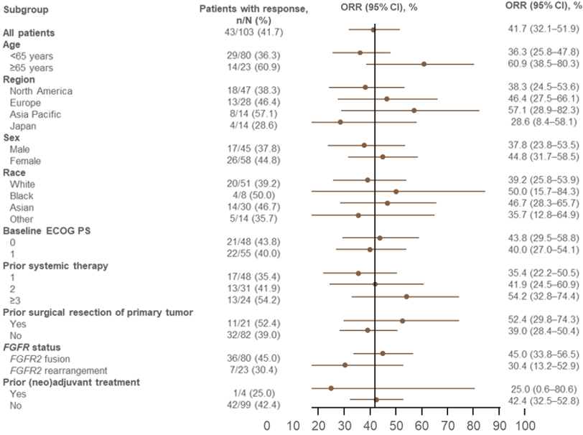
Clinical trial – subgroup analysis and effect modifiers
Figure 1: Subgroup analysis, objective response rate (ORR)
Notes:
Source: EAG report figure 3.7

Slide 59
Other issues 7: Further subgroup analysis
Company
Presented 10/11 of the pre-planned subgroup analyses
Did not present the analysis for ‘patients with solid tissue sample and report’ as 99/103 patients met this criteria and 4 did not
So, the results of this subgroup analysis would be subject to substantial uncertainty
EAG comments
Noted that there are also only 4 patients for the subgroup analysis of ‘prior neo-adjuvant treatment’ which was presented by the company
Therefore, the company’s rationale for excluding the solid tissue sample subgroup is unclear
The company’s subgroup analyses did not consider concomitant treatments, which may influence outcomes
The company should provide subgroup analysis for both of these missing outcomes

Slide 60
Other issues 8: Model verification
EAG:
Several errors were identified in the company’s model after clarification
These mainly related to probabilistic sensitivity analysis and did not affect base case
However, one error related to half-cycle correction and did affect base case results
EAG has corrected all identified errors in the EAG’s model
Concern that there may be additional errors remaining
Company
Provided a corrected company model in response to the Factual Accuracy Check of the EAG report
Tech team
Results from corrected EAG and company models presented in the part 2 slides

