Slide 1
Rucaparib for maintenance treatment of relapsed platinum-sensitive ovarian, fallopian tube or peritoneal cancer ID4069 [Review of TA611]
CONFIDENTIAL
Confidential information redacted
Cost comparison briefing slides
Technical team: Emma McCarthy, Eleanor Donegan, Janet Robertson
Company: Pharma&
© NICE 2024. All rights reserved. Subject to Notice of rights.

Slide 2
Rucaparib (Rubraca, Pharma&)
CONFIDENTIAL
Marketing authorisation (GB) | Maintenance treatment of adult patients with platinum-sensitive relapsed high-grade epithelial ovarian, fallopian tube, or primary peritoneal cancer who are in response (complete or partial) to platinum-based chemotherapy.
Mechanism of action | Poly-ADP-ribose polymerase (PARP) inhibitor which inhibits PARP proteins involved in DNA repair. It allows DNA damage to accumulate and limits the options for DNA repair, resulting in tumour cell death
Administration | Administered orally Dose: 600mg (2x300mg) taken twice daily (1,200mg per day)
Price | £3,562.00 per pack of 60, 300 mg, 250 mg or 200 mg tablets. Company has a confidential commercial arrangement (simple discount PAS)
Nov 2019 - rucaparib recommended by NICE in CDF (TA611) as an option for maintenance treatment of relapsed, platinum-sensitive high-grade epithelial ovarian, fallopian tube or primary peritoneal cancer that has responded to platinum-based chemotherapy in adults (under managed access agreement)
Clinical uncertainty due to immaturity of OS data –additional data collection from ARIEL-3 study needed
Abbreviations: GB: Great Britain; PAS: Patient access scheme

Slide 3
Decision problem
CONFIDENTIAL
 | Final scope | Company decision problem
Population | People with relapsed, platinum-sensitive high-grade epithelial ovarian, fallopian tube or primary peritoneal cancer that is in response (complete or partial) to platinum-based chemotherapy | People with platinum-sensitive relapsed high-grade epithelial ovarian, fallopian tube, or primary peritoneal cancer who are in response (complete or partial) to platinum-based chemotherapy
Intervention | Rucaparib | Rucaparib
Comparators | At least 1 of the following treatments, according to NICE guidance: Niraparib Olaparib (only for people who have a BRCA mutation) | For people who have a BRCA mutation and have had 2 or more courses of platinum-based chemotherapy: Olaparib Niraparib For people who do not have a BRCA mutation and have had 2 or more courses of platinum-based chemotherapy Niraparib
Outcomes | Overall survival, progression-free survival, progression-free survival 2 (i.e. progression-free survival on next line of therapy), time to next line of therapy, adverse effects of treatment, health-related quality of life | As per final scope

Slide 4
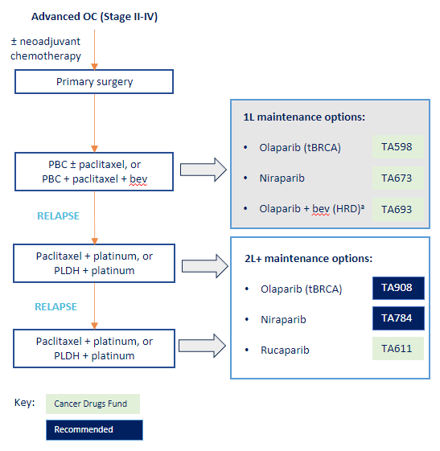
Treatment pathway and choice of comparators
CONFIDENTIAL
Rucaparib is positioned by company as a second- and subsequent-line maintenance therapy option
Company
Population for analyses split into BRCA and non-BRCA subgroups
Comparison of clinical efficacy to olaparib (in people with a BRCA mutation) and niraparib (both BRCA and non-BRCA populations)
Cost comparison with niraparib only
EAG
Company positioning of rucaparib consistent with clinical practice in England and NICE recommended populations (TA784,TA908)
EAG’s clinical expert considered both olaparib (BRCA mutation only) and niraparib to be reasonable comparators for rucaparib
Choice of niraparib as the comparator in cost-comparison analysis is acceptable– subgroup approach also reasonable
Source: company submission document B, Figure 2
Olaparib and niraparib are appropriate comparators

Slide 5
Clinical effectiveness

Slide 6
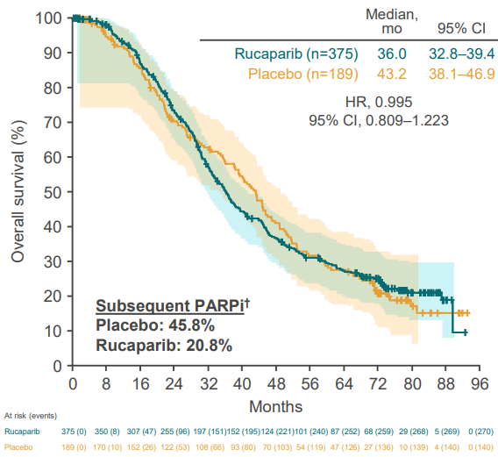
Rucaparib clinical effectiveness– ARIEL3
Rucaparib improves PFS vs placebo but subsequent PARPi use does not match clinical practice and may affect OS
ARIEL-3 data improves PFS vs placebo in ITT and BRCA populations (********************) – same data as TA611
Final analysis (4 April 2022; median follow-up 77.0 months),OS data were mature, having reached 72.7% of events in the ITT population.
No significant difference in OS between rucaparib and placebo in ITT and BRCA populations (********************)
Company – unbalanced subsequent PARPi use may bias OS against rucaparib
Exploratory company analyses excluding subsequent PARPi use in placebo group – significantly longer OS in the rucaparib arm than in the placebo arm
EAG
Agree that subsequent PARPi could impact on OS, but not possible to predict direction of bias
Clinical experts to EAG - 2nd PARPi not permitted in clinical practice. Patients with no previous use could receive subsequent PARPi if responding to platinum-based chemo
Do not consider adjusted analyses appropriate for UK because it breaks randomisation and some people eligible for subsequent PARPi (if they responded to platinum-based chemotherapy)
Source: company submission document B, Figure 13
Abbreviations: PFS, progression-free survival; ITT, intention to treat; OS, overall survival, PARPi, PARP inhibitor
Notes:
Figure: Mature OS data from final analysis of ARIEL3 data (April 2022) – ITT population

Slide 7
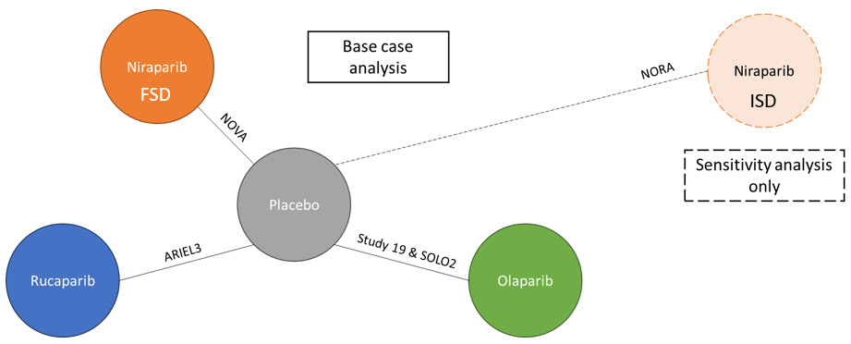
Clinical efficacy test – indirect treatment comparisons
ITCs conducted in absence of head-to-head clinical efficacy data
Company
No direct RCT data for rucaparib vs. comparators
ITCs including NMAs, MAICs and naïve comparison using SACT data to estimate clinical efficacy
NORA excluded in base case ITC (lower starting dose niraparib/only 2 prior lines of chemotherapy– EAG preference) and MAICs
Fixed Bayesian effects for all outcomes
Source: Company submission document B, Figure 23
EAG Included trials are good match for population, agrees with low risk of bias assessment from company
NMAs are most robust efficacy data with no head-to-head data
Abbreviations: ITC; indirect treatment comparison, NMA; network meta analysis; MAICs, matching adjusted indirect comparisons; SACT, Systemic Anti-Cancer Therapy
Notes:
Study 19 of olaparib exc. following clarification

Slide 8
Base case NMA results
Rucaparib and niraparib have similar efficacy
EAG conclusions
NMA are most robust results ****** ********************************************)
******************** due to sparse network
****************************************
*********************************************************************
NMA results ****************** **********************
 | Rucaparib vs olaparib | Rucaparib vs niraparib
BRCA mutated cohort
INV-PFS, HR (95% CI) | ********** | **********
IRC-PFS, HR (95% CI) | ********** | **********
OS, HR (95% CI) | ********** | **********
PFS2, HR (95% CI) | ********** | **********
TSST, HR (95% CI) | ********** | **********
TTD, HR (95% CI) | ********** | *****
Non-BRCA mutated cohort
INV-PFS, HR (95% CI) | *** | **********
IRC-PFS, HR (95% CI) | *** | **********
OS, HR (95% CI) | *** | **********
PFS2, HR (95% CI) | *** | **********
TSST, HR (95% CI) | *** | ****
Source: EAG report, Table 10
ITCs support equivalent efficacy between rucaparib and niraparib
Abbreviations: BRCA, breast cancer gene; CI, confidence interval; HR, hazard ratio; INV, investigator-assessed; IRC; independent review committee; ITT, intention-to-treat; NMA; network meta analysis; MAICs, matching adjusted indirect comparisons; SACT, Systemic Anti-Cancer Therapy; PFS, progression-free survival; PFS2, time to second progression event; OS, overall survival; TSST, time to start of second subsequent therapy, TTD, time to treatment discontinuation
Notes:
Source: EAG report, Table 10

Slide 9
EAG critique of ITCs
No major concerns – suitable for decision making
EAG
Some clinical heterogeneity between trial patient populations – not likely to have substantial impact on outcomes
No comparison of AEs – ARIEL-3 safety data shows rucaparib associated with ******* proportion of patients with Grade 3 or above combined ALT/AST TEAEs versus niraparib in NOVA ********** proportion of patients with at least one Grade 3+ TEAE .
EAG’s clinical experts - despite differences in individual AEs for the PARP inhibitors, there were no major safety concerns regarding differences in AEs between rucaparib, niraparib and olaparib.
Validated OS & PFS for rucaparib vs niraparib and obtained similar results to company
Not all data in NMAs could be validated (unclear source for some data)
Analysis for TTD for rucaparib vs niraparib not possible – no suitable data for niraparib
Rucaparib and niraparib efficacy and safety profiles are similar – appropriate for cost comparison
Abbreviations: AE, adverse events; NMA, network meta-analysis; RCT, randomised controlled trial; TEAEs; treatment-associated adverse events; PFS, progression-free survival; OS, overall survival; TTD, time to treatment discontinuation

Slide 10
Cost comparison

Slide 11
Cost-comparison company base case
CONFIDENTIAL
Results include PAS for rucaparib and cPAS for niraparib
Assumptions
30-year time horizon
Equivalent PFS and OS for rucaparib and niraparib
TTD varies between rucaparib and niraparib - based on naïve comparison of extrapolated TTD KM curves for niraparib (using NOVA data) and rucaparib (using ARIEL3 data).
Patients receiving treatment with a maintenance PARPi do not receive subsequent PARPi
No waning effect for PARPis
AE duration data taken from ARIEL2 study
RDI of rucaparib and niraparib = 100%
Dose of 300 mg per day niraparib
Interventions | Total Costs (£) | Incremental costs (£)
BRCA subgroup
Niraparib | ********** | -
Rucaparib | ********** | **********
Non-BRCA subgroup
Niraparib | 30,307 | -
Rucaparib | 27,792 | -2,515
Source: EAG confidential appendix, Table 2
Abbreviations: AE, adverse event; PFS, progression-free survival; ITT, intention to treat; OS, overall survival, PARPi, PARP inhibitor; RDI, relative dose intensity; TTD, time to treatment discontinuation
Notes:
EAG corrected company base case and scenario results using the eMIT price for subsequent treatment pegylated liposomal doxorubicin hydrochloride (PLDH) instead of the BNF price
Source: EAG confidential appendix, Table 2

Slide 12
Key issue – differences in time to treatment discontinuation
CONFIDENTIAL
Background
Company estimated that TTD is greater with niraparib than rucaparib based on naïve comparison
TTD key driver of cost in the model – impacts drug acquisition, AEs and monitoring costs
Monthly risk of AEs applied to patients on treatment – company assumed greater AE costs with niraparib
Company assumed difference in resource use for progression-free patients on and off treatment
EAG
SACT data and clinical advice indicates that TTD for niraparib and rucaparib is similar
Clinically implausible that treatment with more AEs would have a longer TTD
EAG base case – TTD equivalent for rucaparib and niraparib
Differences in monitoring costs eliminated
Reduction in AE-driven cost differences
Approach more in line with guidance for cost-comparison analysis
Is it appropriate to assume equivalent TTD for rucaparib and niraparib?
Abbreviations: AE, adverse event; SACT, Systemic Anti-Cancer Therapy; PFS, progression-free; OS, overall survival; TSST, time to start of second subsequent therapy, TTD, time to treatment discontinuation

Slide 13
Cost-comparison company scenario analyses
CONFIDENTIAL
Results include PAS for rucaparib and cPAS for niraparib
Scenarios | Incremental cost of rucaparib(£)
 | BRCA | Non-BRCA
Base case | ********** | **********
Assuming equal TTD | ********** | **********
Equal TTD assuming Weibull TTD for BRCA | ********** | N/A
ARIEL3 and NOVA alternative TTD | ********** | **********
SACT rucaparib efficacy | ********** | **********
SACT rucaparib – Alternative fits | ********** | **********
SACT niraparib efficacy | ********** | **********
SACT niraparib– Alternative fits | ********** | **********
Alternative TTD1 – niraparib TTD = treat until progression | ********** | **********
Alternative TTD2 – niraparib TTD = constant discontinuation rate per cycle | ********** | **********
PARPi dosing (65%, NOVA2) | ********** | **********
Update AE incidence | ********** | **********
Updated hypotension, anaemia, neutropenia and thrombocytopenia costs | ********** | **********
Same pre-progression resource use on and off treatment | ********** | **********
Alternative subsequent treatments | ********** | **********
Source: EAG confidential appendix, Table 3
Abbreviations: INV-PFS, BRCA, breast cancer gene;; SACT, Systemic Anti-Cancer Therapy; OS, overall survival; TTD, time to treatment discontinuation
Notes:
EAG corrected company base case and scenario results using the eMIT price for subsequent treatment pegylated liposomal doxorubicin hydrochloride (PLDH) instead of the BNF price
Source: EAG confidential appendix, Table 3

Slide 14
Cost comparison base case – preferred EAG assumptions
CONFIDENTIAL
Results include PAS for rucaparib and cPAS for niraparib
Key assumptions
1. Niraparib time to treatment discontinuation (TTD) = rucaparib TTD
2. Adverse event (AE) rates from the ARIEL3 clinical study report (CSR) addendum from 2023
3. Equal monitoring costs for progression-free patients (except for cycle 1 blood tests for niraparib patients)
4. One-off cost of subsequent treatment based on cost of paclitaxel + carboplatin and PLDH + carboplatin, assuming a 50:50 split.
Costs | BRCA subgroup |  |  | Non-BRCA subgroup
 | Niraparib | Rucaparib | Incremental | Niraparib | Rucaparib | Incremental
Total costs | ********** | ********** | ********** | ********** | ********** | **********
Acquisition costs | ********** | ********** | ********** | ********** | ********** | **********
Subsequent costs | ********** | ********** | ********** | ********** | ********** | **********
Resource costs | ********** | ********** | ********** | ********** | ********** | **********
AE costs | ********** | ********** | ********** | ********** | ********** | **********
EAG base case + AE incremental cost = 0 | ********** | ********** | ********** | ********** | ********** | **********
Abbreviations: AE, adverse event; SACT, Systemic Anti-Cancer Therapy; PFS, progression-free; OS, overall survival; TSST, time to start of second subsequent therapy, TTD, time to treatment discontinuation
Notes:
Source: EAG confidential appendix, Table 6 (additional scenario with EAG base case + AE cost = 0 added in by tech team). For AE costs = 0 scenario, the incremental costs are calculated as: Total incremental costs – AE incremental costs.

Slide 15
CONFIDENTIAL
Potential recommendations: cost comparison
Lower health benefits, higher costs:
do not recommend
Greater health benefits, higher costs:
unable to recommend, need a cost-utility analysis (STA)
Difference in costs
Lower health benefits, lower costs:
unable to recommend, need a cost-utility analysis (STA)
Similar/greater health benefits, similar/lower costs:
recommend as an option
Difference in overall health benefit
Abbreviations: STA: Single technology appraisal

