Slide 1
Managed Access Review Committee adjudication
Nusinersen for treating spinal muscular atrophy [TA588]
12 April 2021

Slide 2
Nusinersen (Spinraza, Biogen Idec)
RECAP
Marketing authorisation | Treatment of 5q spinal muscular atrophy
Mechanism of action | Antisense oligonucleotide that targets SMN2, causing it to make more complete SMN protein
Administration | 12 mg, by intrathecal infusion, on days 0, 14, 28 and 63, then every 4 months.
Price | The list price is £75,000 per vial (excluding VAT; BNF, accessed June 2018). At list price, the total annual treatment cost is £450,000 for the first year and £225,000 subsequently. Over 5 years, the treatment costs per person would be £1.35 million. The company has a commercial arrangement.

Slide 3
Spinal muscular atrophy Disease background
RECAP
SMA is a genetic, progressive neuromuscular disease most commonly caused by mutations in the SMN1 on chromosome 5q
SMN1 gene encodes the “survival motor neurone” (SMN) protein
The lack of SMN protein causes the motor neurones to malfunction, deteriorate and eventually die
Long-term degenerative condition causing muscle weakness, results in gradually worsening physical disabilities and mobility loss.
Estimated that ~100 people are born with SMA per year, and 1,200–2,500 children and adults are currently living with SMA, in the UK
SMN2 can compensate for the SMN1 deletion to some degree, the number of SMN2 gene copies is inversely related to the severity of SMA and can be used to predict the course of the disease

Slide 4
Symptoms and complications
RECAP
Broad relationship between age and gross motor skills acquisition, depending on the different phenotype of SMA

Slide 5
Classification and subtypes of SMA
RECAP
 | Age of onset | Max. motor milestone | Motor ability and additional features | Survival
Type 0 | Before birth | None | Severe hypotonia; unable to sit and roll | Respiratory insufficiency at birth: death within weeks
Type 1 | 2 weeks (Ia) 3 months (Ib) 6 months (Ic) | None | Severe hypotonia; unable to sit and roll | Death/ventilation by 2 years
Type 2 | 6–18 months | Sitting | Proximal weakness: unable to walk independently | Survival into adulthood (typically >25 years)
Type 3 | <3 years (IIIa) >3 years (IIIb) >12 years (IIIc) | Walking | May lose ability to walk | Normal life span
Type 4 | >30 years or 10–30 years | Normal | Mild motor impairment | Normal life span
Type 1 SMA defined as early onset in the model
Type 2 and 3 SMA defined as later onset in the model

Slide 6
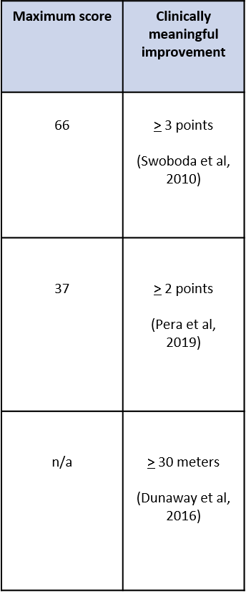
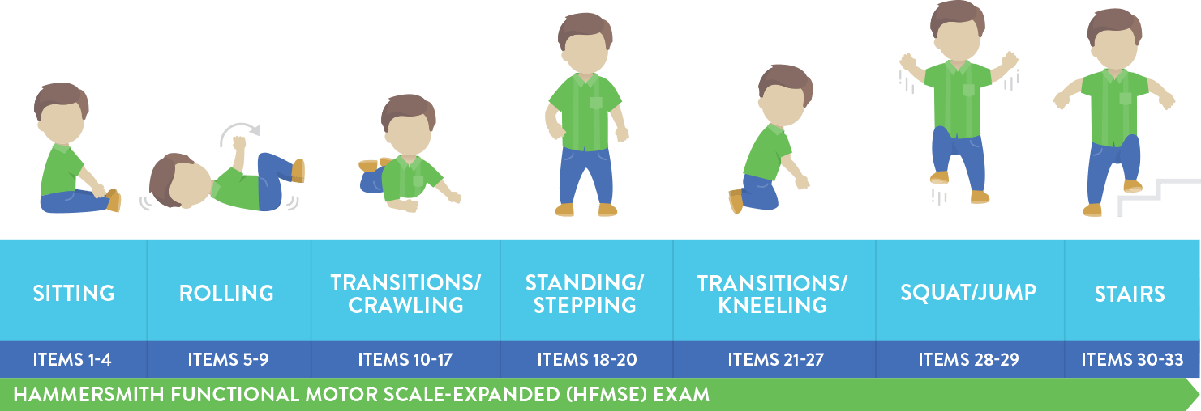
Summary of motor function tests
RECAP
Hammersmith functional motor scale expanded (HFMSE)
Revised Upper Limb Module (RULM)
6 minute- walk test – 6MWT

Slide 7
Summary of main clinical trial evidence
RECAP
Type 1 SMA (‘early onset’)
Type 2/3 SMA (‘later onset’)
ENDEAR (n=122)
CHERISH (n=126)
Randomised, double-blind, multicentre (including the UK), phase III, sham, procedure-controlled trial.
Age between 2 weeks and 6 months
SMN2 copy number = 2
randomised, double-blind, multicentre, phase III, sham, procedure-controlled trial.
Age between 6 months and 12 years
Must be able to sit independently but never walked independently
Additional studies
NURTURE – single-arm pre-symptomatic infants
SHINE – extension of ENDEAR and CHERISH
EMBRACE – for people not eligible for the RCTs
CS2 and CS12 – continuation studies from phase I dose ranging studies in later onset population
CS3A – dose ranging study in infantile onset
Notes:
Data source: ERG report tables 6, 11, 20, 21

Slide 8
NICE committee recommendation
RECAP
Nusinersen is recommended as an option for treating 5q spinal muscular atrophy (SMA) only if:
people have pre-symptomatic SMA, or SMA types 1, 2 or 3 and
the conditions in the managed access agreement are followed
Committee noted that:
Nusinersen substantially improves motor function for people with later‑onset SMA but the effect on survival is unclear
Long-term benefits with nusinersen are uncertain
Notes:
Data source: ERG report tables 6, 11, 20, 21

Slide 9
Managed Access Agreement eligibility criteria
RECAP
Relevant starting criteria:
if independent ambulation is gained before starting therapy patients must still be independently ambulant, with the exception of paediatric patients who have lost independent ambulation in the previous 12 months.
Relevant stopping criteria:
inability to regain ambulation within 12 months of nusinersen initiation in paediatric patients who have lost ambulation in the previous 12 months
Additional stopping rules account for declines in motor functions and patients will stop receiving treatment once the pre-defined thresholds are exceeded
Notes:
Data source: ERG report tables 6, 11, 20, 21

Slide 10
Managed Access committee discussion
RECAP
Committee concluded that:
A managed access agreement has the potential to address uncertainties
Acknowledged the need to manage risks associated with the identified uncertainties. It considered the details of NHSE/I and the company's proposed eligibility criteria in the managed access agreement and concluded that they were clinically achievable
A unique clause was included within the Data Collection Agreement which outlines NICE’s commitment to review new evidence on the potential benefits of nusinersen for non-ambulant type III SMA patients
Notes:
Data source: ERG report tables 6, 11, 20, 21

Slide 11
Evidence review process
Evidence submission from Biogen
Managed Access Oversight Committee review
EAC (independent) review
The MAOC reviews the evidence report from the EAC and indicates whether or not they support the recommendations of the EAC
1. Is the evidence of sufficient quality for decision making?
Yes- the MAA eligibility criteria should be amended to expand access to Type III SMA patients who no longer have independent ambulation
2. Does the new evidence demonstrate a comparable clinical benefit for non-ambulant Type III patients compared with Type II patients (able to sit independently but never had the ability to walk independently)
MAOC supports EAC recommendation
MAOC opposes EAC recommendation
No- the MAA eligibility criteria remains unchanged; patients who are currently ineligible for nusinersen treatment will have access to best supportive care only
3. Does the new evidence provide sufficient new information and demonstrate a comparable clinical benefit to amend the MAA eligibility criteria?
Final recommendation publication
Referral to appraisal committee for adjudication

Slide 12
Summary of evidence submission Company submission – key studies
CS2/CS12
CS11 (SHINE)
open-label, multicentre, multiple-dose, dose-escalation study
2-15 years of age
N=81, but only 9 non-ambulant type III
Motor function outcomes and HRQoL
Presented during original appraisal
Extension of ENDEAR (infantile) and CHERISH (later-onset)
Motor function outcomes and HRQoL
CHERISH eligibility included:
Age between 6 months and 12 years
Must be able to sit independently but never walked independently
Presented during original appraisal
Italian secondary + tertiary care centres
(Maggi et al. 2020)
Registry data commissioned by Biogen
Retrospective
Adults (>18yrs) with ambulant or non-ambulant type III or type II SMA (non-ambulant type III: n=51)
Motor function (HFMSE+RULM)
Observational registry
Spanish, Germany and Italian patients
Children and adults (any age) with either type III or type IV SMA. (non-ambulant type III: n=51)
Comparison of treated vs non-treated and adult vs paediatric
Notes:
Data source: ERG report tables 6, 11, 20, 21

Slide 13
EAC assessment of evidence Quality
Good | Poor
Maggi et al (2020) had good sample size | Very small amount of clinical evidence
All studies had measures administered by objective third party (e.g. therapist) | Vast majority had very low sample sizes
 | Lots of missing or pooled data for type III non-ambulant subgroup
 | Either not stated when patients lost ambulation or includes patients who lost ambulation >12 months ago
 | No comparative clinical evidence with type III non-ambulant control group using best standard care
 | Not randomised
EAC concluded that it does not consider new evidence of sufficient quality for decision-making concerning the existing eligibility criteria with respect to non-ambulant type III SMA patients

Slide 14
EAC assessment of evidence Study outcomes
EAC presented the following studies together:
CS2/CS12 (n=15) and CS11 (n=2)
Yeo et al 2020: US Hospital data records (n=2)
Barp et al 2020: Case series, Italian Neurorehabilitation Unit (n=2)
In total, 9 non-ambulant type III and 12 type II participants
The EAC considered that:
Motor function measures suggest that non-ambulant type III patients are generally already at ceiling or scoring very highly on RULM and show both improvement and deterioration on the HFMSE.
This is compared to type II patients who show marked clinically meaningful improvements of up to 5 points or higher for the HFMSE and 4 points for the ULM.
A great number of type II patients showed clinically meaningful improvements.

Slide 15
EAC assessment of evidence Study outcomes
HFMSE | HFMSE
Type II | 10 | 2 | 0
Type III | 2 | 2 | 2
RULM | HFMSE
Type II | 5 | 1 | 0
Type III | 3 | 6 | 0
Respiratory | HFMSE
Type II | - | - | -
Type III | - | - | 2
6MWT (ambulation) | HFMSE
Type II | 1 gained | 10 not gained
Type III | 2 regained | 2 not regained

Slide 16
EAC assessment of evidence Registry outcomes – Maggi et al (2020)
Had largest sample sizes from the clinical evidence with 51 adult type III non-ambulant patients and 13 adult type II patients
Results were reported as change from baseline to 6 months (T0-T6), 10 months (T0-T10) and 14 months (T0-T14)
Showed statistically significant improvements in motor function measures for non-ambulant type III patients. Only one of the means reached a level of clinically meaningful improvement and ranges reported showed deterioration for some patients.
Type II participants showed no significant improvement.
However, very few patients at the later follow-up
Notes:
baseline to 14 months follow-up; 13-0 for type II and 52-7 for type III non-ambulant

Slide 17
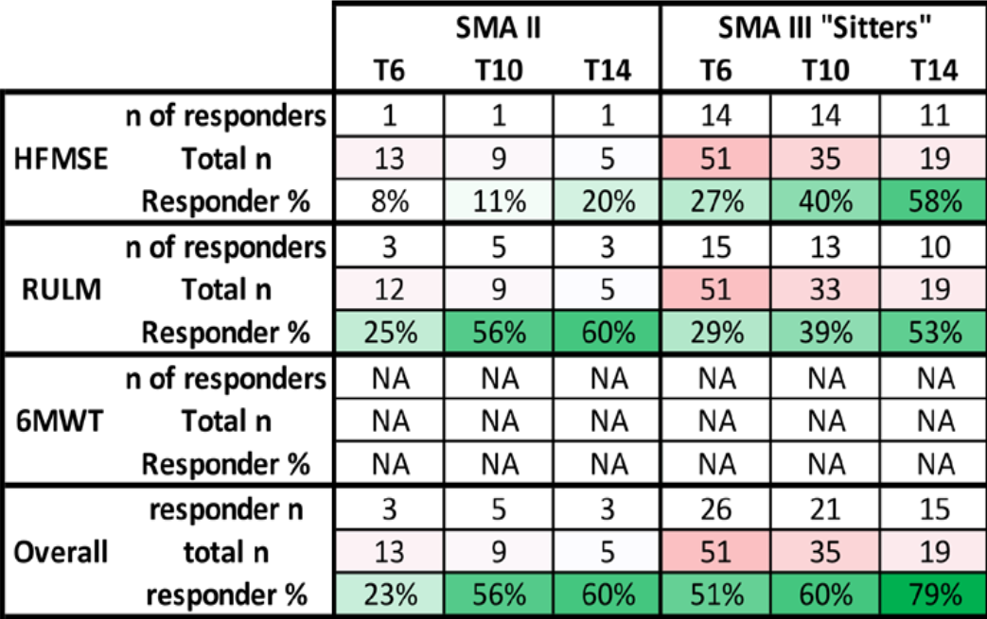
Maggi et al (2020)
Figure adapted from Maggi et al (2020): Heatmap/table of clinically meaningful functional improvements during treatment.
Red colour code corresponds to population size at given time
Green colour code corresponds to % of responders (ie, patients with clinically meaningful improvement) at a given time point
Notes:
baseline to 14 months follow-up; 13-0 for type II and 52-7 for type III non-ambulant

Slide 18
Maggi et al (2020) – mean change in HFMSE score
*
*
*
Clinically meaningful
*
Statistically significant
*Hammersmith functional motor scale expanded

Slide 19
Maggi et al (2020) – mean change in RULM score
*
*
Clinically meaningful
*
Statistically significant
*Revised Upper Limb Module

Slide 20
EAC assessment of evidence Registry outcomes – Biogen commissioned
European data of 168 type III non-ambulant patients
159 treated with nusinersen (REDACTED TEXT adult, REDACTED TEXT paediatric)
9 untreated (REDACTED TEXT adult, REDACTED TEXT paediatric)
Used standard linear modelling to report estimated/predicted amount of change for HFMSE and RULM over 12 months.
Data showed that showed REDACTED TEXT over 12 months.
EAC considers this a very good sample size but note that this is modelled data and there are relatively few participants in the comparison group

Slide 21
EAC assessment of evidence Registry outcomes – Biogen commissioned
Adult patients
Paediatric patients
REDACTED TEXT
REDACTED TEXT
Hammersmith functional motor scale expanded and Revised Upper Limb module

Slide 22
Summary of evidence submission Patient advisory group feedback
As part of the MAA review, evidence was invited from patient groups. These are included within the appendices of the company submission.
SMA UK submitted evidence on:
Survey asking about ‘The Impact of Not Being Eligible for Treatment on Those Who Have SMA Type III and Their Families’
PROMS follow-up surveys of two children who had lost ability to walk and will be subject to stopping criteria of remaining ambulant
Testimonies from adults in Europe who have SMA Type III, have lost their ability to walk and have been treated with nusinersen
Importance of treatment outcomes to those with Type II and Type III

Slide 23
Summary of evidence submission Patient advisory group feedback
The evidence re-enforces the severe impact that SMA has on the quality of life of patients, carers and their families
Eligibility criteria that stops a small group from receiving this drug is extremely distressing and is unfair
The need to meet eligibility criteria to receive, and continue to receive, nusinersen is stressful for patients and their families
Treatment which stops the progression of disease would be life-changing, even if it doesn’t mean regaining ambulation
People who have lost the ability to walk but have received nusinersen report improvements in daily activities
Notes:
Data source: ERG report tables 6, 11, 20, 21

Slide 24
Summary of evidence submission Clinician case series
As part of the MAA review, evidence was invited from clinicians on the use of nusinersen within the UK. These are included within the appendices of the company submission.
Case series were presented for
2 siblings: one who is non-ambulant and not treated with nusinersen, and one who is ambulant and treated with nusinersen
2 siblings: one who is non-ambulant and not treated with nusinersen, and one who is ambulant and treated with nusinersen
1 patient who has lost ambulation on nusinersen
1 patient who has regained ambulation nusinersen
Notes:
Data source: ERG report tables 6, 11, 20, 21

Slide 25
EAC assessment of evidence Patient advisory group feedback
Testimonial information from 94 patients and/or family members.
55 from non-ambulant type III patients or family members from 5 sources
41 from concerning either type II, ambulant or not treated with nusinersen
Of the 5 sources:
1 presented information from people who are non-ambulant with type III SMA about the impact of being ineligible for treatment under the managed access agreement, including the mental health impact.
1 reported importance of specific outcomes to patients other than being able to walk
3 related to the effects of receiving treatment (in both children and adults)
Vast majority in favour of nusinersen in the non-ambulant type III population
However, EAC concluded that, it is not possible to validate these reports and so it was not appropriate for us to use this information in decision making process

Slide 26
EAC assessment of evidence Conclusion
New evidence does not provide sufficient new information and demonstrate a comparable clinical benefit for non-ambulant patients to support a recommendation to amend the MAA eligibility criteria to expand access to non-ambulant type III SMA patients
The quality of evidence as a whole is too poor and the results too inconclusive
The majority of the evidence appears to show that those who are type III non-ambulant would show less improvement that those with type II

Slide 27
MAOC consideration of evidence
MAOC do not support the recommendation of the EAC and recommend access should be expanded to non-ambulant type III SMA patients
The MAOC considered that the objectives of the interim review did not allow for the evidence to be considered fairly and highlight:
assessing the quality of the evidence for decision-making was not considered in the context of SMA as a rare disease
current SMA classification systems were not developed to distinguish between groups of patients for commissioning purposes
EAC has relied upon clinically meaningful improvement in clinical studies, which do not reflect outcomes that patient’s report as being important for them
stabilisation (as opposed to an improvement) is the benefit of nusinersen for this group and the framing of the question for the evidence review does not allow for consideration of this point
patient accounts of the benefits of treatment were not considered

Slide 28
MAOC consideration of evidence SMA classification
SMA classification system was intended to aid our understanding of disease states - not act as a barrier to access treatment
boundaries between the different SMA clinical classifications are not clear cut and the application of a type can be a subjective decision
the assessment of ambulation is very subjective and can vary from day to day
the MAA applies the WHO definition for independent ambulation which we heard is not commonly used in clinical classification and so has created inconsistencies with regards to nusinersen access

Slide 29
MAOC consideration of evidence Stabilisation is the aim of treatment
Nusinersen preserves motor neurones, rather than creating new ones
‘Comparable clinical benefit’ to type IIs is the wrong benchmark to consider. Instead, the benchmark for these patients should be stabilisation of disease
The evidence presented demonstrate that nusinersen stabilises patients

Slide 30
MAOC consideration of evidence disease assessment scales
The disease assessment scales measure functional ability, e.g. the ability to walk
These do not capture important outcomes that relate to upper limb and fine motor skills. These can be very important to patients and as they have great impacts on maintaining independence
Benefits of treatment which are important to patients but are not captured in the scales presented in the evidence review include:
Increased energy levels allowing patients to perform better at work or school
Being able to transfer independently to a wheelchair
Maintaining voice strength and the ability to talk

Slide 31
MAOC consideration of evidence patient voice was not considered
Patient reported outcomes were not considered sufficiently by the EAC
They note that this evidence highlights:
The mental impact of being unable to access treatment
The benefits of nusinersen that are not captured by current assessment scales
Evidence to determine what is a clinically meaningful difference to patients

Slide 32
MAOC consideration of evidence SMA is a rare disease
The EAC considered that the evidence submitted was of insufficient quality to recommend changing the eligibility criteria
The MAOC considered that the level of evidence submitted, that is real world evidence as opposed to randomised studies, was of the quality expected given the rarity of SMA
The MAOC highlighted that several publications they considered relevant to this evidence review had not been included in the EAC’s report or presentation and requested further detail on reasons why this evidence was omitted.

Slide 33
Additional Evidence
By exception, NICE has accepted a further evidence submission from the patient groups following the MAOC meeting, including:
A video detailing an SMA patient’s perspective provided in the papers ahead with a request from the patient groups that this video be viewed as part of Committee’s deliberations
Additional unpublished paper from Muntoni et al
Statistically significant improvement in mean HFMSE and RULM scores at 12 months for non-ambulant type IIIs
Type III ‘sitters’ | N | Baseline Mean Score (95%CI) | 12-month Mean Score (95%CI) | Mean difference (95%CI) | p-value
HFMSE score |  | REDACTED TEXT REDACTED TEXT | REDACTED TEXT | REDACTED TEXT | REDACTED TEXT
RULM score | REDACTED TEXT | REDACTED TEXT | REDACTED TEXT | REDACTED TEXT | REDACTED TEXT
EAC has not critiqued additional evidence

Slide 34
Key issues
Considering the new evidence that has become available since the eligibility criteria were developed, does Committee consider that there is sufficient evidence of a reasonable quality to amend the existing treatment criteria, and thereby allow access for non-ambulant type III SMA patients?

