Slide 1
Lead team presentation
Durvalumab for maintenance treatment of unresectable non-small cell lung cancer after platinum-based chemoradiation
Rebecca Harmston, David Bowen, Peter Hall
ERG: Kleijnen Systematic Reviews
Technical team: Gary McVeigh, Lucy Beggs, Victoria Kelly, Jasdeep Hayre, Linda Landells
Company: AstraZeneca
14th February 2019

Slide 2
Key issues
Trial generalisability: Is PACIFIC generalisable to the NHS population in England?
If not, can this be resolved with data collection or adjustment to hazards used in the model?
Treatment effect duration: Is the likely treatment effect duration 3 or 5 years?
Progression-free survival: Is a log-normal extrapolation of durvalumab appropriate?
Utility values: Are the utility values from PACIFIC with treatment-related decrement applied appropriate?
End of life: Does durvalumab meet NICE’s end of life criteria?
Cancer Drugs Fund: Does durvalumab meet the criteria for inclusion in the CDF?
Innovation: Are there any benefits of durvalumab not captured in the QALY?
Equalities: Are there any equalities issues that need to be taken into account?

Slide 3
Durvalumab (Imfinzi, AstraZeneca)
Description of technology | Human monoclonal antibody that targets the ‘programmed death ligand-1’ (PD-L1) protein. Durvalumab blocks PD-L1 interaction with both PD-1 and CD80 on T cells, countering the tumour's immune-evading tactics and activating the immune system to attack the cancer.
Marketing authorisation | [Durvalumab] as monotherapy is indicated for the treatment of locally advanced, unresectable non-small cell lung cancer (NSCLC) in adults whose tumours express PD-L1 on ≥ 1% of tumour cells and whose disease has not progressed following platinum-based chemoradiation therapy.
Dosage and administration | 10 mg/kg administered as an intravenous infusion over 60 minutes every two weeks.
Stopping rule | Summary product characteristics = Treatment until disease progression or unacceptable toxicity, or a maximum of 12 months.

Slide 4
Patient and carer perspectives
Submission form National Lung Cancer Forum for Nurses
Lung cancer is a distressing condition with numerous complex symptoms
Many people have co-morbidities which affect performance status & quality of life
Carers of people with lung cancer often feel helpless
Treatments for lung cancer remain limited → unmet need
Treatments are seen as a life line and new treatments provide hope
People with lung cancer and their carers welcome new treatments which improve symptoms and survival without having a negative impact on quality of life
Side effects & quality of life are always important, but especially when a cure is not possible
Any treatment which can improve side effects and quality of life is a bonus
Durvalumab appears to be well tolerated and to reduce recurrent disease in this population
Durvalumab also appears to have a survival benefit

Slide 5
Background
Comparators | Best supportive care
Key clinical trial | Subgroup of PACIFIC randomised controlled trial comparing durvalumab with placebo in PD-L1 ≥1% (n=303)
Key results | PFS HR: 0.44 (95% CI: 0.30, 0.64) OS HR: 0.54 (95% CI: 0.35, 0.81)
Model | Semi-markov state transition model with 3 health states: progression-free, progressed disease, death
Company ICER | £28,433/QALY gained
Technical team preferred deterministic ICER | £48,631 to £48,649/QALY gained
ICER range across scenarios | £22,503/QALY gained to £65,040/QALY gained

Slide 6
Issues resolved after technical engagement
 | Summary | Technical team consideration | Stakeholder responses | Updated company base case?
4* | Company did not apply age-related decrement to utilities in original submission. | Apply age-related disultility. | Calculated decrement from Kind (1999); applied additively p/cycle. | ✓
5 | Company considered effect of adverse events captured in utility values. ERG highlighted that incidence varied by treatment. | Apply adverse event decrement derived from mixed-effects model of trial data. | Accept ERG’s approach. | ✓
6 | Company assumed 100% vial sharing in original submission. | Due to small number of eligible patients, vial sharing unrealistic. | Company consider vial sharing may still be realistic but assume 0% to reduce uncertainty. | ✓
*Partial resolution of issue; other considerations still outstanding.

Slide 7
Outstanding issues after technical engagement
Issue 1: Overlapping vs sequential prior chemoradiation therapy (CRT) and generalisability of PACIFIC trial
Issue 2: Treatment effect duration
Issue 3: Progression-free survival (PFS) extrapolation
Issue 4: Health state utilities
Issue 7: End of life considerations
Issue 8: Cancer Drugs Fund

Slide 8
Issue 1: Overlapping vs sequential prior CRT therapy (1)
Durvalumab’s MA covers people who have had overlapping or sequential cycles of prior CRT, whereas PACIFIC trial only recruited people after 2+ overlapping cycles of CRT
Company submission indicates that 66% of patients receive sequential CRT in UK
Overlapping CRT may improve survival over sequential CRT (although clinical expert advises that difference is likely to be small)
Patients who are suitable for overlapping CRT may have a better prognosis (and so better survival outcomes) than patients who are not suitable for overlapping CRT
Response from engagement:
Company report that clinical experts agree that difference in outcomes between overlapping and sequential CRT is likely to be small
Sequential CRT will be explored in PACIFIC-6 RCT and PACIFIC-R follow up of early access programme *************→ company pursuing CDF
Scenario with risk from Auperin meta-analysis* (HR=0.9) applied to data to reflect sequential CRT → scenario presented in cost-effectiveness results
Roy Castle Lung Cancer Foundation: majority receive sequential CRT, but practice would change if durvalumab was recommended in people with prior overlapping CRT
Agree that difference in outcomes between types of CRT are likely to be small
*Meta-analysis of RCTs of PFS in overlapping vs sequential CRT (HR, 0.90; 95% CI, 0.79 to 1.01)

Slide 9
Issue 1: Overlapping vs sequential prior CRT therapy (2)
Response from engagement cont:
BTOG-NCRI-ACP-RCP-RCR consider the ‘sequential’ cohort to be older and have more co-morbidities than the PACIFIC cohort (leading to worse performance status)
Toxicity in sequential cohort is unknown and should not be extrapolated from PACIFIC
Studies such as PACIFIC-6 are needed to provide robust data for the sequential cohort
PACIFIC is generalizable to patients fit for overlapping CRT
ERG comment:
Comparisons of CRT types are largely based on expert opinion rather clinical trial data
Company’s exploration of cost-effectiveness in sequential CRT population is reasonable
Technical report:
Remains uncertainty about the comparability of overlapping and sequential prior-CRT
However, PACIFIC is the best available source of evidence for this appraisal
Are data from PACIFIC generalisable to NHS population in England?
If not, can this be resolved through:
Further data collection?
Adjustment to hazards used in economic model?

Slide 10
Issue 2: Treatment effect duration (1)
Company’s original base-case assumed 10 year treatment effect duration
Clinical expert advice indicated that treatment effect duration of up to 5 years is realistic
Previous NSCLC appraisals in the advanced setting assume 3-5 year treatment effect duration → these appraisals have typically had 2 year stopping rule (rather than 1 year)
Some choices of extrapolation lead to counter-intuitive results, where decreasing the treatment effect duration decreases the ICER
These counter-intuitive results happens in scenarios where the hazard functions for treatment arms cross, and the treatment effect duration is varied around this point
Response from engagement:
Company: updated model assumes 5 year treatment effect (with 3 & 10 year scenarios)
Although stopping rule differs from other NSCLC appraisals, earlier stage & use after CRT may mean same treatment effect duration still plausible
Uncertainty can be addressed with PACIFIC follow-up data
Treatment effect waning not seen in PACIFIC follow up (~41mnth) → 3 years not realistic

Slide 11
Issue 2: Treatment effect duration (2)
Response from engagement cont:
Company: Proposed amendment to model to ‘cap’ the hazard functions so that hazard of progression in durvalumab arm cannot exceed risk of progression in SoC → resolves issue of counter-intuitive results
Applying the hazard cap affects modelled treatment effect duration depending on which extrapolation is used (for example, limits treatment effect duration to 39 months when using log-normal extrapolation in durvalumab arm and generalised gamma in SoC)
Roy Castle Lung Cancer Foundation: 5 years seems reasonable
ERG comment:
ERG base-case incorporates company’s amendment to ‘cap’ the hazard curves
Technical report:
Reasonable to assume a 3-5 year treatment effect duration
Incorporate company’s amendment to ‘cap’ hazard curves
Uncertainty about treatment effect duration could be reduced with PACIFIC follow-up data.
What is the likely treatment effect duration?

Slide 12
Issue 3: Progression-free survival extrapolation (1)
Company initially modelled generalised gamma extrapolation of both treatment arms
ERG & clinical expert consider that generalised gamma is acceptable for SoC (predicting 17%, 13% and 8% PFS at 3, 5 and 10 years)
However, consider predictions in durvalumab arm are optimistic (46%, 40% and 26% PFS at 3, 5 and 10 years)
ERG propose log-normal extrapolation of durvalumab arm (predicting 38%, 27% and 17% PFS at 3, 5 and 10 years); clinical expert considers predictions realistic
DSU Technical Support Document 14 advises that the same extrapolation distribution is used for both arms, but ERG consider that the deviation is justified as immunotherapy plausibly changes natural history of disease
Technical team note that both the company and ERG models predict proportion of patients remaining progression-free at 10 years → cure rate model explored in a scenario analysis
Updated after committee meeting to correct factual inaccuracy

Slide 13
Issue 3: Progression-free survival extrapolation (2)
Company response to engagement:
Clinical experts consulted by the company predicted 10-25% point difference in progression-free survival for the durvalumab arm vs SoC arm at 10 and 15 years
Parametric extrapolations (scenarios 3a to 3d):
Company base-case remains generalised gamma extrapolation for both treatment arms
Scenarios exploring log-normal extrapolation in durvalumab arm & in both arms
Scenario with 50:50 average of generalised gamma & log-normal in durvalumab arm
Cure rate model based on time threshold (scenarios 3e & 3f):
People progression-free after 5 or 10 years are ‘cured’ with no risk of progression
Scenarios conditional on base-case (generalised gamma extrapolation in both arms)
Mixture cure rate model based on underlying risk (scenario 3g):
Proportion of patients assumed to have reduced risk of event (‘cured’ group)
Extrapolations ranked by statistical goodness-of-fit, then chosen on basis of proportion of patients predicted to be cured (log-normal in both treatment arms)
Updated from original technical report to correct factual inaccuracy

Slide 14
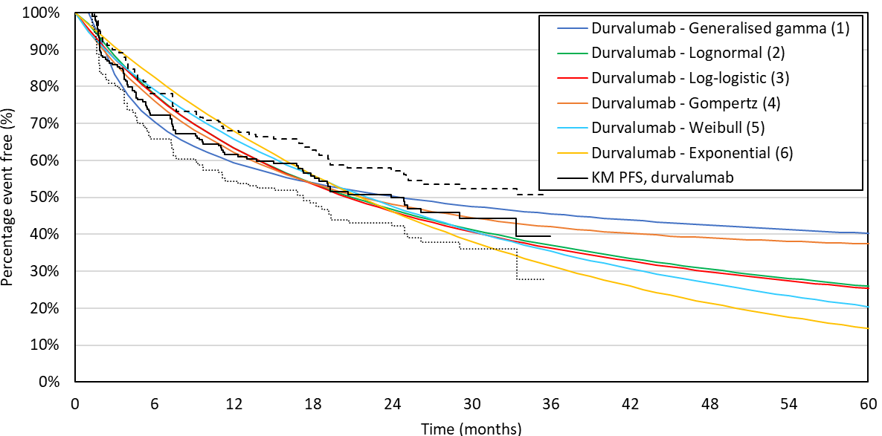
Issue 3: Progression-free survival extrapolation (3)
Parametric extrapolations of durvalumab PFS (up to 5 years):

Slide 15
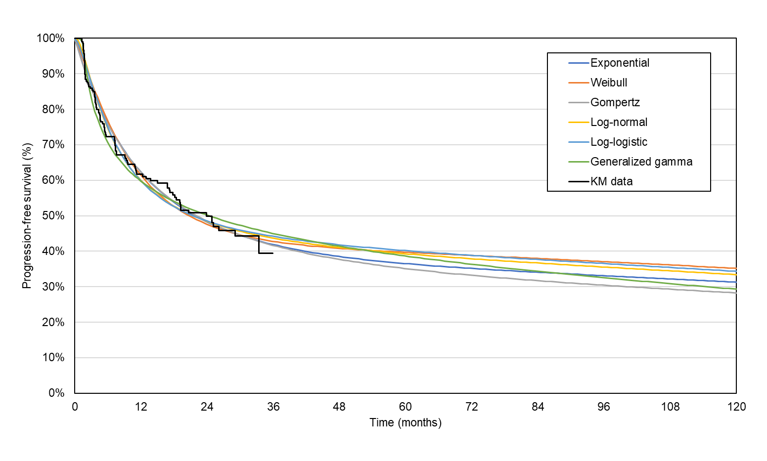
Issue 3: Progression-free survival extrapolation (4)
Scenario 3g: Extrapolations of durvalumab PFS from the mixture cure rate model (up to 10 years)

Slide 16
Issue 3: Progression-free survival extrapolation (5)
Response from engagement:
Company submitted following scenarios (3a = base-case):
 | Durvalumab (predictions based on 5 year treatment effect duration) | PFS in durvalumab arm
 |  | 3 year | 5 year | 10 year
3a | Generalised gamma for both arms | 46% | 40% | 26%
3b* | Log-normal durvalumab & generalised gamma SoC | 38% | 27% | 17%
3c* | Log-normal for both arms | 37% | 26% | 9%
3d | Average of generalised gamma & log-normal for both treatment arms | 42% | 33% | 18%
3e | Generalised gamma for both arms, patients progression-free at 5 years assumed ‘cured’ | 46% | 40% | 36%
3f | Generalised gamma for both arms, patients progression-free at 10 years assumed ‘cured’ | 46% | 40% | 26%
3g | Mixture cure rate model with log-normal for both arms (implies ******durvalumab & ****** SoC ‘cured’) | 44% | 39% | 33%
Cure rate models
*Hazard functions ‘capped’ to risk in durvalumab arm always ≤ risk in SoC arm to prevent spurious results when varying treatment effect duration
Updated after committee meeting to correct factual inaccuracy

Slide 17
Issue 3: Progression-free survival extrapolation (6)
ERG comment:
Generalised gamma extrapolation of durvalumab likely overestimates PFS
Very few patients at the end of the KM curve → extrapolations highly uncertain
KM data suggests hazards are non-monotonic (exponential, Weibull and Gompertz distributions assume monotonic hazards and are therefore inappropriate)
No scientific or clinical basis to use ‘average’ of log-normal/generalise gamma curves
The cure rate models which assume that people who have not progressed after a given time point are overly optimistic and lack clinical rationale
PACIFIC data are not mature enough to establish the proportion of people who are cured, meaning a mixture cure rate model is of limited use
ERG preferred approach is a log-normal for durvalumab & generalised gamma for SoC
ERG base-case incorporates company’s amendment to ‘cap’ the hazard curves
Technical report:
Agree with ERG preferred approach
Is a log-normal extrapolation of the durvalumab arm appropriate?
If not, which method of extrapolating PFS is appropriate?

Slide 18
Issue 4: Utility values
Company’s original model used utilities derived from PACIFIC EQ-5D data but progression-free utility value was higher than general population → clinical expert considers unrealistic
Response from engagement:
Company: PACIFIC is only source of EQ-5D data for the progression-free (PF) population
Accounting for trial population World Health Organisation (WHO) performance status, PACIFIC utility for PF does not lack face validity
Ara and Brazier (2011) approximates general cancer utility values where condition specific data are not available → data on duration or severity of the condition were not collected
Updated base-case uses PF utility value from PACIFIC and progressed disease (PD) utility from literature
Updated base-case applies age-related decrement of -0.004 from Kind et al. (1999)
ERG comment: Taking utilities from PACIFIC for PF state and literature for PD state may overestimate utility loss of progressed disease relative to remaining progression free
Technical report:
Company’s modelling of age-related disutility is acceptable
Prefer to use utilities from PACIFIC for both health states with treatment-related decrement applied (PF: 0.827 for SoC & 0.803 for durv, PD: 0.793 for SoC & 0.769 for durv)
Are the trial utilities with the treatment-related decrement appropriate?
Updated after committee meeting to correct factual inaccuracy

Slide 19
Issue 7: End of life considerations (1)
Life expectancy:
Company argue < 24 months based on evidence from National lung Cancer Audit, Public Health England, the SOCCAR trial (a Phase 2 trial which compared overlapping CRT with sequential CRT in people with unresectable Stage III NSCLC) and clinical expert opinion
Median OS in PACIFIC SoC arm was 29.1 months
Company & ERG models predict SoC mean OS= 54.8 months & median OS= 28.5 months
Extension to life:
PACIFIC OS 24-month: 72.8% (durv.) vs 53.6% (placebo) (HR [95% CI] = 0.53 [0.36, 0.77])
Company model predicts 52.5 month extension to life & ERG model predicts 31.7 month
Response from engagement:
Company: Although mean and median OS in PACIFIC indicate that durvalumab does not meet end-of-life criteria, UK-specific real world data should also be considered
Sequential cohort likely to have poorer prognosis than PACIFIC cohort
Highlighted several UK based studies with median OS ranging 18.4 to 22.3 months
Evidence from PACIFIC suggests survival benefit over SoC of more than 3 months
Updated after committee meeting to correct factual inaccuracy

Slide 20
Issue 7: End of life considerations (1)
Response from engagement cont:
Roy Castle Lung Cancer Foundation: National Lung Cancer Audit and other trial data shows that average life expectancy for locally advanced unresectable Stage III patients is less than 24 months
BTOG-NCRI-ACP-RCP-RCR: SoC arm in the RTOG 0617 study had a median survival of 28 months, but this study was in people offered overlapping CRT → for UK population a median survival of around 24 months would be more realistic
Durvalumab extends life for more than 3 months compared to standard care
ERG comment:
ERG does not consider durvalumab to meet the end of life criteria
Technical report:
PACIFIC & economic models indicate that extension to life criteria is met
PACIFIC trial, ERG & company models = OS >24 months in standard of care arm
Durvalumab does not meet the short life expectancy criteria and therefore does not meet the end of life criteria specified in NICE’s guide to the methods of technology appraisal
What is the life expectancy of patients receiving standard of care?
How long does durvalumab extend life for?

Slide 21
Issue 8: Cancer Drugs Fund (1)
Committee decision making criteria:
Starting point: drug not recommended for routine use due to clinical uncertainty
1. Is the model structurally robust for decision making? (omitting the clinical uncertainty)
Proceed down if answer to each question is yes
2. Does the drug have plausible potential to be cost-effective at the offered price, taking into account end of life criteria?
3. Could further data collection reduce uncertainty?
4. Will ongoing studies provide useful data?
and
5. Is CDF data collection via SACT relevant and feasible?
Consider recommending entry into CDF
(invite company to submit CDF proposal)
Define the nature and level of clinical uncertainty. Indicate the research question, analyses required , and number of patients in NHS in England needed to collect data.

Slide 22
Issue 8: Cancer Drugs Fund (2)
Response from engagement:
Company: pursuing CDF (focusing on population with prior sequential CRT)
Median duration of follow-up = 21.1 months for placebo & 26.9 months for durvalumab
Further data for overlapping CRT cohort will be available in ****** through:
Final analyses from PACIFIC (with ~five years of follow-up & ***************** *************************)
Further data for sequential CRT cohort will be available in ****** through:
PACIFIC-6 study of durvalumab in people with prior sequential CRT
PACIFIC-R observation study (including follow-up of early access programme)
CDF will give access to sequential population with significant unmet need and a small number of eligible patients while company collect additional relevant clinical trial data
Roy Castle Lung Cancer Foundation: Unmet need in the population, and PACIFIC suggests clinical benefit of durvalumab → as data matures and new data become available, hope that durvalumab can be available through the CDF

Slide 23
Issue 8: Cancer Drugs Fund (3)
Additional considerations about CDF & data collection :
Primary endpoints for OS & PFS in PACIFIC have been met
PFS data from PACIFIC are 73% mature in durvalumab arm and 47% mature in SoC arm
OS data from PACIFIC are 50% mature in Soc and 33% mature in durvalumab
Median PFS in PACIFIC SoC arm was 5.6 months (low compared with other trials in Stage 3 NSCLC) → future data collection may provide information on whether SoC treatment arm is generalisable
NHS England considers that PACIFIC results are promising but uncertain, and welcome application for durvalumab to enter the CDF
Would also welcome more mature data on subsequent treatment
Subsequent treatment with immunotherapy in company submission is low (8.5% in durvalumab arm & 24% in SoC arm) → likely to be due to immaturity of follow-up data
Technical report:
No plausible potential for cost-effectiveness at current value proposition
If committee accept modelling assumptions that resulted in a plausible range of ICERs with lower end under £30,000 durvalumab could be considered for the CDF
Does durvalumab meet the criteria for inclusion in the Cancer Drugs Fund?
Updated after committee meeting to correct factual inaccuracy

Slide 24
CDF clinical lead statement
Overlapping & sequential CRT are used in patients (overlapping cohort is typically fitter)
RTOG 9410 trial shows 5 year OS after overlapping vs sequential CRT was 16% vs 10%, and smaller Japanese trial showed 16% vs 9% → overlapping CRT is preferred treatment for people who are eligible
Increased use of PET scanning since trials → 5 year OS of 20-30% after overlapping CRT
Uncertainty about subsequent treatments due to immaturity of PACIFIC data
Company modelled % of people receiving pembrolizumab & nivolumab are highly uncertain (and nivolumab is not used in routine commissioning)
People who progress after durvalumab would receive pembrolizumab, atezolizumab or chemotherapy (or targeted treatment for EGFR/ALK+)
People who progress on durvalumab would not receive further immunotherapy
PACIFIC shows small but definite increase in serious toxicities in durvalumab arm
PACIFIC is broadly generalisable only to the population having overlapping CRT
Clinical and cost effectiveness of durvalumab after sequential CRT is unknown
Cost of PD-L1 testing does not need to be included in model as are already routinely funded
Proposed commissioning criteria based on overlapping CRT cohort only

Slide 25
Additional areas of uncertainty
Issue | Why issue is important | Impact on ICER
Submission based on more restricted population that NICE scope (due to regulatory approval) | PACIFIC not designed to be powered for PD-L1 >1% subgroup PD-L1 >1% subgroup determined post-randomisation Time-to-progression & post-progression survival analyses not pre-specified. | Unknown
Demographics of trial population | PACIFIC was not stratified by PD-L1 status, and only included 8 UK patients At engagement, company provided supporting data from NCRAS* | NCRAS data reduces uncertainty, but some uncertainty remains (see Issue 1).
Model structure | Company model post-progression survival rather than explicitly modelling overall survival → based on smaller sample size PPS determined post-randomisation PPS data based on people who progressed within trial follow-up, may not represent people who progress later | Magnitude and direction of any bias are unclear.
*NCRAS=National Cancer Registration and Analysis Service

Slide 26
Other issues for information
Issue | Comments
Stopping rule | Until disease progression, unacceptable toxicity or for maximum 12 months
Post-progression survival | Extrapolated using exponential distribution
Modelling of subsequent treatment | Modelling in line with PACIFIC distribution Costed in line with distribution used in PACIFIC
Innovation | Company considers durvalumab to be innovative Technical team considers all relevant benefits captured in model
Equalities | NHS England have raised an equalities consideration for patients who have insufficient tissue for PD-L1 testing or whose PD-L1 test fails
Are there any equalities issues that need to be taken into account?
Are there any benefits of durvalumab not captured in the QALY?

Slide 27
Cost effectiveness results: company base-case
Key assumptions in company base-case:
5 year treatment effect duration
Generalised gamma extrapolation of durvalumab and SoC treatment arms
Progression free survival utility values from PACIFIC (0.803 for durv, 0.827 for SoC)
Progressed disease utility value from literature (0.67)
 | Total costs | Total QALYs | Inc. costs | Inc. QALYs | ICER (£/QALY)
Deterministic base-case
Durvalumab | ********* | ****** | ********* | 2.26 | £28,433
SoC | ********* | ******
Probabilistic base-case
Durvalumab | ********* | ****** | ********* | 2.07 | £31,387
SoC | ********* | ******
NB. Results do not contain commercial arrangements for durvalumab or subsequent treatments → will be presented in Part 2

Slide 28
Cost effectiveness results: ERG base-case & technical report
Key assumptions:
Log-normal extrapolation of durvalumab, generalised gamma extrapolation of SoC
Hazard ‘cap’ applied so risk of progression in durvalumab never exceeds SoC
Utility values from PACIFIC with age-related disutility and treatment included as covariate in mixed-effects model
ERG assumes 5 year treatment effect duration, technical report assumes 3-5 year
However, hazard ‘cap’ using log-normal extrapolation means duration capped at 39 months
Inc. costs | Inc. QALYs | ICER (£/QALY)
3 year treatment effect duration
Deterministic base-case
********* | 1.36 | £48,649
Probabilistic base-case
Not provided |  | £ 49,290
Inc. costs | Inc. QALYs | ICER (£/QALY)
5 year treatment effect duration
Deterministic base-case
********* | 1.36 | £48,631
Probabilistic base-case
********* | 1.38 | £48,031
NB. Results do not contain commercial arrangements for durvalumab or subsequent treatments
NB. Results do not contain commercial arrangements for durvalumab or subsequent treatments → will be presented in Part 2

Slide 29
Scenario analyses: progression-free survival & treatment effect duration (deterministic)
Based on ERG & technical report preferred utility values
Exploration of progression-free survival modelling (analyses run by NICE technical team) | ICER (£/QALY)
 | 3yr tx effect duration | 5yr tx effect duration
Generalised gamma for both arms | £37,157 | £29,378
Log-normal durvalumab & generalised gamma SoC* | £48,649 | £48,631
Log-normal for both arms* | £65,040 | £52,680
Average of generalised gamma & log-normal for both treatment arms | £45,879 | £36,579
Generalised gamma for both arms, patients progression-free at 5 years assumed ‘cured’ | £30,139 | £23,210
Generalised gamma for both arms, patients progression-free at 10 years assumed ‘cured’ | £36,164 | £28,488
Mixture cure rate model with log-normal for both arms (implies ******* durvalumab & ******* SoC ‘cured’) | £31,275 | £29,260
NB. Results do not contain commercial arrangements for durvalumab or subsequent treatments → will be presented in Part 2
*Hazard cap applied where appropriate
Updated after committee meeting to correct factual inaccuracy

Slide 30
Scenario analysis: adjustment for sequential CRT
Key assumptions:
Log-normal extrapolation of durvalumab, generalised gamma extrapolation of SoC
Hazard ‘cap’ applied so risk of progression in durvalumab never exceeds SoC
HR of 0.9 applied to PACIFIC data to reflect performance of sequential CRT cohort (HR taken from Auperin et al. (2010) meta-analysis)
Scenarios:
Utility values from PACIFIC with treatment-related decrement (tech. report & ERG preferred)
Utility values from literature with treatment-related decrement applied (progression-free: 0.73 for SoC & 0.706 for durv, progressed: 0.67 for both)
Literature based values explored as are lower than trial utilities, and may better reflect sequential CRT cohort (as this cohort has worse prognosis at baseline)
Utilities | Deterministic ICER (£/QALY)
 | 3 year treatment effect duration | 5 year treatment effect duration
PACIFIC | £ 52,193 | £ 52,175
Literature | £ 58,156 | £ 58,135
NB. Results do not contain commercial arrangements for durvalumab or subsequent treatments → will be presented in Part 2

Slide 31
Key issues
Trial generalisability: Is PACIFIC generalisable to the NHS population in England?
If not, can this be resolved with data collection or adjustment to hazards used in the model?
Treatment effect duration: Is the likely treatment effect duration 3 or 5 years?
Progression-free survival: Is a log-normal extrapolation of durvalumab appropriate?
Utility values: Are the utility values from PACIFIC with treatment-related decrement applied appropriate?
End of life: Does durvalumab meet NICE’s end of life criteria?
Cancer Drugs Fund: Does durvalumab meet the criteria for inclusion in the CDF?
Innovation: Are there any benefits of durvalumab not captured in the QALY?
Equalities: Are there any equalities issues that need to be taken into account?

Slide 32
Back up slides

Slide 33
Scenario analyses: progression-free survival & treatment effect duration
Based on company preferred utility values
Exploration of progression-free survival modelling (analyses run by NICE technical team) | ICER (£/QALY)
 | 3yr tx effect duration | 5yr tx effect duration
Generalised gamma for both arms | £35,838 | £28,433
Log-normal durvalumab & generalised gamma SoC* | £46,631 | £46,615
Log-normal for both arms* | £61,926 | £50,475
Average of generalised gamma & log-normal for both treatment arms | £44,073 | £35,298
Generalised gamma for both arms, patients progression-free at 5 years assumed ‘cured’ | £29,138 | £22,503
Generalised gamma for both arms, patients progression-free at 10 years assumed ‘cured’ | £34,889 | £27,576
Mixture cure rate model with log-normal for both arms (implies ******* durvalumab & ******* SoC ‘cured’) | £30,235 | £28,307
NB. Results do not contain commercial arrangements for durvalumab or subsequent treatments → will be presented in Part 2
*Hazard cap applied where appropriate
Updated after committee meeting to correct factual inaccuracy

Slide 34
Scenario analyses: progression-free survival & treatment effect duration
Based on literature based utility values
Exploration of progression-free survival modelling (analyses run by NICE technical team) | ICER (£/QALY)
 | 3yr tx effect duration | 5yr tx effect duration
Generalised gamma for both arms | £41,722 | £33,107
Log-normal durvalumab & generalised gamma SoC* | £54,334 | £54,315
Log-normal for both arms* | £71,688 | £58,446
Average of generalised gamma & log-normal for both treatment arms* | £51,204 | £41,017
Generalised gamma for both arms, patients progression-free at 5 years assumed ‘cured’ | £34,000 | £26,262
Generalised gamma for both arms, patients progression-free at 10 years assumed ‘cured’ | £40,635 | £32,125
Mixture cure rate model with log-normal for both arms (implies ******* durvalumab & ******* SoC ‘cured’) | £35,298 | £33,050
NB. Results do not contain commercial arrangements for durvalumab or subsequent treatments → will be presented in Part 2
*Hazard cap applied where appropriate
Updated after committee meeting to correct factual inaccuracy

Slide 35
Scenario analyses: progression-free survival & treatment effect duration (probabilistic)
Based on ERG & technical report preferred utility values
Exploration of progression-free survival modelling (analyses run by NICE technical team) | Probabilistic ICER (£/QALY)
 | 3yr tx effect duration | 5yr tx effect duration
Generalised gamma for both arms | £ 40,781 | £ 32,407
Log-normal durvalumab & generalised gamma SoC* | £ 49,290 | £ 47,963
Log-normal for both arms* | £ 65,662 | £ 53,448
Average of generalised gamma & log-normal for both treatment arms* | £ 45,445 | £ 39,745
Generalised gamma for both arms, patients progression-free at 5 years assumed ‘cured’ | £ 33,349 | £ 24,884
Generalised gamma for both arms, patients progression-free at 10 years assumed ‘cured’ | £39,919 | £ 30,997
Mixture cure rate model with log-normal for both arms (implies ******* durvalumab & ******* SoC ‘cured’) | NA | NA
NB. Results do not contain commercial arrangements for durvalumab or subsequent treatments → will be presented in Part 2
*Hazard cap applied where appropriate

Slide 36
Company exploration of modelled % point PFS benefit and company clinical expert estimations
Clinical experts consulted by the company predicted 10-25% point progression-free survival benefit for the durvalumab arm vs SoC arm at 5, 10 and 15 years
Modelled extrapolation of durvalumab and SoC arms | % point PFS benefit of durvalumab over SoC
 | 5 year | 10 year | 15 year
Generalised gamma for both arms | 28% | 18% | 14%
Log-normal durvalumab & generalised gamma SoC | 14% | 9% | 7%
Average of generalised gamma & log-normal for both treatment arms* | 24% | 13% | 9%
Generalised gamma for both arms, patients progression-free at 5 years assumed ‘cured’ | 28% | 25% | 21%
Generalised gamma for both arms, patients progression-free at 10 years assumed ‘cured’ | 28% | 18% | 15%
Mixture cure rate model with log-normal for both arms (implies ******* durvalumab & *******SoC ‘cured’) | 23% | 19% | 16%
Numbers in bold fall within company clinical expert estimated range

