Slide 1
Voclosporin with immunosuppressives for treating lupus nephritis
For public – ACIC information is redacted XXXX
This topic uses NICE’s updated methods for health technology evaluations, 2022: https://www.nice.org.uk/process/pmg36/chapter/introduction-to-health-technology-evaluation
Second appraisal committee meeting
Technology appraisal committee D [16 February 2023]
Chair: Dr Megan John
Evidence assessment group: Peninsula Technology Assessment Group (PenTAG)
Technical team: Owen Swales, Fatima Chunara, Linda Landells
Company: Otsuka Pharmaceuticals
Slides 3, 4 and 18 have been updated post ACM2
© NICE 2023. All rights reserved. Subject to Notice of rights.

Slide 2
Recap from ACM1
Not recommended for treating lupus nephritis as company’s model and long-term treatment effect estimations are highly uncertain leading to ICERs likely above the cost-effective range | Not recommended as ICERs above the range considered cost-effective
Managed access (IMF) | Not suitable (additional data gathered would not resolve the uncertainties)
Equalities issues | Issues identified, committee concluded that none were relevant to its decision
Innovation | All benefits captured by the model, voclosporin not innovative
Outstanding uncertainties identified by committee | Clinical positioning of voclosporin Treatment duration for voclosporin Attrition bias in AURORA trials Extrapolation of long-term outcomes Model structure
Abbreviations: ACM, appraisal committee meeting; ICER, incremental cost-effectiveness ratio; IMF, innovative medicines fund

Slide 3
Key issues for discussion
Some key issues were not resolved after ACM1
Table 1 Key issues not resolved during draft guidance consultation
Issue | Committee conclusion | Company draft guidance response
Clinical positioning | Voclosporin used for induction, not maintenance, appropriate comparators are all first-line inductions given with MMF or MMF alone | Aligned on induction use, appropriate comparators are MMF, tacrolimus + MMF
Treatment duration | 36-month stopping rule too long for inductions, re-treatment not included in model | Provided scenarios for different treatment durations, no scenario for re-treatment
Model structure: CKD 3b-4 | Response should be achievable from CKD 3b-4 states, uncertainties with transition probabilities, treatment discontinuation and transplant rates | Provided CKD 3b-4 response scenarios, TTD scenarios, aligned transplant rates, note uncertainty with transition probabilities
Long-term outcomes | High uncertainty in long-term extrapolations and using short-term data for long-term outcomes | Provided potential model output validation from external literature (also provided at clarification stage)
Attrition bias | AURORA data at risk of attrition bias as 39.5% of people discontinued across the trials | Provided scenario analyses for people lost to follow-up
Abbreviations: ACM, appraisal committee meeting; CKD, chronic kidney disease; MMF, mycophenolate mofetil; TTD, time to treatment discontinuation

Slide 4
Resolved and partially resolved key issues
Key issues that were resolved or partially resolved after ACM1
Table 2 Key issues resolved or partially resolved during draft guidance consultation
Issue | Committee conclusion | Company draft guidance response
Modelled costs | Extra monitoring costs for voclosporin were not needed due to different monitoring requirements | No changes needed (resolved)
Model transparency | Model should be able to refer to previous settings, have clearly referenced and described data sources, and assurances on modelling and calculation errors | Company carried out extended quality control processes checking inputs and model calculations (partially resolved as EAG found minor residual issues)*
Network meta-analyses | Preferred the company to have used the random effects network meta-analysis in its base case | Change implemented (resolved)
Model structure | Transplantation rates too high compared to advice | Change implemented (resolved)
 | Assuming no TTD for non-trial comparators was inappropriate | Updated to assume TTD for non-trial comparators matches voclosporin (partially resolved)**
Abbreviations: ACM, appraisal committee meeting; EAG, evidence assessment group; MMF, mycophenolate mofetil; TTD, time to treatment discontinuation)
*EAG found errors with model settings and kidney transplant costs **EAG assumes TTD for non-trial comparators matches MMF

Slide 5
Voclosporin (Lupkynis, Otsuka Pharmaceuticals)
CONFIDENTIAL
RECAP
Table 3 Technology details
Marketing authorisation | Voclosporin in combination with MMF for the treatment of adult patients with active class 3, 4 or 5 (including mixed class 3/5 and 4/5) LN MHRA licence granted in November 2022, following EU reliance procedure
Mechanism of action | Voclosporin is a CNI immunosuppressant which inhibits lymphocyte proliferation, T-cell cytokine production and expression of T-cell activation surface antigens The mechanism potentially reduces in kidney inflammation and tissue damage
Administration | The recommended dose of voclosporin + MMF is 23.7mg of voclosporin twice daily and 1g of MMF twice daily, both self-administered as oral capsules Treatment continuation informed by risk-benefit analysis at 24 weeks (at least)
Price | List price for voclosporin of XXXX per 180 pack of 7.9 mg soft capsules List price for MMF of £6.83 per 50 pack of 500 mg tablets 12-month list price of voclosporin and MMF: XXXX A patient access scheme is available for voclosporin (updated after ACM1)
Abbreviations: ACM, appraisal committee meeting; CNI, calcinerium inhibitor; EU, European Union; LN, lupus nephritis; MHRA, Medicines and Health Regulatory Agency; MMF, mycophenolate mofetil

Slide 6
Consultation responses to draft guidance (1)
Comments received from:
Otsuka Pharmaceuticals (company)
Lupus UK
UKKA
UKRPG
NHS England Rheumatology
NHS England Renal
Abbreviations: NHS, National Health Service; UKKA, United Kingdom Kidney Association; UKRPG, United Kingdom Renal Pharmacy group

Slide 7
Consultation responses to draft guidance (2)
Summary of responses
Clinical evidence
Lupus UK: evidence requirements of the committee are too strict for a new treatment for LN, progression to ESRD takes years, such data will not be available from a phase 3 randomised-controlled trial
Lupus UK, UKKA, UKRPG: lower steroid use in AURORA trials is reflective of clinical practice
NHS England (Rheumatology): direction of travel of clinical practice is to reduced steroid usage
NHS England (Renal): lower steroid use in AURORA trials is not reflective of clinical practice
UKRPG, NHS England (Renal): best clinical endpoint is biopsy, but multiple biopsies are too high risk and will only be used in specific cases, thus standard clinical renal response criteria should be used
Clinical positioning
NHS England (Renal): would not use voclosporin as a first line treatment due to limited evidence, would consider its use only in later treatment lines
UKKA: voclosporin use would be similar to that of tacrolimus – used to induce remission on a short term basis (approx. 12 months) rather than as a long term maintenance treatment
UKRPG: voclosporin should at least be used for refractory patients for approx. 12 months to ensure a stable response, retreatment should be allowed as with other LN treatments
Abbreviations: ESRD, end stage renal disease; LN, lupus nephritis; NHS, National Health Service; UKKA, United Kingdom Kidney Association; UKRPG, United Kingdom Renal Pharmacy group

Slide 8
Consultation responses to draft guidance (3)
Summary of responses
Company’s model
Lupus UK, UKRPG, NHS England (Renal and Rheumatology): model does not capture the impact of good initial outcomes on better longer term outcomes, effective early treatments reduce the risk of progression, lead to reduced downstream costs, cumulative improvements to QoL, better outcomes
NHS England (Renal and Rheumatology): model does not capture the relapsing and remitting nature of the disease and the possibility for retreatment in later treatment lines
Lupus UK, UKKA, UKRPG, NHS England (Rheumatology): the model does not capture the significant benefits of using lower dose steroids that is possible with voclosporin, reduced steroid use leads to less serious side effects and better outcomes
Abbreviations: NHS, National Health Service; QoL, quality of life; UKKA, United Kingdom Kidney Association; UKRPG, United Kingdom Renal Pharmacy group

Slide 9
Equality considerations
Poorer outcomes for some people and fertility concerns
Draft guidance
Committee concluded that accessibility and side effect concerns with other treatments also apply to voclosporin as it is given with MMF and steroids, but voclosporin would be an alternative to treatments such as cyclophosphamide
MMF cannot be given during pregnancy so this would also apply to voclosporin
Differences in prevalence cannot usually be resolved in a technology appraisal, although the committee can consider whether a specific equality issue has a significant impact on access to treatment
Committee agreed that its recommendation would not have a different effect on people protected by the equality legislation than on the wider population
Does the committee consider that there are any relevant equality or health inequality issues that it should consider in its decision making, and if so how?
Abbreviations: MMF, mycophenolate mofetil

Slide 10
Other considerations
Uncaptured benefits raised by the company and stakeholders
Reduced monitoring burden compared to current CNIs
Oral administration reduces hospital visits and improves quality of life for people with lupus nephritis
More effective induction treatments and reduced steroid use lead to improved longer term outcomes and a cumulative increase in quality of life due to reduced side effects
There is a lower risk of diabetes and adverse lipids unlike other CNIs which is beneficial in those patients at risk of diabetes or cardiovascular complications
Current treatments can lead to significant damage to the immune system, voclosporin may lead to improved immuno-deficiency
Are there any benefits not captured in the QALY calculation?
Abbreviations: CNI, calcineriun inhibitor; QALY, quality-adjusted life year

Slide 11
Treatment pathway
RECAP
Treatments vary by LN class and are given with tapered corticosteroids
Figure 1 Treatment pathway
Hydroxychloroquine recommended unless contraindicated for all people with LN
People given additional immunosuppressives as below with tapered corticosteroids
Class 3 or 4 LN
Pure Class 5 LN
Pulse IV methylprednisolone,
then oral prednisone with MMF or MPA or low-dose IV CYC
MMF or MPA with pulse IV methylprednisolone, then oral prednisone
Induction treatment
MMF or MPA + CNI*
High-dose IV CYC
Rituximab + MMF/MPA or IV CYC
IV CYC monotherapy
CNI* monotherapy
MMF or MPA + CNI*
Alternative inductions
MMF or MPA
AZA monotherapy
CNI* (if above not tolerated)
Continue same treatment with tapering of corticosteroids
Maintenance treatments
Abbreviations: AZA, azathioprine; CNI, calcinerium inhibitor; CYC, cyclophosphamide; IV, intravenous; LN, lupus nephritis; MMF, mycophenolate mofetil; MPA, mycophenolic acid
*CNI = tacrolimus or ciclosporin
Notes:
Source: adapted from Table B.1-5. in the company submission

Slide 12
Key issue: Clinical positioning of voclosporin
What are the most appropriate comparators for voclosporin?
Draft guidance
Voclosporin would be used to induce remission, not for maintenance, and that first-line induction treatments with MMF (methylprednisolone, rituximab and tacrolimus) and MMF alone are appropriate comparators
Company draft guidance response
Voclosporin would be used as per AURORA trials – as a first- or subsequent-line induction therapy for LN
Most appropriate comparators are MMF alone, followed by tacrolimus + MMF
Stakeholder draft guidance responses
UKKA, UKRPG, NHS England (Renal): voclosporin would be used to induce remission for 12 months, perhaps as subsequent-line induction like tacrolimus, would not be used as a maintenance treatment
EAG comments
Company clarify that voclosporin would not be used as a maintenance treatment
Agree with company that MMF alone and tacrolimus + MMF are key comparators, but note that alternative treatment ordering may mean other comparators are appropriate for decision-making
What are the most appropriate comparators for voclosporin?
Abbreviations: EAG, evidence assessment group; LN, lupus nephritis; MMF, mycophenolate mofetil; NHS, National Health Service; UKKA, United Kingdom Kidney Association; UKRPG, United Kingdom Renal Pharmacy group

Slide 13
Key issue: Duration of treatment
Does the model reflect the expected treatment duration of voclosporin?
Draft guidance
36-month stopping rule too long for induction treatments and re-treatment should be included in the model
Company draft guidance response
Provided the committee requested scenario analyses for different treatment durations (12- and 18-months), but no scenarios allowing for re-treatment in the model were provided
Stakeholder draft guidance responses
UKKA, UKRPG, NHS England (Renal): voclosporin would be used to induce remission for 12 months
EAG comments
Treatment duration (36 months) too long for inductions, also expect treatment duration to vary by person
12- and 18- month treatment duration scenarios are helpful but uncertain as re-treatment not included
AURORA showed inconsistent but significant differences in treatment effect for different lines of induction
Consider that treatment duration and re-treatment could impact clinical and cost effectiveness results
Does the model reflect the expected treatment duration of voclosporin?
Abbreviations: EAG, evidence assessment group; NHS, National Health Service; UKKA, United Kingdom Kidney Association; UKRPG, United Kingdom Renal Pharmacy group

Slide 14
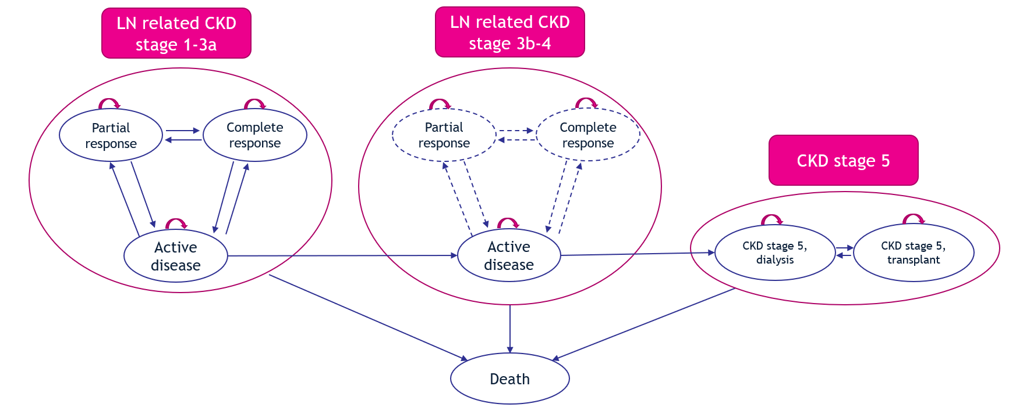
Company’s model overview
The company developed a cohort-level state-transition Markov model
Figure 2 Model structure
Key issue: People in CKD 3b-4 states cannot achieve response, company showed ‘small’ ICER impact in scenario analyses –
to be discussed
Abbreviations: CKD, chronic kidney disease; ICER, incremental cost effectiveness ratio; LN, lupus nephritis
Notes:
Source: company submission Figure B.3-1

Slide 15
Key issue: The company’s model structure
Is the company’s model structure appropriate for decision-making?
Table 4 Key model structure issues not resolved during draft guidance consultation
Issue | Draft guidance | Company draft guidance response | EAG comments
CKD 3b-4 response not possible | Unachievable CKD 3b-4 response should be amended | Explored 3 scenarios where CKD 3b-4 response possible (2.5% CR; 2.5% PR; 1.25% CR and 1.25% PR) using expert estimates, small ICER impact | Scenarios highly uncertain but indicated a small impact on the deterministic results, ideally would be included in base case
Transition probabilities | ‘Count method’ used may mean values are overestimated | Note alignment with EAG on concerns with ‘count method’ and other approaches, maintain count method given the limited data | ‘Count method’ is uncertain and may be overestimated, other approaches are also highly uncertain
Is the company’s model structure appropriate for decision-making?
Abbreviations: CKD, chronic kidney disease; CR, complete response; EAG, evidence assessment group; PR, partial response

Slide 16
Key issue: Estimating long-term outcomes (1)
CONFIDENTIAL
Trial data covering 3 years is used to estimate 69 years of outcomes
Issue background
Company and EAG adopted differing levels of long-term treatment waning for voclosporin and comparators
Committee noted high uncertainty in company and EAG long-term treatment effect extrapolations
Key uncertainty is using short-term data to extrapolate for long-term outcomes (for approx. 69 years)
Draft guidance responses
Company: provided scenario analysis with no relative effect for voclosporin after 36 months and provided evidence of external model output validity by showing similarities in the percentage of people in ESRD at 5 and 10 years in the model and external literature for MMF
Lupus UK, UKRPG, NHS England (Renal and Rheumatology): good initial outcomes lead to better longer term outcomes, effective early treatments reduce the risk of progression and better outcomes
Lupus UK, UKKA, UKRPG, NHS England (Rheumatology): using lower dose steroids with voclosporin leads to less serious side effects and better outcomes in the long term
% of patients in ESRD | Tektonidou 2016 | Gisca 2021 | Model for MMF
After 5 years | 5.74% | 5.02% | XXXX
After 10 years | 9.98% | 10.96% | XXXX
Abbreviations: EAG, evidence assessment group; ESRD, end stage renal disease; MMF, mycophenolate mofetil; NHS, National Health Service; UKKA, United Kingdom Kidney Association; UKRPG, United Kingdom Renal Pharmacy group

Slide 17
Key issue: Estimating long-term outcomes (2)
Trial data covering 3 years is used to estimate 69 years of outcomes
EAG comments
Satisfied that Tektonidou 2016 and Gisca 2021 provided a reasonable comparison to validate the model
Still high uncertainty in time spent in health states prior to ESRD (literature only available for ESRD)
Company’s scenario analysis with no relative effect for voclosporin after 36 months was limited because prior model functionality was removed, meaning comparisons to previous base cases could not be drawn
There are two types of uncertainty with long-term treatment effects:
Duration of treatment effect, which has been explored at various stages of the appraisal process
Using short-term data to inform long-term transitions and outcomes, which could not be resolved in the current model and with current efficacy data
 | ACM1/2 company base cases | ACM1 EAG base case | ACM2 EAG base case
Transition probabilities after 36 months | AD/PR states: Voclosporin = MMF CR state: Voclosporin = MMF, using 30- and 36-month average of both arms | All states: Voclosporin = MMF, using 30/36-month average of both arms | All states: Voclosporin = MMF*
*EAG adapted its base case as previous model functionality was removed, limiting checking of model calculations
Is the level of uncertainty associated with long-term extrapolations acceptable?
Abbreviations: ACM, appraisal committee meeting; AD, active disease; CR, complete response; EAG, evidence assessment group; ESRD, end stage renal disease; MMF, mycophenolate mofetil; PR, partial response

Slide 18
Key issue: Attrition bias in AURORA trials
39.5% of people discontinued across AURORA 1 and 2, risking attrition bias
Issue background
AURORA trial data is at risk of attrition bias as 39.5% of people discontinued across AURORA 1 and 2
Committee wanted to see different response assumptions and extrapolations from AURORA data
Company draft guidance response
Risk of bias is reduced because study personnel and patients remained blinded in AURORA 2 study
Provided 3 scenario analyses for AURORA 1 people lost to follow-up at the request of committee:
Last observation carried forward (company consider most logical scenario)
Assuming people who had voclosporin were non-responders, people who had MMF move to CR
Assuming people who had MMF were non-responders, people who had voclosporin move to CR
EAG comments
Scenario 1 seems the most appropriate, but questioned different patient numbers to the base case
Scenarios 2 and 3 used extreme response assumptions and are highly unlikely in practice
Scenario 1 produced ICERs similar to the company base case, scenario 2 lead to voclosporin dominated by MMF, scenario 3 reduced base case ICERs
Can the level of attrition bias in AURORA data be compensated for?
Abbreviations: CR, complete response; EAG, evidence assessment group; ICER, incremental cost effectiveness ratio; MMF, mycophenolate mofetil; QALY, quality-adjusted life year

Slide 19
Cost-effectiveness results
All ICERs are reported in PART 2 slides
because they include confidential
comparator PAS discounts
Summary
Company’s base case ICER against MMF is within the range that would usually be considered a cost-effective use of NHS resources
EAG’s base case ICER against MMF is higher than the range that would usually be considered a cost-effective use of NHS resources
Abbreviations: EAG, evidence assessment group; ICER, incremental cost-effectiveness ratio; MMF, mycophenolate mofetil; NHS, national health service; PAS, patient access scheme

Slide 20
Company and EAG base cases
Table 5 Differences between revised company and EAG base cases
Key issue/scenario | Company base case | EAG base case | ICER impact
Treatment discontinuation: inappropriate to assume no TTD for non-trial comparators | Non-trial comparators TTD equal to voclosporin + MMF | Non-trial comparators TTD equal to MMF | No change to ICER vs MMF
Long-term effects: Transition probabilities after 36 months | AD/PR states: Voclosporin = MMF CR state: Voclosporin = MMF, using average of both arms | Voclosporin = MMF for all states* | ~+£6,000 (rounded to nearest £1k)
*EAG had to adapt its base case because previous model functionality to select the average of both arms was not included in the model, which also limited crosschecking of model calculations.
EAG also made minor fixes to the model settings and kidney transplant costs but did not include these changes in its preferred base case as the changes resulted in an ICER impact of less than £10.
Abbreviations: AD, active disease; CR, complete response; EAG, evidence assessment group; ICER, incremental cost-effectiveness ratio; MMF, mycophenolate mofetil; PR, partial response; TTD, time to treatment discontinuation

Slide 21
Key issues and scenarios for committee to consider
Committee will consider the following scenarios and uncertainties in Part 2 of the meeting
Table 6 Key issues for committee to consider in decision making
Key issue | Uncertainty | Scenario analysis results in Part 2 slides
Clinical positioning | What are the most appropriate comparators for voclosporin? | N/A
Treatment duration | Does the model reflect the expected treatment duration of voclosporin? | 12- and 18- month treatment duration for all treatments including voclosporin (with varying response assumptions)
Model structure | Is the company’s model structure appropriate for decision-making? | Response achievable from CKD 3b-4 states Treatment discontinuation for non-trial comparators set equal to MMF [EAG base case]
Long-term outcomes | Is the level of uncertainty associated with long-term extrapolations acceptable? | Assume all long-term transitions for voclosporin = MMF [EAG base case]
Attrition bias | Can the level of attrition bias in AURORA data be compensated for? | Different response assumptions for people lost to follow-up in AURORA 1
Abbreviations: CKD, chronic kidney disease; EAG, evidence assessment group; MMF, mycophenolate mofetil

Slide 22
Thank you.
© NICE 2022. All rights reserved. Subject to Notice of rights.

Slide 23
Back up slides

Slide 24
Background on lupus nephritis
RECAP
LN is divided into classes and can lead to increased risk of ESRD and death
Causes
Systemic lupus erythematosus (SLE) is a chronic condition that causes inflammation in connective tissues, occurring when the immune system attacks the body’s tissues and organs
Lupus nephritis (LN) happens when SLE involves the kidneys, specifically glomeruli cells
Epidemiology
Each year around 3,000 people will be diagnosed with SLE in England and Wales, about 40% to 60% of whom will develop LN
Women with Indian-Asian, African-Caribbean or Chinese family backgrounds are most diagnosed
Diagnosis, symptoms and prognosis
LN is divided into classes (1 to 6) based on glomerular pathology
Symptoms of LN include blood or foam in urine, swelling in extremities and high blood pressure
Untreated LN can permanently damage kidneys, leading to increased risk of ESRD and mortality
There is no cure for LN, treatment aims to preserve renal function and prevent disease flares
Abbreviations: ESRD, end-stage renal disease; LN, lupus nephritis; SLE, systemic lupus erythematosus

Slide 25
Decision problem
RECAP
Comparators are uncertain and discussed on the next slide
Table 7 Population, intervention, comparators and outcomes from the scope
 | Final scope | Company | EAG comments
Population | Adults with active LN | Same as final scope | -
Intervention | Voclosporin with immunosuppressive therapies | Same as final scope | -
Comparators | Standard therapy for LN without voclosporin: including the following induction treatments MMF, CYC, AZA, RTX, a CNI plus MMF (typically given with corticosteroids) followed by maintenance treatment with MMF or AZA plus corticosteroids | Same as final scope | MMF considered main comparator but uncertainty remains
Outcomes | Renal response, remission and renal events Incidence of end-stage renal disease Corticosteroid use Mortality Adverse events Health-related quality of life | Same as final scope | -
Abbreviations: AZA, azathioprine; CNI, calcinerium inhibitor; CYC, cyclophosphamide; LN, lupus nephritis; MMF, mycophenolate mofetil; RTX, rituximab

Slide 26
Patient perspectives
RECAP
LN is debilitating and current treatments offer limited choices
Submissions from patient experts, AOFAC Foundation and Lupus UK
Most challenging aspects of LN are the symptoms and the subsequent impact on ability to work and mental wellbeing
Fatigue (81%) and joint pain/swelling (60%) reported as the most difficult symptoms to live with: “Daily, I have to push myself”
LN significantly impacts independence as 58% of people with LN need help with household care, 1 in 3 need help with personal care
Significant impact on carers for people with LN due to helping with daily tasks, socialising and working less, constant worry for their health
57% of people with LN feel isolated once a week
Current treatments mostly have debilitating side effects leading to other illnesses, especially with steroids
Oral administration of voclosporin a real benefit in reducing hospital visits but the need to swallow a whole tablet may be a barrier for some
“[Being a carer] can be difficult at times…you feel so helpless…there are days when their joints are so swollen that I need to do everything; bathe, help dress, prepare meals”
“My care has always been great but it was trying to choose the lesser evil…led to further illnesses and burdens…destroyed my immune system”
Abbreviations: AOFAC, Athonia Oyindamola Folakemi Afelumo Coshare; LN, lupus nephritis

Slide 27
Clinical perspectives
RECAP
Treatments take time to improve outcomes, but cause adverse effects
Submissions from clinical experts, BSR, UKKA and UK RPG
High unmet need as LN is not curable, leads to a cycle of relapsing and remitting and some patients disease does not respond leading to ESRD
Initial treatments aim to induce remission, with maintenance treatments given to maintain remission. Also aim to reduce organ damage and adverse events, improve symptoms and quality of life
Recently steroids have been suggested as the cause of side effects, use is therefore tapered/stopped. Ideal dosage is uncertain
Treatment response measured in imperfect ways, can take a year or more for meaningful disease marker changes
Current treatments have adverse effects causing direct morbidities, contributing to non-compliance, some people do not respond
Voclosporin may be less effective for some people due to high pill burden impacting adherence and swallowing difficulty
“There are problems with adverse effects of current therapies which have
direct morbidities and also contribute to non-compliance”
“Voclosporin + MMF would be a triple therapy as a first option rather than MMF dual therapy”
Abbreviations: BSR; British Society for Rheumatology; ESRD, end-stage renal disease; RPG, Renal Pharmacy Group; LN, lupus nephritis; MMF, mycophenolate mofetil; UKKA, United Kingdom Kidney Association

Slide 28
Key clinical trials
RECAP
Primary evidence is from two trials, the second a continuation of the first
Table 8 Clinical trial designs and outcomes
 | AURORA 1 (N=357) | AURORA 2 (N=216)
Design | Phase 3, multicentre, double-blind, placebo-controlled, randomised trial | Phase 3, multicentre, double-blind, placebo-controlled, randomised, 24-month long-term continuation study for AURORA 1 patients who completed study and were not expected to require renal dialysis or kidney transplant. Primary outcomes were safety, efficacy and HRQoL are secondary outcomes.
Population | Adults with active LN
Intervention | Voclosporin + MMF and low-dose corticosteroids
Comparator(s) | Placebo + MMF and low-dose corticosteroids
Duration | 52 weeks (12 months)
Primary outcome | CRR at 52 weeks
Key secondary outcomes | Time to changes in UPCR; PRR at 24 and 52 weeks; CRR at 24 weeks; HRQoL; adverse events
Locations | 142 sites in 27 countries (none in UK)
Used in model? | Baseline characteristics; transition probabilities; utilities; costs and resource use, adverse events
Abbreviations: CRR, complete renal response; HRQoL, health-related quality of life; LN, lupus nephritis; MMF, mycophenolate mofetil; N, number of patients; PRR, partial renal response; UPCR, urine protein creatinine ratio

Slide 29
AURORA 1 trial results
RECAP
Voclosporin significantly improves renal response up to 52 weeks
Table 9 AURORA 1 response outcomes results
Figure 3 Probability of UPCR ≤0.5mg/mg
 | Voclopsorin + MMF (N=179) | Placebo + MMF (N=178) | Odds Ratio [95% CI]
CRR at 24 weeks | 32.4% | 19.7% | 2.23 [1.3, 3.7]
CRR at 52 weeks | 40.8% | 22.5% | 2.65 [1.6, 4.3]
PRR at 24 weeks | 70.4% | 50.0% | 2.43 [1.56, 3.79]
PRR at 52 weeks | 69.8% | 51.7% | 2.26 [1.45, 3.51]
HR 2.02 [1.51, 2.70] p<0.001
Figure 4 Probability of 50% reduction in UPCR
HR 2.05 [1.62, 2.60] p<0.001
Urine protein creatinine ratio (UPCR) measures the levels of protein and creatinine in urine, UPCR ≤0.5mg/mg can be a component of CRR
Abbreviations: CI, confidence interval; CRR, complete renal response; HR, hazard ratio; MMF, mycophenolate mofetil; N, number of patients; PRR, partial renal response; UPCR, urine protein creatinine ratio
Notes:
Sources: Table 6 taken from Table B.2-19 in company submission; Figure 2 taken from Figure B.2-4 in the company submission; Figure 3 taken from B.2-5 in the company submission

Slide 30
AURORA 2 trial results
CONFIDENTIAL
RECAP
Voclosporin improves renal response up to 30 months, less clear after
Table 10 AURORA 2 response outcomes results
CRR is defined as a composite of UPCR of ≤0.5 mg/mg, eGFR of ≥60 ml/min/1.73² or no confirmed eGFR decrease of >20% from baseline, no rescue medication, and no more than 10 mg prednisone equivalent per day for ≥3 consecutive days or for ≥7 days in total during weeks 44–52
PRR defined as ≥50% reduction in UPCR from baseline
 | Voclosporin + MMF (N=116) | Placebo + MMF (N=100) | Odds Ratio [95% CI]
CRR at 18 months | XXXX | XXXX | XXXX
CRR at 24 months | XXXX | XXXX | XXXX
CRR at 30 months | XXXX | XXXX | XXXX
CRR at 36 months | XXXX | XXXX | XXXX
PRR at 18 months | XXXX | XXXX | XXXX
PRR at 24 months | XXXX | XXXX | XXXX
PRR at 30 months | XXXX | XXXX | XXXX
PRR at 36 months | XXXX | XXXX | XXXX
Abbreviations: CI, confidence interval; CRR, complete renal response; eGFR, estimated glomerular filtration rate; MMF, mycophenolate mofetil; N, number of patients; PRR, partial renal response
Notes:
Source: taken from Tables B.2-22 and B.2-23 in the company submission

Slide 31
NMA methodology
RCTs included in the NMA were identified by SLR
SLR conducted identified 44 RCTs that evaluated the efficacy and safety of active treatments in people with active LN
Studies screened to identify those reporting CRR and PRR for comparators, to inform short term efficacy inputs in the model
17 RCTs reporting on 8 treatments for CRR
10 RCTS reporting on 6 treatments for PRR
Abbreviations: CRR, complete renal response; LN, lupus nephritis; NMA, network meta-analysis; PRR, partial renal response; RCT, randomised controlled trial; SLR, systematic literature review

Slide 32
NMA methodology: comparators
RECAP
The NMA included CRR and PRR data for most comparators
Table 11 Comparators included in NMA and implied voclosporin treatment line
Comparator | NMA outcome | Implied voclosporin treatment line | Other considerations
MMF | Reference treatment for the NMA | 1. Induction first-line 3. Maintenance | Considered relevant comparator by EAG
Voclosporin + MMF | CRR and PRR | - | Intervention
Azathioprine | CRR only | 3. Maintenance
High-dose cyclophosphamide | CRR and PRR | 2. Induction alternative | Stakeholders suggest rarely used in NHS due to toxicity
Low-dose cyclophosphamide | CRR and PRR | 1. Induction first-line
Rituximab + MMF | CRR and PRR | 2. Induction alternative | First-line use prohibited in current NHSE guidance
Tacrolimus | CRR and PRR | 2. Induction alternative 3. Maintenance | Other CNI ciclosporin less used
Tacrolimus + MMF | CRR only | 2. Induction alternative | Considered relevant comparator by EAG
Abbreviations: CRR, complete renal response; MMF, mycophenolate mofetil; NMA, network meta-analysis; PRR, partial renal response

Slide 33
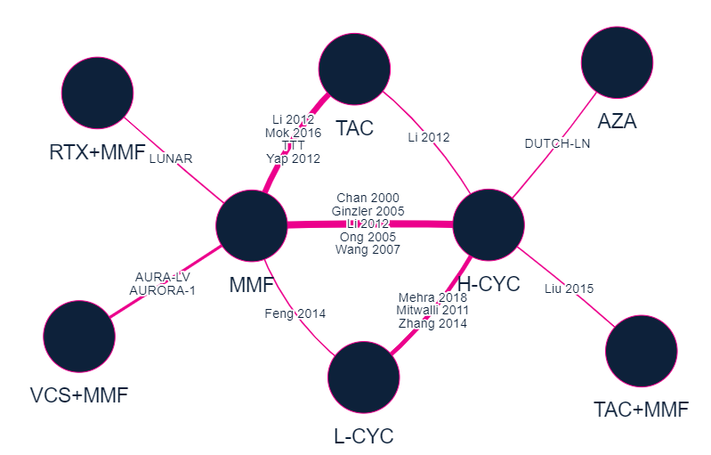
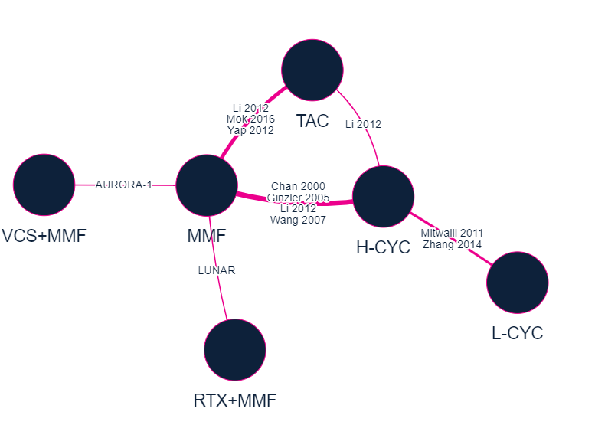
NMA network diagrams
Systematic literature review identified 17 RCTs reporting on 8 treatments for CRR and 10 RCTS reporting on 6 treatments for PRR which were used in CRR and PRR NMAs
Figure 5 NMA network for CRR
Figure 6 NMA network for PRR
Abbreviations: AZA, azathioprine; CRR, complete renal response; H-CYC, high-dose cyclophosphamide; L-CYC, low-dose cyclophosphamide; MMF, mycophenolate mofetil; NMA, network meta-analysis; PRR, partial renal response; RCTs, randomised controlled trials; RTX, rituximab; TAC, tacrolimus; VCS, voclosporin
Notes:
Sources: Figures B.2-7 and B.2-8 in company submission

Slide 34
NMA results for CRR
CONFIDENTIAL
Figure 7 Forest plot for posterior median ORs for CRR
XXXXXXXXXXXXXXXXXXXXXXXXXXXXXXXXXXXXXXXXXXXXXXXXXXXXXXXX
Abbreviations: AZA, azathioprine; CRR, complete renal response; H-CYC, high-dose cyclophosphamide; L-CYC, low-dose cyclophosphamide; MMF, mycophenolate mofetil; NMA, network meta-analysis; OR, odds ratio; RTX, rituximab; TAC, tacrolimus; VCS, voclosporin
Notes:
Source: taken from Figure B.2-9 in the company submission

Slide 35
NMA results for PRR
CONFIDENTIAL
Figure 8 Forest plot for posterior median ORs for PRR
XXXXXXXXXXXXXXXXXXXXXXXXXXXXXXXXXXXXXXXXXXXXXXXXXXXXXXXXXXXXXXXXXXXX
Abbreviations: H-CYC, high-dose cyclophosphamide; L-CYC, low-dose cyclophosphamide; MMF, mycophenolate mofetil; NMA, network meta-analysis; OR, odds ratio; PRR, partial renal response; RTX, rituximab; TAC, tacrolimus; VCS, voclosporin
Notes:
Source: taken from Figure B.2-10 in the company submission

Slide 36
NMA results
CONFIDENTIAL
Table 12 AURORA 2 response outcomes results
 | Median odds ratio for CRR | Median odds ratio for PRR
MMF | Reference | Reference
Voclosporin + MMF | XXXX | XXXX
Azathioprine | XXXX | -
High dose CYC | XXXX | XXXX
Low dose CYC | XXXX | XXXX
Rituximab + MMF | XXXX | XXXX
Tacrolimus | XXXX | XXXX
Tacrolimus + MMF | XXXX | -
XXXX
XXXX
Abbreviations: CRR, complete renal response; CYC, cyclophosphamide; MMF, mycophenolate mofetil; PRR, partial renal response
Notes:
Source: taken from Tables B.2-30 and B.2-32 in the company submission

Slide 37
How company incorporated evidence into model
RECAP
AURORA 1 and 2 data contributed most evidence used in the model
Table 13 Input and evidence sources for non-efficacy inputs
Input | Assumption and evidence source
Baseline characteristics | AURORA 1 and AURORA 2 patient data
Transition probabilities | AURORA 1 and 2 data; NMA; literature; expert opinion; assumptions
Utilities | AURORA 1/2 data for health states CKD 1-3a, literature for CKD 3b-5
Costs and resource use | NHS reference costs, PSSRU Unit Costs of Health and Social Care, previous NICE appraisals, clinical trial and observational data, disease treatment guidelines
Adverse events | AURORA 1 for voclosporin + MMF and MMF, literature for others
Abbreviations: CKD, chronic kidney disease; MMF, mycophenolate mofetil; NHS, national health service; NMA, network meta-analysis; PPSRU, Personal Social Services Research Unit

Slide 38
Known uncertainty: Generalisability of AURORA trials
Uncertain steroid use in AURORA trials
Issue background
The committee concluded that the population in the AURORA trials are generalisable to the UK population but that the steroid doses used are not reflective of established NHS clinical practice
Draft guidance responses
Lupus UK, UKKA, UKRPG, NHS England (Rheumatology): lower steroid use in AURORA trials is reflective of clinical practice
NHS England (Renal): lower steroid use in AURORA trials is not reflective of clinical practice
Company response and EAG comments
The company did not provide responses on this issue, thus the EAG did not provide any comments
Abbreviations: EAG, evidence assessment group; NHS, National Health Service; UKKA, United Kingdom Kidney Association; UKRPG, United Kingdom Renal Pharmacy group

Slide 39
Uncertainty in the new methods and processes : maintaining and updating our approach
Understanding and presenting uncertainty
Improvements to ensure uncertainty is thoroughly characterised, clearly presented and fully understood
Considering uncertainty in decision making
Retain critical consideration of uncertainty and decision risk
Ensure no inappropriate barriers, through formalised flexibility with uncertainty
Maintain key principle: more caution when there is less certainty about the evidence
Low uncertainty, low decision risk = more likely to recommend
High uncertainty, high decision risk = less likely to recommend
Clarify and formalise flexibility: higher uncertainty may be considered when evidence generation is difficult:
Rare diseases
Populations including children
Innovative and complex technologies
Notes:
Flexibility in uncertainty should take into account how the nature of the population/technology has contributed to evidence generation difficulties and uncertainties.
The decision should consider the nature, scale and consequences of the decision uncertainty and risk of decision error.

