Slide 1
Bulevirtide for treating chronic hepatitis D [ID3732]
PART 1
For public contains redacted
Chair: Charles Crawley
Technology appraisal committee B
Lead team: Mary Weatherstone, Nigel Westwood, Peter Wheatley-Price
Evidence assessment group: BMJ Technology Assessment Group
Technical team: Vicky Gillis-Elliott, Rufaro Kausi, Richard Diaz
Company: Gilead
14th December 2022– 2nd meeting
© NICE [2022]. All rights reserved. Subject to Notice of rights.
Notes:
This topic uses NICE’s updated methods for health technology evaluations, 2022: https://www.nice.org.uk/process/pmg36/chapter/introduction-to-health-technology-evaluation

Slide 2
RECAP
Bulevirtide (Hepcludex, Gilead)
Marketing authorisation | Bulevirtide received a conditional marketing authorisation from MHRA in November 2021 Marketing authorisation wording: “Hepcludex is indicated for the treatment of chronic hepatitis delta virus (HDV) infection in plasma (or serum) HDV-RNA positive adult patients with compensated liver disease.” Bulevirtide was awarded Promising Innovative Medicine designation by the MHRA in March 2019
Mechanism of action | Bulevirtide binds to the sodium/taurocholate cotransporting peptide (NTCP) of hepatocytes inhibiting entry of HDV By blocking the essential entry receptor, new infection of hepatocytes is decreased, viral spread is inhibited, and the life cycle of HDV is disrupted.
Administration | Bulevirtide is a daily 2mg subcutaneous injection, self-administered by patients
Price | Company has a confidential commercial arrangement (simple discount patient access scheme)
Abbreviations: HDV, hepatitis D virus; MHRA, medicines and healthcare products regulatory authority.

Slide 3
DGC Committee requests for further clarification and analyses
DGC | Area of uncertainty and committee preferences | Provided by company? | Included in base case?
3.3 and 3.4 | Bulevirtide positioning for METAVIR stage F2 and above: Committee would like to see transient elastography (FibroScan) data | Yes | No
3.7 | Baseline characteristics of people taking bulevirtide: Committee would like epidemiology data to include the mean age and proportions with cirrhosis based on UKHSA data | Yes- partially | No –scenario analysis partially
3.10 | Assumptions around ongoing response: Committee would like to see data for evolution of response beyond 48 weeks | No | No
3.12 | Size of utility gain for combined responders: Committee would like justification for the Tobit model and variables used in the regression analysis | Yes | Yes
3.15 | QALY weighting for severity and the long-term survival for people on standard care, without bulevirtide: Committee would like: Natural history of hepatitis D for people on standard care Graphical representations of health state occupation over time | Yes | N/A
Abbreviations: DGC Draft Guidance Consultation

Slide 4
Committee requests for scenario analyses
DCG section | Area of uncertainty and committee preferences | Provided by company?
3.9 | Risk of progression through fibrosis stages: Committee requested the following scenario analyses: A low but not zero risk of progression through fibrosis stages for combined responders A low but not zero risk of progression to hepatocellular carcinoma for combined responders A lower probability of fibrosis regression for combined responders | Yes
3.11 | Duration of treatment longer than 48 weeks in MYR 301: Committee requested scenario analyses showing: Treatment continues in those that develop hepatocellular carcinoma The same treatment continuation assumptions for virological and combined responders Treatment stopping for those with convincing evidence of virus eradication | Yes
3.12 | To address uncertainties in the assumption of utility gain for people having a combined virological and biochemical response the committee requested scenario analyses showing alternative estimates of utility gain for combined responders, based on previous hepatitis appraisals | Yes

Slide 5
Preliminary recommendation
Bulevirtide is not recommended, within its marketing authorisation, for treating chronic hepatitis D with compensated liver disease in adults
The company positioned bulevirtide for people with chronic hepatitis D who did not respond to PEG-IFN , or for people who cannot have it.
bulevirtide was positioned for people with a METAVIR stage of F2 or over. Testing for METAVIR stage is invasive and many people refuse it.
Some people in the trial did not have a METAVIR stage and had a stage of F1 or F0.
Clinical trial shows bulevirtide is effective compared with standard care. But uncertainties around how long it works for.
Abbreviations: PEG-IFN, peginterferon alfa-2a.

Slide 6
Clinical evidence recap

Slide 7
RECAP
Chronic hepatitis D
Hepatitis D is an infectious disease of the liver caused by the hepatitis D virus
It only affects people who are already infected with the hepatitis B virus as it needs the hepatitis B surface antigen to complete its replication
It is usually spread through blood-to-blood or sexual contact
Around half of all people who acquire HDV will develop chronic hepatitis D, defined as an infection lasting longer than 6 months
Hepatitis D is the most severe form of viral hepatitis
People with chronic hepatitis D have an increased risk of liver-related events such as cirrhosis and hepatocellular carcinoma
The rate of disease progression is higher for those co-infected with chronic hepatitis D compared to patients with chronic hepatitis B infection only
DGC:
Committee noted the high disease burden of chronic hepatitis D
Current treatment options are limited and there is a significant unmet need for effective treatments
Abbreviations: DGC, draft guidance for consultation; HDV, hepatitis D virus.

Slide 8
DGC consultation

Slide 9
DGC consultation responses
Responses received from:
Company: Gilead Sciences Ltd
NHS England
Abbreviations: DGC, draft guidance for consultation

Slide 10
Stakeholder comments
NHS England
Agree scope of review included the relevant evidence and summaries provided reasonable reviews of the current evidence on the use of bulevirtide for hepatitis delta infection
Agree there is a need for further clarification in relation to:
selection of patients using non-invasive fibrosis tests,
positioning as a primary therapy or purely for those intolerant / unresponsive to interferon and
duration of therapy and stopping rules.
Source: ACD comments form, ITP Support Association, Abbreviations: TPO-RA: thrombopoietin receptor agonist

Slide 11
Updated clinical effectiveness evidence

Slide 12
CONFIDENTIAL
Proposed positioning in METAVIR stage of F2 or above (1/2)
(DGC section 3.3 and 3.4)
DGC: Unclear why company positioned bulevirtide for use in a narrower population and unclear how this population would be identified in clinical practice
Background
Company focused on people in MYR301 with compensated liver disease and significant fibrosis (METAVIR stage of at least F2), whose disease had not responded adequately to, or were ineligible for IFN-based therapy
Committee queried this positioning given the METAVIR F-stage distribution in MYR301
MYR301 assessed liver disease with a liver biopsy which is rarely used in clinical practice but transient elastography (FibroScan) is widely used to assess eligibility for PEG-IFN in people with chronic hepatitis D
Company response at consultation
In CG165 PEG-IFN is recommended only for people with hepatitis D infection and significant fibrosis (METAVIR stage of at least F2 or Ishak stage of at least 3)
In MYR301 transient elastography (FibroScan) scores were collected at baseline and week 48
Literature identified a threshold aligning transient elastography scores to METAVIR stage F2 or above
Optimal threshold 7.25 kPa or above (Qi et al, 2018 meta-analyses) 8.0 kPa or above (EASL guidelines)
xx xxxxx xx% of people in MYR301 had a METAVIR stage of F2 or more at baseline
Carried out scenario analyses in 3 subgroups combining response at Week 24 and 48
(METAVIR score F2 or above; FibroScan 8.0kPA or above; FibroScan 7.25 kPA or above)
Abbreviations: DGC; draft guidance for consultation; IFN, interferon; kPa, kilopascal; PEG-IFN, peginterferon alfa-2a

Slide 13
Proposed positioning in METAVIR stage of F2 or above (2/2)
(DGC section 3.3 and 3.4)
EAG comments
The overlap between people in MYR 301 with significant fibrosis defined as METAVIR stage 2 and above or transient elastography (FibroScan) scores above 7.25 kPa was very low
Response for the subgroups of people in MYR301 with transient elastography (FibroScan) scores equivalent of significant fibrosis (7.25kPa) were similar to the overall population, this had a limited impact on the ICER
Although MYR301 included people with less severe liver disease (METAVIR stage F0 and F1), this had limited effect on complete or partial response rates
METAVIR staging in the model was based on external data sources rather than those in MYR301
The proportion in different health states in the model has a larger impact on the ICER and potentially on the severity weighting
EAG notes transient elastography (FibroScan) has less than optimal accuracy for diagnosing significant fibrosis and discriminating between adjacent fibrosis and no agreement in clinical practice on cut-offs
EAG were unable to validate source used to identify EASL fibrosis thresholds and note here is no agreement in clinical practice on the cut-offs for advanced fibrosis, but consider 8 to be the most validated threshold
Is it appropriate to position bulevirtide for people with significant fibrosis?
Abbreviations: DGC, draft guidance for consultation; EASL, European Association for the Study of the Liver; ICER, incremental cost effectiveness ratio; kPa; kilopascal

Slide 14
CONFIDENTIAL
Mean age and cirrhosis status for hepatitis D in the UK (1/2)
(DGC section 3.7 and 3.16)
DGC: Committee noted it would like mean age and cirrhosis status of people at diagnosis based on UKHSA data
Background
Company used Spaan et al (2020) to identify baseline age of people with CHD in the UK to inform base case analysis (assumed median age of 35.1 years)
UKHSA analyses confirmed median age of 35 years but committee consider UKHSA data on mean age would increase certainty in the cost-effectiveness results and severity weighting
Company response at consultation
UKHSA data on baseline age at diagnosis suggest majority of people with CHD in the UK are young so consider median is more appropriate and severity modifier should be applied
Carried out scenario analysis where baseline age was set to UKHSA mean age of xxxx years (using severity modifier makes a difference to ICER)
Source | Median age | Mean age
UKHSA (all people n=602) | 35.0 years | xxxx years
UKHSA (cohort currently alive n= 570) | 35.0 years | xxxx years
Abbreviations; CHD, chronic hepatitis D; DGC, draft guidance for consultation; HDV; hepatitis delta virus; ICER, incremental cost-effectiveness ratio;
RNA ribonucleic acid; UKHSA,UK Health Security Agency

Slide 15
Mean age and cirrhosis status for hepatitis D in the UK (2/2)
(DGC section 3.7 and 3.16)
EAG comments
EAG was surprised data on baseline distribution of cirrhosis was not collected in the UKHSA study and recommends the committee confirms this with the company
Reiterates preference for mean age instead of median age for the UKHSA population
The choice of source for baseline characteristics has a significant impact on assumptions made around the severity modifier
What assumptions affecting the severity modifier do the committee prefer?
Abbreviations: DGC, draft guidance for consultation; UKHSA, UK Health Security Agency;

Slide 16
Updated cost effectiveness evidence

Slide 17
Progression and regression rates for combined responders (1/2)
(DGC section 3.9)
DGC: Combined responders could still have detectable virus so would be at low risk of progressing but not zero; Combined responders may be at risk of hepatocellular carcinoma;
It is plausible virus can regress for combined responders but company’s transition probabilities seemed high
Background
Committee requested scenario analyses for combined responders showing:
Low but not zero risk of progression through fibrosis;
Low but not zero risk of progression to hepatocellular carcinoma
Lower probability of fibrosis
Company response at consultation
Assumption | Company base case assumption | Company scenario analysis
Progressing through fibrosis states | No probability of progressing through fibrosis states or to decompensated cirrhosis | Progression for combined responders was 20% of that for partial responders.
Progressing to HCC | No probability of progressing to HCC | Progression in combined responders was 20% of that for partial responders.
Regression | Regression can start from beginning of treatment | Risk of regression reduced by 50% for combined responder
Abbreviations; DGC, draft guidance for consultation; HCC, hepatocellular carcinoma;

Slide 18
Progression and regression rates for combined responders (2/2)
(DGC section 3.9)
.
EAG critique
EAG’s clinical experts agree combined responders have no progression in fibrosis compared with non-responders but it is not clinically plausible to assume combined responders would never develop HCC
Also agree combined responders could have fibrosis regression
EAG’s preferred assumption is that fibrosis regression could only start from cycle 4 onwards (96 weeks) in the model and have carried out scenario analyses – small impact on model
Has the company appropriately modelled progression and regression rates?
Abbreviations; DGC, draft guidance for consultation; HCC, hepatocellular carcinoma,

Slide 19
CONFIDENTIAL
Treatment duration beyond 48 weeks (1/2)
(DGC section 3.11)
.
DGC: Clinical experts considered treatment would continue for combined or virological responders developing HCC and stop for people with convincing evidence of virus eradication.
Committee were uncertain if company’s stopping rule aligned with MYR 301 further data is available
Company response at consultation
Scenarios to explore how treatment continuation criteria impact on estimates of cost-effectiveness estimates
 | Base case assumption | Scenario analyses
Treatment continuation for HCC | Costs of treating HCC are included | No costs for treating HCC
Treatment continuation for virologic responders | Non-responders stop treatment and virologic responders stay on treatment until week 72 | Definition of response changed to include virologic only and combined response. All responders continue treatment beyond 72 weeks, non-responders stop at week 48. As above but non responders stop treatment at week 72
Treatment stopping for virus eradication | Combined responders with undetectable RNA at 48 weeks will stop treatment 52 weeks later | Bulevertide costs removed from Week 120 for the proportion of people in this group(x xx xxxxxx)
Treatment continuing for virologic responders combined with treatment stopping for virus eradication | Not included in base case. Company noted the same continuation rules may only apply to specific cases | Scenario only; proportion with undetectable RNA is (x xxxx xxxx) Company consider this is the most realistic scenario
 | Base case assumption | Scenario analyses
Treatment continuation for HCC | Costs of treating HCC are included | No costs for treating HCC
Treatment continuation for virologic responders | Non-responders stop treatment and virologic responders stay on treatment at week 48 without further assessment | Continuation rules at Weeks 48 and 72 are the same for virologic and combined responders
Treatment stopping for virus eradication | Combined responders with undetectable RNA at 48 weeks will stop treatment 52 weeks later | Bulevertide costs removed from Week 120 for the proportion of people in this group xx xx xx xxxxx
Treatment continuing for virologic responders combined with treatment stopping for virus eradication | Not included in base case. Company noted the same continuation rules may only apply to specific cases | Scenario only; proportion with undetectable RNA is xx xx xxxxxxx Company consider this is the most realistic scenario
Abbreviations; DGC, draft guidance for consultation; HCC, hepatocellular carcinoma; RNA, Ribonucleic acid

Slide 20
Treatment duration beyond 48 weeks (2/2)
(DGC section 3.11)
.
EAG critique
EAG had 2 concerns regarding extrapolations beyond observed data in the model:
Company has not provide an update on availability of 96-week data from MYR301 but the EAG consider response data in the model should be limited to 48 weeks until more mature data is available
In MYR301 people having bulevertide continued treatment up to 144 weeks, so a scenario where non-responders stop treatment at week 72 might not adequately reflect costs and benefits for these patients
EAG is still unclear what the treatment cut-off point for non-responders in clinical practice
It recommends clinical expert opinion validates the assumptions of stopping treatment options for non-responders given in the model
The company consider people In MYR301 with undetectable HDV RNA at week 120 would be considered cured and not need retreatment with bulevirtide
The EAG recommends the clinical experts validate this assumption
Has the company appropriately modelled treatment continuation and stopping?
Abbreviations; DGC, draft guidance for consultation;

Slide 21
CONFIDENTIAL
Size of utility gain for combined responders (1/3)
(DGC section 3.12)
.
DGC: Committee concluded size of utility benefit for combined responders was uncertain. There was a lack of justification for the Tobit approach in the regression model
Company response at consultation
Justification for use of Tobit model for utility gain
Justify using a Tobit model because EQ-5D scores in MYR301 were significantly skewed
This suggests a ceiling effect which occurs when high proportions have maximum scores on the observed variables so using an alternative OLS regression would not be appropriate when there is a ceiling effect
EAG critique
Concerned the company did not use a stepwise approach to choosing the variables in the Tobit model and variables were selected based on internal discussion and clinical expert opinion.
This would explain why the final variables included in the Tobit model were not statistically significant
Has sufficient justification been provided for the Tobit regression model?
Abbreviations; DGC, draft guidance for consultation; OLS, ordinary least squares;
Notes:
Source: Figure 1 in company response to consultation

Slide 22
CONFIDENTIAL
Size of utility gain for combined responders (2/3)
(DGC section 3.12)
.
DGC: Combined response in previous hepatitis appraisals was associated with a smaller utility gain
Committee requested alternative estimates of utility gain based on previous hepatitis TAs
Company response at consultation
Utility gain for responders from past technology appraisals
Utility gains for people in SVR from previous hepatitis B and C TAs and literature have been in the same range as combined responders in MYR301
In TAs for hepatitis B no utility gain was assumed for virologic responders who were not in SVR and people with SVR were assumed to have a small utility decrement (1%) relative to the general population
In TAs for hepatitis C only identified utility gains for people with SVR.
Heterogeneity from literature suggest utility gain can vary between different cohorts Consider MYR301 best represents cohort having treatment with bulevirtide so it is appropriate to use in model
Alternative scenarios for responder utility gains
Company have noted that utility gains in previous TAs are in the same region as those in MYR301 but explored 2 scenarios where utility gain in the model (xxxxx) was reduced by 50% and 75%
Abbreviations; DGC, draft guidance for consultation; HCC, hepatocellular carcinoma, SVR, sustained virologic response, TA, technology appraisal

Slide 23
Size of the utility gain for combined responders (3/3)
(DGC section 3.12)
.
EAG critique
In previous TAs utility gain for SVR was defined as proportion with negative RNA and normal ALT after treatment whereas in the company analysis utility gain was defined when people were still on treatment
The value estimated by company is slightly higher than the highest utility value reported in previous TAs
Consider company has used arbitrary values and has carried out a scenario analysis reporting the impact of using the lowest and the highest utility gain reported in previous TAs
Utility gains for people with SVR in NICE TAs
Technology Appraisal publication | Utility gain | SVR measured at
TA330 (2015) Sofosbuvir for chronic hepatitis C | 0.05 | 24 weeks after stopping therapy
TA363 (2015) Ledipasvir–sofosbuvir for treating chronic hepatitis C | 0.04 | 72 weeks after stopping therapy
TA413 (2016) Elbasvir–grazoprevir for chronic hepatitis C | 0.03 | 12 weeks after stopping therapy
Is the company justification for alternative estimates of utility gain for combined responders, based on previous hepatitis appraisals appropriate?
Abbreviations; ALT, Alanine aminotransferase; DGC, draft guidance for consultation; HCC, hepatocellular carcinoma; ; RNA, Ribonucleic acid; SVR, sustained virologic response; TA, technology appraisal

Slide 24
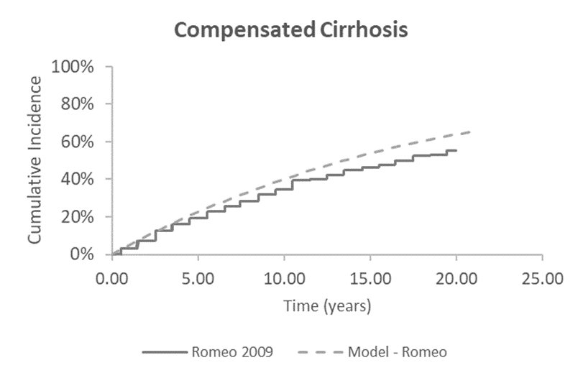
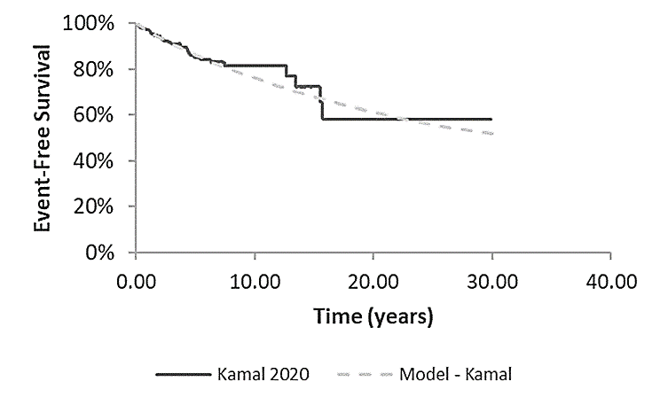
Long-term survival for people on standard care, without bulevirtide (1/4)
(DGC section 3.15)
.
DGC: The EAG’s assumptions around natural history modelling of chronic hepatitis D may affect severity weighting calculations. It would be helpful to validate model predictions for people on standard care using external literature sources along with graphical representations of health state occupation over time
Company response at consultation
Kaplan-Meier plots survival plots extracted from model align with those from published literature
Progression and survival rates in the literature
Model predictions for incidence of compensated cirrhosis in people F0 to F3 at start of model generally aligns with Romeo et al (2009) study and incidence of decompensated cirrhosis were similar to Kamal et al (2020)
Compensated cirrhosis in Romeo 2009 and model
Decompensation-free survival in Kamal 2020 and model
Natural Model
history predicted
Natural Model
history predicted
Abbreviations; DGC, draft guidance for consultation;

Slide 25
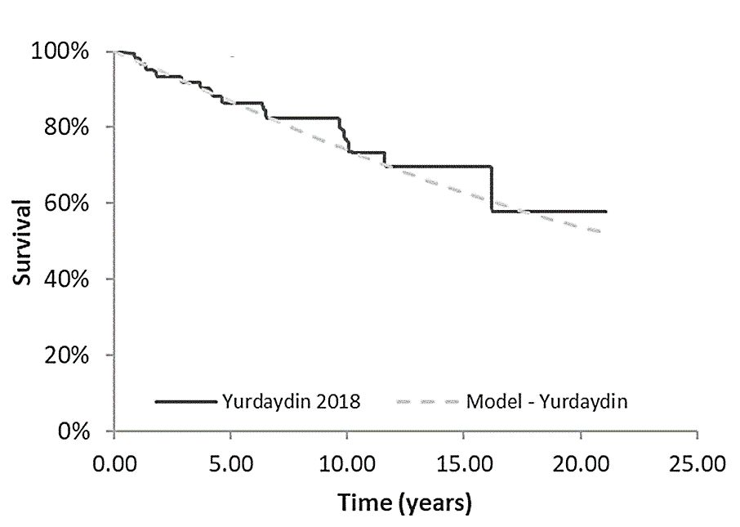
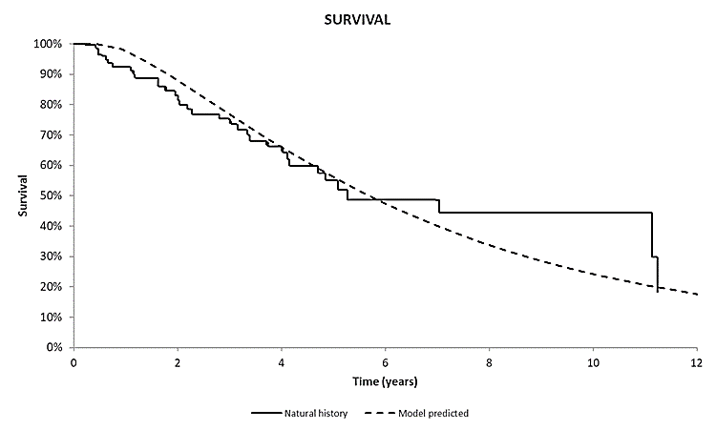
Long-term survival for standard care, without bulevirtide (2/4)
(DGC section 3.15)
.
Company response at consultation
Progression and survival rates in the literature
Model showed generally similar results for the cumulative incidence of hepatocellular carcinoma for BSC compared to those without a maintained virologic response from Yurdaydin et al (2018) and model predictions for those who are completely compensated cirrhotic (100% F4) were aligned with Gheorge et al (2005)
Survival from Yurdaydin et al (2018) and model
Survival of compensated cirrhosis (F4) from Gheorge (2005) and model
Natural Model
history predicted
Abbreviations; BSC, best supportive care; DGC, draft guidance for consultation;

Slide 26
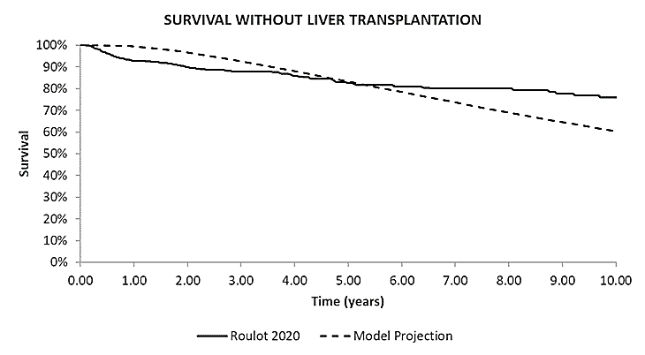
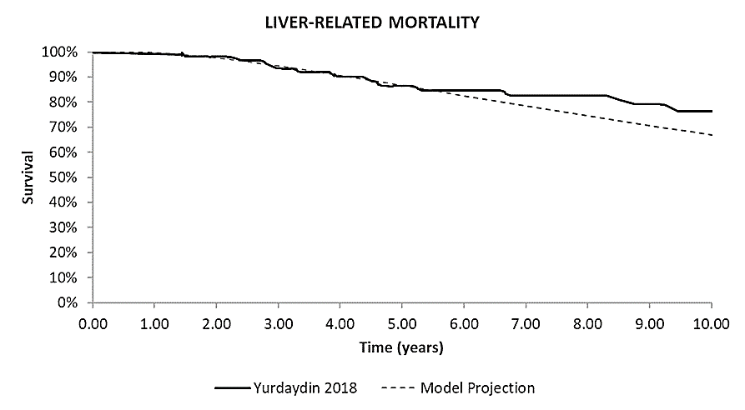
Long-term survival for standard care, without bulevirtide (3/4)
(DGC section 3.15)
.
Company response at consultation
Progression and survival rates in the literature
Model projections from the combined non-cirrhotic and cirrhotic populations were generally similar to Roulot et al (2020) but there is uncertainty beyond 8 years due to low number of events at end of follow-up. The projections were similar for liver-related mortality for BSC compared to those without MVR from the Yurdaydin et al., (2018)
Survival of F0 to F4 without MVR from Yurdaydin
(2018) and model
Survival of F0 to F4 from Roulot et al (2020) and model
Abbreviations; BSC, best supportive care; DGC, draft guidance for consultation; MVR, maintained virologic response

Slide 27
Long-term survival for standard care, without bulevirtide (4/4)
(DGC section 3.15)
.
EAG critique
Overall, the model predictions seem reasonable against the external literature sources but could not validate the figures in the economic model containing the estimated data
It does not consider the company has used a systematic approach to selecting the data sources to estimate the natural history of disease
The company’s choices of external literature are inconsistent with the company’s choice of sources to model the natural history of disease.
Have the model predictions for people on standard care been adequately validated?
Abbreviations; DGC, draft guidance for consultation;

Slide 28
Cost-effectiveness results Updated after consultation

Slide 29
Base case assumptions after consultation
Technology
Company base case after consultation: | EAG preferred base case
1: Average age of people diagnosed with hepatitis D in the UK based on UKHSA median age of 35.0 years, supported by Spaan et al. (2020) | 1: When the EAG's preferred assumptions are used the severity weighting of 1.2 does not apply
2: Treatment stopped for those with convincing evidence of virus eradication | 2: Estimation of the probability of HCC from F2 to F4 states according to Romeo and Kushner
3: MYR301 data not extrapolated beyond Week 48 | 3: Estimation of probability of fibrosis progression from the F2 to F4 states according to Romeo
4: Age-related utility decrements included. | 4: Assuming 30% of HCC patients will be cured from HCC and accrue a utility of 0.81.
5: Health state utilities based on MYR301 | 5: Assuming complete responders have the same probability as partial responders of developing HCC
6: Post-liver transplant utility value set to MYR301. | 6: Assuming fibrosis regression can only start occurring from cycle 4 onwards (96 weeks) in the model.
7: Assuming people who develop HCC stay on bulevirtide.
Company accepted several of the EAG preferred assumptions discussed at the first Meeting
EAG agree with 3 to 7 of company changes but disagree with change 1 and uncertain if change 2 should form base case .
Abbreviations: HCC, hepatocellular carcinoma; UKHSA, UK Health Security Agency

Slide 30
Company’s revised base case with and without severity weighting
CONFIDENTIAL
Company’s revised deterministic base case results with and without severity weighting of 1.2
Technology | Total costs (£) | Total QALYs | Incremental costs (£) | Incremental QALYs | ICER (£/QALY) 1.2 severity weighting | ICER (£/QALY)
BSC | xxxxxxx | xxxx |  |  | -
Bulevirtide | xxxxxxxx | xxxxx | xxxxxxxx | xxxx | £24,061 | £28,874
Company’s revised deterministic base case results without severity weighting
Company’s revised probabilistic base case results with and without severity weighting of 1.2
Technology | Total costs (£) | Total QALYs | Incremental costs (£) | Incremental QALYs | ICER (£/QALY) 1.2 severity weighting | ICER (£/QALY)
BSC | xxxxxxx | xxxx |  |  | -
Bulevirtide | xxxxxxxx | xxxxx | xxxxxxxx | xxxx | £24,467 | £29,361
Abbreviations: BSC, best supportive care; EAG, External Assessment Group; ICER, incremental cost-effectiveness ratio; QALY, quality-adjusted life year.

Slide 31
EAG’s preferred base case with and without severity weighting
CONFIDENTIAL
EAG’s preferred deterministic base case results with maximum utility gain for combined responders (xxxx)
Technology | Total costs (£) | Total QALYs | Incremental costs (£) | Incremental QALYs | ICER (£/QALY) 1.2 Severity weighting | ICER (£/QALY)
With cirrhotic distribution of 60% reflecting company’s base case
BSC | xxxxxxx | xxxx |  |  |  | -
Bulevirtide | xxxxxxxx | xxxxx | xxxxxxxx | xxxx | £27,429* | £32,915
With cirrhotic distribution at baseline reflecting MYR 301 population (47% with compensated cirrhosis) | Cirrhotic distribution at baseline reflects the MYR 301 population (47% of patients with compensated cirrhosis) | Cirrhotic distribution at baseline reflects the MYR 301 population (47% of patients with compensated cirrhosis) | Cirrhotic distribution at baseline reflects the MYR 301 population (47% of patients with compensated cirrhosis) | Cirrhotic distribution at baseline reflects the MYR 301 population (47% of patients with compensated cirrhosis) |  | Cirrhotic distribution at baseline reflects the MYR 301 population (47% of patients with compensated cirrhosis)
BSC | xxxxxxx | xxxx
Bulevirtide | xxxxxxxx | xxxxx | xxxxxxxx | xxxx | £30,702* | £36,843
EAG’s preferred probabilistic base case results with maximum utility gain for combined responders (xxxx)
Technology | Total costs (£) | Total QALYs | Incremental costs (£) | Incremental QALYs | ICER (£/QALY) 1.2 Severity weighting | ICER (£/QALY) | ICER (£/QALY)
With cirrhotic distribution of 60% reflecting company’s base case
BSC | xxxxxxx | xxxx |  |  |  | -
Bulevirtide | xxxxxxxx | xxxxx | xxxxxxxx | xxxx | £27,927* | £33,513
With cirrhotic distribution at baseline reflecting MYR 301 population (47% with compensated cirrhosis) | Cirrhotic distribution at baseline reflects the MYR 301 population (47% of patients with compensated cirrhosis) | Cirrhotic distribution at baseline reflects the MYR 301 population (47% of patients with compensated cirrhosis) | Cirrhotic distribution at baseline reflects the MYR 301 population (47% of patients with compensated cirrhosis) | Cirrhotic distribution at baseline reflects the MYR 301 population (47% of patients with compensated cirrhosis) |  | Cirrhotic distribution at baseline reflects the MYR 301 population (47% of patients with compensated cirrhosis)
BSC | xxxxxxx | xxxx
Bulevirtide | xxxxxxxx | xxxxx | xxxxxxxx | xxxx | £31,286* | £37,544
Notes: *Calculated by NICE technical team for ease of access; When the EAG's preferred assumptions are used the severity weighting of 1.2 does not apply
Abbreviations: BSC, best supportive care; ICER, incremental cost-effectiveness ratio; QALY, quality-adjusted life year.

Slide 32
EAG’s preferred base case with and without severity weighting
CONFIDENTIAL
EAG’s preferred deterministic base case results with minimum utility gain for combined responders (0.03)
Technology | Total costs (£) | Total QALYs | Incremental costs (£) | Incremental QALYs | ICER (£/QALY) 1.2 Severity weighting | ICER (£/QALY)
With cirrhotic distribution of 60% reflecting company’s base case
BSC | xxxxxx | xxxx |  |  |  | -
Bulevirtide | xxxxxxxx | xxxxxx | xxxxxxxx | xxxx | £28,790* | £34,548
With cirrhotic distribution at baseline reflecting MYR 301 population (47% with compensated cirrhosis) | Cirrhotic distribution at baseline reflects the MYR 301 population (47% of patients with compensated cirrhosis) | Cirrhotic distribution at baseline reflects the MYR 301 population (47% of patients with compensated cirrhosis) | Cirrhotic distribution at baseline reflects the MYR 301 population (47% of patients with compensated cirrhosis) | Cirrhotic distribution at baseline reflects the MYR 301 population (47% of patients with compensated cirrhosis) |  | Cirrhotic distribution at baseline reflects the MYR 301 population (47% of patients with compensated cirrhosis)
BSC | xxxxxx | xxxx
Bulevirtide | xxxxxxxx | xxxxxx | xxxxxxxx | xxxx | £32,389* | £38,867
EAG’s preferred probabilistic base case results with minimum utility gain for combined responders (0.03)
Technology | Total costs (£) | Total QALYs | Incremental costs (£) | Incremental QALYs | ICER (£/QALY) 1.2 severity weighting | ICER (£/QALY)
With cirrhotic distribution of 60% reflecting company’s base case
BSC | xxxxxx | xxxx |  |  |  | -
Bulevirtide | xxxxxxxx | xxxxxx | xxxxxxxx | xxxx | £29198* | £35,038
With cirrhotic distribution at baseline reflecting MYR 301 population (47% with compensated cirrhosis) | Cirrhotic distribution at baseline reflects the MYR 301 population (47% of patients with compensated cirrhosis) | Cirrhotic distribution at baseline reflects the MYR 301 population (47% of patients with compensated cirrhosis) | Cirrhotic distribution at baseline reflects the MYR 301 population (47% of patients with compensated cirrhosis) | Cirrhotic distribution at baseline reflects the MYR 301 population (47% of patients with compensated cirrhosis) |  | Cirrhotic distribution at baseline reflects the MYR 301 population (47% of patients with compensated cirrhosis)
BSC | xxxxxx | xxxx
Bulevirtide | xxxxxxxx | xxxxxx | xxxxxxxx | xxxx | £33,108* | £39,730
Notes: *Calculated by NICE technical team for ease of access; When the EAG's preferred assumptions are used the severity weighting of 1.2 does not apply
Abbreviations: BSC, best supportive care; EAG, External Assessment Group; ICER, incremental cost-effectiveness ratio; QALY, quality-adjusted life year.

Slide 33
EAG preferred base case with and without severity weighting
CONFIDENTIAL
Preferred assumption | Total QALYs for BSC | Cumulative ICER (£/QALY) - 1.2 | Cumulative ICER (£/QALY)
Company revised base case | xxxx | £24,061 | £28,874
Mean age reported in the UKHSA study | xxxx | £24,371 | £29,245
Probability of HCC from F2 to F4 states according to Romeo and Kushner | xxxx | £24,928 | £29,913
Probability of fibrosis progression from F2 to F4 states according to Romeo | xxxx | £25,556* | £30,668
30% of HCC patients get cured from HCC and accrue utility of xxxx. | xxxx | £25,698* | £30,838
Complete responders have same probability as partial responders of developing HCC | xxxx | £27,270* | £32,724
Fibrosis regression only starts occurring from cycle 4 onwards (96 weeks) in the model | xxxx | £27,429* | £32,915
Cirrhotic distribution at baseline reflects the MYR 301 population (47% with compensated cirrhosis) | xxxx | £30,702* | £36,843
Utility gain with complete response is 0.03 and company’s base case baseline cirrhotic distribution (60%) | xxxx | £28,790* | £34,548
Utility gain with complete response is 0.05 and company’s base case baseline cirrhotic distribution (60%) | xxxx | £27,784* | £33,341
Utility gain with complete response is 0.03 and MYR 301 baseline cirrhotic distribution (47%) | xxxx | £32,389* | £38,867
Utility gain with complete response is 0.05 and MYR 301 baseline cirrhotic distribution (47%) | xxxx | £31,140* | £37,369
Notes: *Calculated by NICE technical team for ease of access; When the EAG's preferred assumptions are used the severity weighting of 1.2 does not apply Abbreviations: BSC, best supportive care; EAG, External Assessment Group; ICER, incremental cost-effectiveness ratio; QALY, quality-adjusted life year.

Slide 34
EAGs exploratory analyses using maximum utility gain for combined responders is xxxx
CONFIDENTIAL
Scenario | ICER with 1.2 severity weighting (£/QALY)* | ICER without severity weighting (£/QALY)
Company revised base case after consultation: | £24,061 | £28,874
Company’s base case baseline cirrhotic distribution (60%) Scenario a: Removing assumption people with undetectable HDV RNA discontinue bulevirtide from the model | £30,970 | £37,165
Company’s base case baseline cirrhotic distribution (60%) Scenario b: Partial responders continue and non-responders stop treatment at week 48. | £31,558 | £37,870
Company’s base case baseline cirrhotic distribution (60%) Scenario c: Partial responders continue and non-responders stop treatment at week 72. | £31,964 | £38,357
Baseline cirrhotic distribution reflects MYR 301 population Scenario a: Removing assumption people with undetectable HDV RNA discontinue bulevirtide from the model | £34,667 | £41,601
Baseline cirrhotic distribution reflects MYR 301 population Scenario b: Partial responders continue and non-responders stop treatment at week 48. | £35,631 | £42,758
Baseline cirrhotic distribution reflects MYR 301 population Scenario c: Partial responders continue and non-responders stop treatment at week 72. | £36,079 | £43,295
Notes*Calculated by NICE technical team for ease of access; When the EAG's preferred assumptions are used the severity weighting of 1.2 does not apply** Estimated severity weighting using MYR 301 baseline characteristics is 1 Abbreviations: ICER, incremental cost-effectiveness ratio; QALY, quality-adjusted life year

Slide 35
Thank you
© NICE [2022]. All rights reserved. Subject to Notice of rights.

